Slide 1
(Training for the Future) 2021: A Transformation Odyssey
Starring…Ian meadows, Sophia Burton, Richard webb , ALISON LOWELL & irfan Razvi.

Slide 2
Introducing the cast..
Ian Meadows – LOC Treasurer, Optometrist performer
Sophia Burton – LOC CET Lead, Optometrist contractor
Richard Webb – LOC Training Lead, Optometrist contractor
Alison Lowell – LOC Secretary
Irfan Razvi – LOC Chair, Optometrist contractor
A STAFFORDSHIRE LOC PRODUCTION

Slide 3
What is Changing?
Eye care Transformation (IR)
2019 – NHS long term plan published
2020 – pre COVID19 -National Outpatient Transformation Programme(NOTP)
2020 – post COVID19 -National Eye Care Restoration and Transformation Programme (NERTP)
Local Eye Health Network (IR)
LOC Transformation
New committee structure (IR)
Managed Clinical Networks / Training focus (RW, SB, AL)
Work force Development Grant (IM)

Slide 4
NHS long term plan – ICS
The NHS Long Term Plan confirmed that all parts of England would be served by an integrated care system from April 2021, building on the achievements of earlier work through sustainability and transformation partnerships
Clinical commissioning groups will be subsumed into integrated care systems by the end of 2021, and will be statutorily dissolved into ICS in April 2022 if the government's planned health bill goes ahead
Integrated care happens when NHS organisations work together to meet the specific needs of their local population. It removes traditional divisions between hospitals and family doctors, between physical and mental health, and between NHS and council services.
In the past, these divisions have meant that too many people experienced disjointed care. Eg: Ophthalmology vs Optometry.

Slide 5
NHS long term plans -PCNs
Primary care networks (PCNs) are expected to be key part of NHS LTP and are expected to be the building blocks around which integrated care systems are built. Bringing general practices together to work at scale has been a policy priority for some years for a range of reasons, including to manage financial pressures; to provide a wider range of services to patients and to more easily integrate with the wider health and care system.
PCNs will be focused on service delivery, rather than on the planning and funding of services, responsibility for which will remain with commissioners. The ambition is that primary care networks will be the mechanism by which primary care representation is made stronger in integrated care systems, with the accountable clinical directors from each network being the link between general practice and the wider system.

Slide 6
NHS long term plan -ICPs
Integrated care partnerships (ICPs) are alliances of NHS providers that work together to deliver care by agreeing to collaborate rather than compete. These providers include hospitals, community services, mental health services and GPs. Social care and independent and third sector providers may also be involved.

Slide 7
Getting It Right First Time (GIRFT)
GIRFT programme aims to bring about higher-quality care in hospitals, at lower cost, by reducing unwanted variations in services and practices. Predominantly a Secondary Care initiative
Presently focused on high volume low complexity Cataract and Glaucoma Clinics- allowing data/image gathering in “image clinics” before virtual review by Ophthalmologist ( glaucoma Px’s reviews may be 2 years overdue now )
Talk of “image warehouses” run by accredited staff, i.e.. Orthoptists, nurses, photographers

Slide 8
National Outpatient Transformation Project (NOTP)
Well documented capacity issues in secondary care over the last decade. It would take 2.5 years for Acute trust Ophthalmology to catch up with backlog if we stopped referring today! (Feb 2020). Referral, management and patient care journey has historically been incredibly inefficient.
Cue: NOTP= All hospitals have to reduce outpatient appts by 30% = 2 million appt somewhere else. OPHTHALMOLOGY is largest outpatient speciality = identified as priority! = £ ½ million/ year worth of activity.
COVID-19 then struck and this changed to Restoration and Transformation … But where do these patients go?
Primary Care identified as under used (and underfunded) resource for eyecare provision.

Slide 9
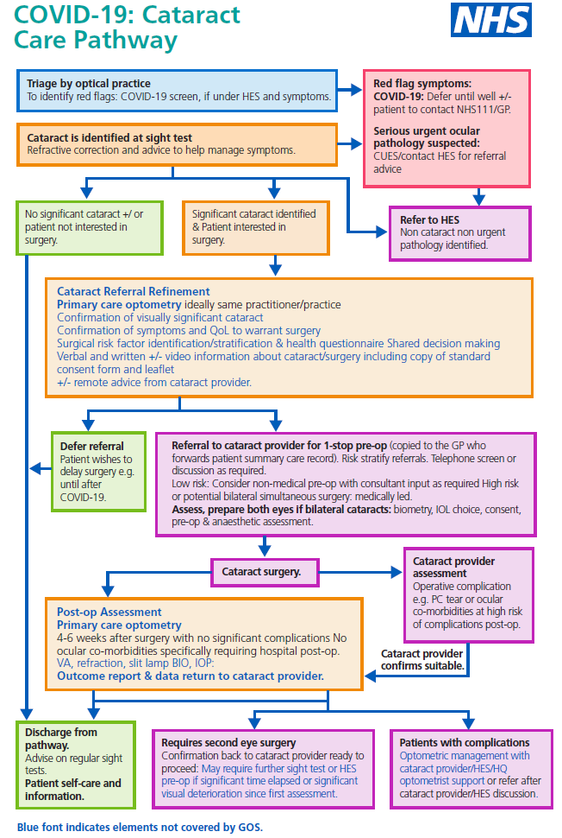
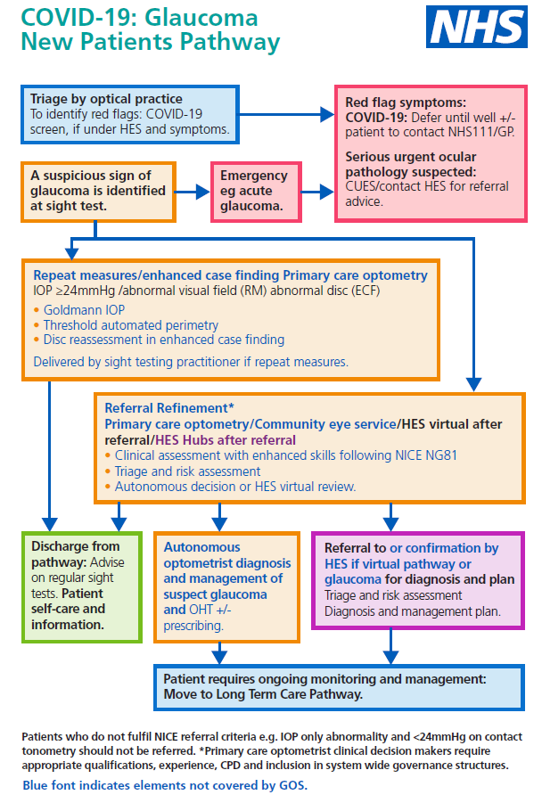
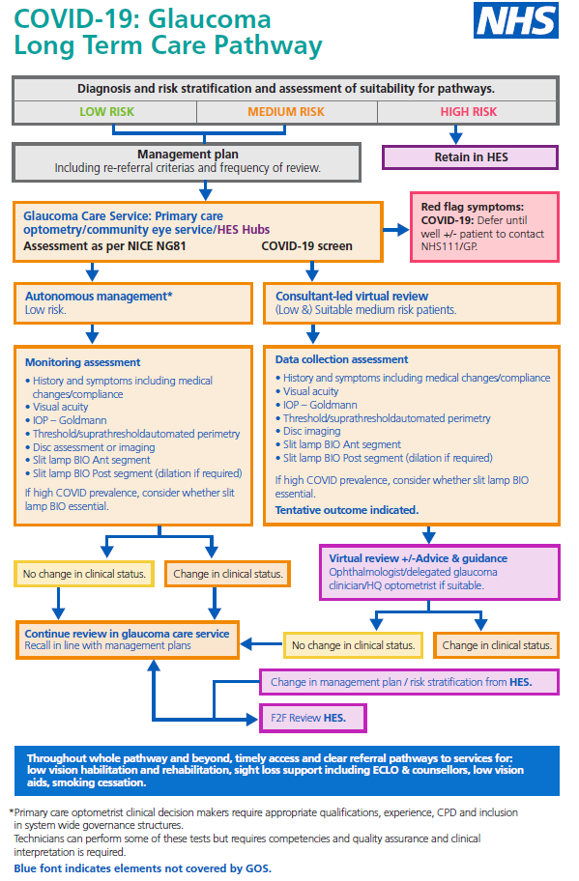
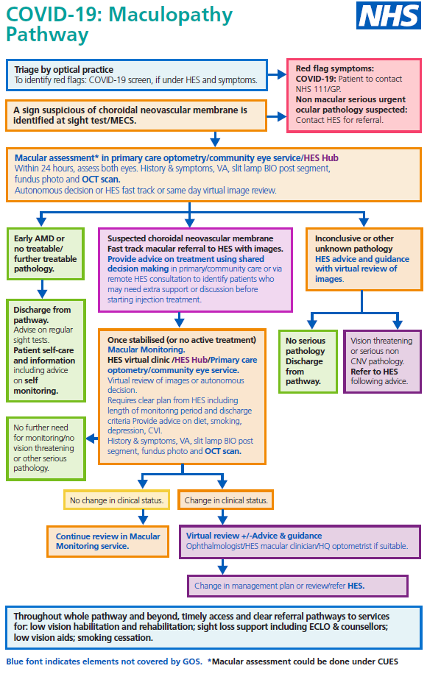
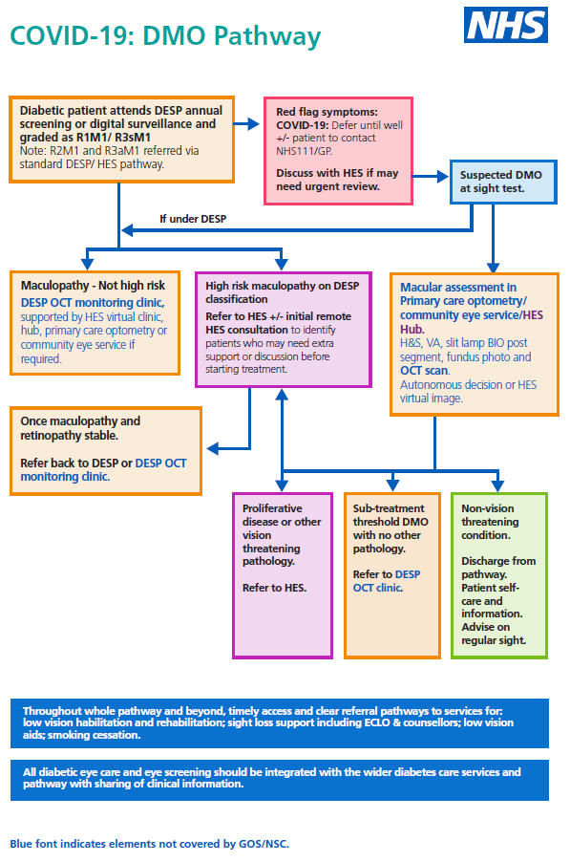
NOTP five pathways: clinical consensus..
Clinical pathways developed after CoOptom & RCOphth consensus = CUES + 5 key areas already published

Slide 10
NOTP - 2
Digital Transformation plan underpins the importance of technology in the future NHS; setting out the critical priorities that will support transformation and provide a step change in the way the NHS cares for patients
As of 1 July 2019, NHSX formed, which brings teams from the Department of Health and Social Care AND NHS England & Improvement together into one unit. Responsible for driving digital transformation and leading policy, implementation and change in this area.
Eyecare electronic Referral System EeRS - Patients will be referred in an efficient and comprehensive way to the correct speciality with full supporting clinical findings, reducing waiting times, repeat visits and lost information
Benefitting Optical practices, Ophthalmology, Commissioners and PATIENTS!
Move to integrate virtual consultation using Telemed/ Video-consultation.

Slide 11
Known challenges to local transformation

Slide 12
Staffordshire challenges…
Staffordshire
Population 874,190, Size 1047 sq miles.
1 ICS (‘Together we are better Staffordshire & Stoke-on-Trent’)
3 ICPs (one for each locality)
26 PCNs
3 NHS Acute trust Hospitals
110 Optical practices
1 LOC!

Slide 13
Local Eye Health Network (LEHN) to connect clinical leaders across Staffordshire
Joining the dots and making connections

Slide 14
New Local Eye Health Network (LEHN)
ICS/ICPs need Clinical guidance before any service is commissioned. NHS long term plan & NOTP clearly want primary care Optometry to play big role in delivery of integrated patient eye care
GIRFT - hospital centric. PCNs - GP biased at moment and not yet mature. Ophthalmology Clinical improvement / Eye service review groups either CCG or hospital biased. Platform needed to ensure our views on eyecare are consulted at the earliest stage.
Cue -New LEHN proposal. Pan-Staffs group to include representation from LOC, Ophthalmology, ICS/ICP, NHSE Transformation lead, NHS OA and LEHN chair (facilitate). This will then feed into ICS/ICP. The group will deal with all matters of eyecare provision in Staffs, not just Restoration & Transformation.
Ensuring we take the will of the profession to the central discussion*

Slide 15
LOC Transformation – new committee structure
Structure revamped last year to role based membership to ensure better engagement with profession but also better representation at the highest level of NHS discussions, eye care strategy and service development in Staffordshire.
In addition to the core roles of Chair, Vice-Chair, Secretary & Treasurer,
Community Services Officers
Training Leads
CET Officers
Dispensing Optics Leads

Slide 16
LOC Position (at the moment*)
We do see this as a fantastic opportunity for Optical profession to further their stake in primary eye care provision
Opportunity to future proof the Optical practice business model
We are professional clinicians with the ability to deal with Co-morbidities without further unnecessary referral
Ability to diagnose/ manage/ treat (in particular cases)
Primary care is already in the community, easily accessible, qualified workforce
While we recognise the importance of “upskilling”, we will be strongly driving the message of existing CORE COMPETENCY
HOWEVER, the pathways must have some way of fitting into our practices and crucially the tariff must reflect the professional eye care we would be delivering..

Slide 17
Why is this important for me 1?
NHSE have laid out their vision for the Future of NHS Eye care and community Optical practice is at the fore-front of this
College of Optometrists & RCOphth joined up clinical steer for proposed pathways with a collaborative Ophthalmology-Optometry approach
NHSE proposals at White Paper stage and just matter of time before legislation
Clear documented preference for NHS community Optometry and NHS Acute trusts to combine forces to provide a sustainable eye care service for local population
OPPORTUNITY FOR OUR PROFESSION – whether you are a contractor or performer, you need to pay attention here..

Slide 18
Why is this important for me 2?
Where is the profession going? No crystal ball but analysing trends suggests that while the core Optical services will always be needed in some shape or form, the biggest demand and therefore funding being made available is for patient eye care.
Is this something you as practitioner and/or practice can accommodate? Do you want to?
If not, why not?
If you do, what transformation is required to make this possible from clinical skills perspective? What transformation is required from practice business perspective?
How can the LOC support Transformation for the profession?*
Cue – Richard, Sophia, Alison & Ian.. with some of the answers!

Slide 19
Managed Clinical Networks
Seen as the vehicle for delivering the changes demanded by NOTP and restoration.
OPTOMETRY LED for the first time in shared care history.
Championed by Claire Roberts and being piloted in Shropshire and Staffordshire.
Shropshire initially with Medical Retina and Staffs with Glaucoma.
Richard Webb, LOC Training Lead/ MCN Co-ordinator

Slide 20
Background to Workforce Development
Staffs LOC received a workforce development grant from NHSE&I to help facilitate the further education through CoO higher qualifications in the key areas outlined by NOTP.
The Ophthalmology Common Clinical Competency Framework (OCCCF) was initially launched in collaboration between CoO, RCO, RCN and BIOS. The aim is to outline shared competencies in AMD, Cataract, Glaucoma and Emergency Eyecare that can be aligned to the different health care professionals working with Ophthalmology.
The initial hope from CoO was that the higher qualifications would align directly with the OCCCF Levels but unfortunately the curriculum was developed in a complex way that makes this comparison difficult - work is ongoing to try to develop this.
Higher qualifications demonstrate up to date knowledge and skills specific to the additional ways that community optometrists can help alleviate the pressures outside of work on GOS.

Slide 21
Managed Clinical Networks
MCN’s are a concept widely used in Dentistry to bring together colleagues working in the community and the acute trust.
There are currently minimal opportunities to engage with consultants.
The aim is to develop relationships and share clinical learning to benefit working across both settings and to allow for a more collaborative approach to problem solving when issues around services arise.
In Shropshire pilots have been developed in Glaucoma and AMD.
Staffordshire also has funding for a pilot MCN.
Due to the unique complexities of the Staffordshire region, the decision was made to focus on Glaucoma initially and to try to encourage engagement from all 3 of the acute trusts.

Slide 22
Proposed MODEL
3 Ophthalmology leads with special interest in Glaucoma
1 Optometry Lead
Arranging and facilitating meetings
Reporting back to LOC / LEHN
1 Clinical Audit Lead
21 Optoms
Who have or are working towards higher qualifications (good baseline knowledge or relevant anatomy, epidemiology, diagnostics, guidelines and land mark studies)
Representing all regions across the county
4 remote evening meetings per year
Clinical placement / audit sessions in acute trust
Funded at £150 / half day session
Covid-19 permitting

Slide 23
Benefits
Improving the relationships between primary care and the hospital setting, problem solving and improving current clinical decision making related to referral, discharge and co-management.
Developing a number of glaucoma champions in the community who are ready and prepared with evidence of the skills required to deliver new pathways as they are developed though recovery and restoration programmes NOTP and GIRFT.
Champions have the opportunity to apply and develop their skills in practical clinical scenarios.
Glaucoma champions can share learning with the wider Optometry profession and provide support for other Optoms interested in higher glaucoma qualifications.
To enable a pan-Staffordshire forum bringing together permanent stakeholders including representatives from the 3 acute trusts along with community optometry.

Slide 24
Action Plan
Meeting 8th July to engage with representatives from Ophthalmology, to get approval of and input to the delivery model of the MCN.
Phase 2 invitation for workforce development / higher qualification grants.
Expressions of interest for MCN members / leads, open to all working in Staffordshire.
Launch meeting in September 2021 via Zoom/Teams.

Slide 25
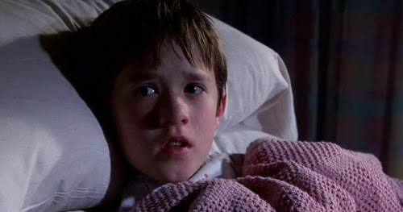
Training – a Personal view
I enrolled on The Professional Certificate Glaucoma with Bradford University in June 2020.
I applied for the LOC training grant as soon as I heard about it – initially based on my general interest in glaucoma, something we come across regularly in practice.
Since applying for the grant, I started a job 1 day a week at Royal Stoke and my interests took me to joining the Glaucoma Clinic there.
DODGY DISCS AND NARROW ANTERIOR ANGLES…….I SEE THEM ALL THE TIME………..
Sophia Burton, LOC CET Lead
This Photo by Unknown Author is licensed under CC BY-SA

Slide 26
Training – a Personal view
The course at Bradford is a distance learning course
Duration 3 months
Intakes are January/June/September
Other providers are-
Manchester University and Cardiff

Slide 27
Training – a Personal view
The course is designed to consolidate what you already know, remind you of some theory behind it, introduce you to new techniques and expand your existing knowledge.
The lectures can be done in your own time – lockdown helped for me!
Most of the lectures are easy to digest, a couple are heavy on landmark studies and epidemiology. There is one voice that is soporific but coffee helped…..
Practical workshops should have been held for Disc assessment, Goldmann Tonometry, Pachymetry and Van Hericks with intro to gonioscopy but was cancelled due to COVID.
Instead we had a relaxed practical session prior to assessment on the same day.

Slide 28
Training – a Personal view
Assessment was straight forward, staff at Bradford were eager to help and put everyone at ease.
MCQs and a practical assessment.
They want you to pass!
I hadn’t done pachymetry before but this skill was straight forward and passed on the same day with a bit of practice in my case.
Now I have a Professional Certificate in Glaucoma – ready for any future pathways that require it, if I’m interested in diversifying my daily routine.
The Glaucoma Clinic at Royal Stoke is happy I have this qualification and I’m pleased I have something that gives me options in the future and something to build on if I want to specialise further.

Slide 29
Training – a Personal view
Independent Prescribing.
A lot more work compared to The Prof Cert. I was glad I got my study head on for this but now I’m in that mindset, I can see the finish.
Personal interest tempted me to do this course and I saw the benefit of having an extra skill to offer in daily practice and at the hospital. I wanted to keep up with future changes in optometry and give myself options.
Aston University is an online course entirely, in hindsight maybe I would have enjoyed a course with more interaction. I chose this delivery to tie in with family-life though so it works for me.
Hot tip – even before you start the course, make a note of interesting patient episodes where independent prescribing might have been useful. If you can, take photos/scans to illustrate.
GET GEEKY!
This Photo by Unknown Author is licensed under CC BY-SA-NC

Slide 30
Professional Certificate in Glaucoma – Course Feedback
“The online course was easy to complete as it was online lectures that you can do in your own time. I can't comment on the practical day that should have been held, but was not due to COVID. Instead the assessment day was combined with some relaxed practice of techniques - Goldman Tonometry, Pachymetry, Disc assessment and Van Hericks. I found the course consolidated existing knowledge and techniques and gave chance to take that up a step so I also found it interesting”
“Doing the Prof Cert has opened the doors for me to do the Higher qualification, if I decide to further my learning even more/become involved in any future community monitoring”
Alison Lowell, LOC Secretary

Slide 31
Professional Certificate In Glaucoma – Course Feedback
“It has given me a broader understanding of Glaucoma and led me to successfully refer a few patients. I am now looking more deeply for Glaucoma with each patient”
“It has definitely helped me improve my understanding of the disease and my ability to communicate with a higher degree of confidence to the glaucoma consultants about the management of their patients”
“I referred one patient with non obvious glaucomatous changes. The patient returned to me happily saying that the ophthalmologist said this was a 1 in a million chance of being picked up.”

Slide 32
NHS England training grant
INITIAL FUNDING £30,000.00
In 2019-20 this money was used solely for the purpose of encouraging and enabling Optoms to gain the Professional Certificate in Glaucoma.
The money had been secured with a business model for this qualification and also for vitreo-retinal training, which we were unable to implement due to Lockdown
However, as the NOTP gathered impetus we identified the need for a greater, more independent and confident role for the Optometrist
We approached NHSE again with a new model for encouraging our profession to become Independent Prescribers to reduce referral into Secondary Care, they shared our view and were happy to support the initiative
EXPENDITURE
INITIAL GRANT 6 x £250.00 £ 1,500.00
COMPLETION GRANT 1 x £550.00 £ 550.00
TOTAL EXPENDITURE £2,050.00
BALANCE C/F £27,950.00
Ian Meadows, LOC Treasurer

Slide 33
One difficult and uncertain year later….
Already paid to Practitioners
INITIAL Glaucoma Grant 15 x £250.00 £ 3,750.00
COMPLETION GRANT 2 x £550.00 £ 1,100.00
IP Initial Grant 6 x £600.00 £ 3,600.00
Already allocated for completion of courses £ 7,150.00
So 50% of the initial funding has been spent….

Slide 34
How the Money is shared out….
Initially the LOC needed to ensure we had countywide coverage of practitioners with this enhanced qualification to illustrate to NHS that this funded training would help all Staffordshire Patients and this was achieved quite quickly with a first cohort of employed contractors/performers working exclusively in the county
But NHS and LEHN were encouraging us to drive this forward
To that end the LOC decided to open up the funding by allowing applications from more than one practitioner in a single practice ( thus ensuring holiday cover, etc )
We also decided to accept applications from Locums and part-time practitioners with a few small tweaks to the funding…
no financial reward to applicants, ie. Only covering total course costs
pro-rata’d funding depending on number of days worked in Staffordshire
we also take into account any funding available from other sources, ie Hospitals

Slide 35
Your Chance to Grab a Training Grant
Money was made available to the LEHN/LOC to launch and manage the MCNs in the first year
We already have a commitment from NHS/E to provide us with a similar amount this year and believe they have committed to ongoing funding for future years to allow this to grow
It has also been inferred that if the LOC can show a genuine desire for the profession to get involved with the MCNs and enhance their individual skill set, more training money and administrative funding will be made available
So while this isn’t a bottomless pit of money and we are dealing with it on a first come, first served basis,
why wouldn’t you want to upskill yourself ready for the future and take advantage of funding before it’s gone

Slide 36
Thank you!
Thank you to Alison Lowell & Ian Meadows for structuring this presentation! Thank you to Richard for all his efforts with regards to MCN set up. Thank you Sophia for sharing your in valuable insight into HQ. Thank you Ian for steering the LOC finances, through all these developments.
THANK YOU ALL FOR LISTENING!
PLEASE DO SAVE QUESTIONS TILL THE END, where we intend to have an interactive Q & A session. Thank you!

