Slide 1
SOUTH STAFFORDSHIRE MECS
Mark McCracken (Clinical Governance & Performance Lead, MECS)
Primary Eyecare (Shropshire & Staffordshire) Ltd [SASPEC]

Slide 2
Peats (Jul 2015 – Apr 2017)
PEATS = Primary Eyecare Assessment & Treatment Service
18 month pilot
Triaging of acute and non-acute referrals, e.g. GPs can choose to send referrals from non MECS-accredited optometrists into the service for refinement.
Treatment of minor eye conditions
Minor eye procedures

Slide 3
PEATS
18 optical practices within or bordering the two CCG areas served as subcontractors to SASPEC
“PEATS Referral Form for GPs” document uploaded to Map of Medicine. Inclusion/exclusion criteria
The PEATS service to triage the referral within 48 hours
Patient to be seen by the PEATS service within 2 weeks
Urgent referrals to be seen within 24 hours

Slide 4
Peats reception triage form

Slide 5
PEATS RECEPTION TRIAGE FORM

Slide 6
Peats reception triage form

Slide 7
PEATS
An evaluation of Stafford and Cannock PEATS by SAS and CC CCGs (August 2016) has found:
74% of PEATS patients can be managed solely by community optometrists
6% of PEATS patients can be managed by community optometrists working with GPs
Only 20% need referral to the HES
100% of patients were very satisfied with the service

Slide 8
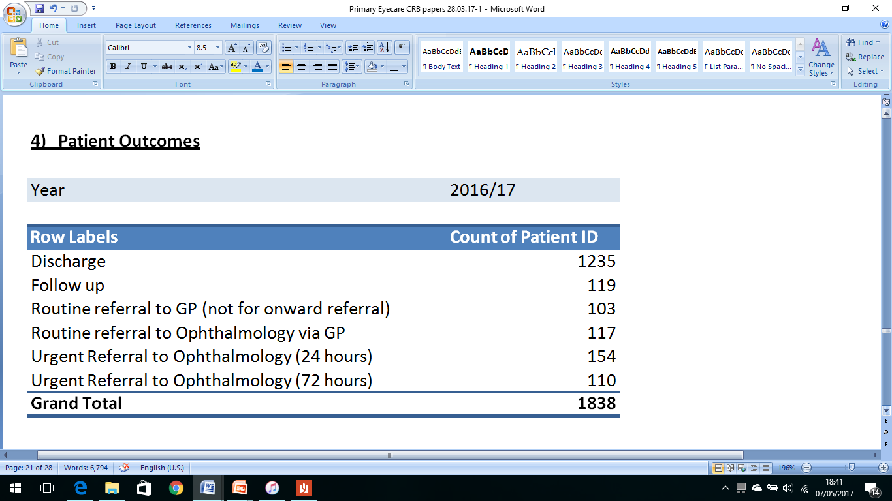

Slide 9
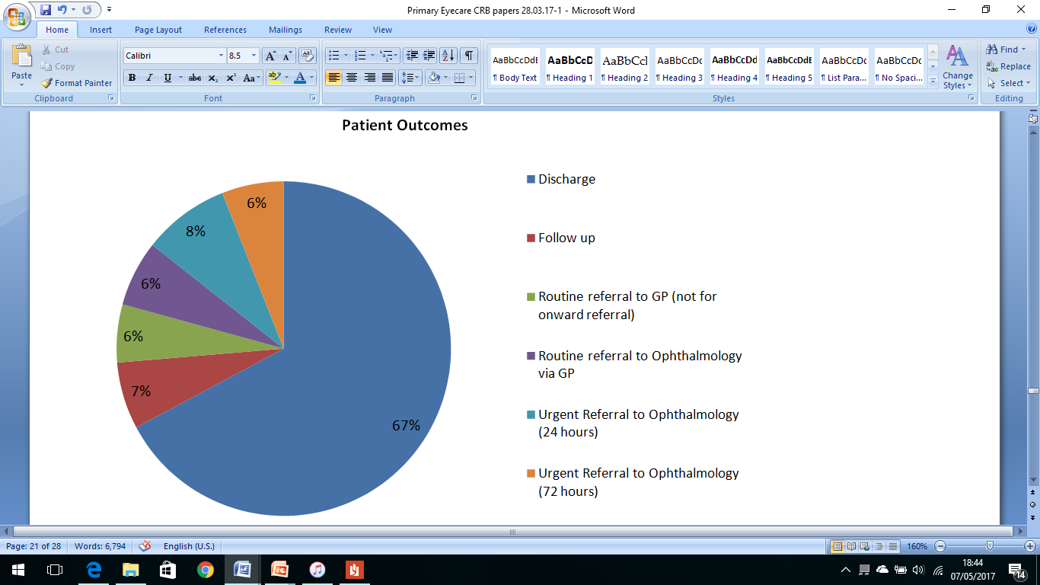

Slide 10
FOR PEATS’ SAKE!!!! Why mecs????
Known nationally as MECS.
The guidelines from ophthalmology commissioning mention MECS, and increasingly GPs understand what is meant by MECS.
The accreditation is the LOCSU MECS certificate from WOPEC.
Using the name MECS will also help to reduce cross-border issues.

Slide 11
Welcome to SE Staffs and seisdon peninsula practices!!

Slide 12
MECS – purpose
The prime purpose of MECS is to reduce onwards referrals to secondary care.
Where referral to secondary care is required, it will be to a suitable specialist.
Experience in other similar services, is that 75-80% of patients are managed in the practice, and only 20-25% are referred to secondary care.
You should use this as your benchmark !
The IT system will be monitoring this, both by practice and by practitioner.

Slide 13
MECS – Optomanager module
All provision of service must be recorded on the IT system (Webstar Health OptoManager MECS module).
This system will allow Primary Eyecare (Shropshire & Staffordshire) Ltd to track patients all the way through the pathway and provide the data required by the company’s Clinical Governance and Performance Lead (CGPL) to manage the performance of the service according to the Local Quality Requirements.
All contacts regarding MECS should be recorded, even if they don’t result in an appointment. This is for your own protection, so that there is a record.

Slide 14
MECS - Conditions
Distorted vision
Mild–to-moderate ocular pain
Systemic disease affecting the eye
Differential diagnosis of the red eye
Foreign body and emergency contact lens removal (not by the fitting practitioner)
Dry eye
Epiphora/watery eyes
Trichiasis/ingrowing eyelashes
Differential diagnosis of lumps and bumps in the vicinity of the eye
Flashes/floaters
Retinal lesions
Field defects (patient reported)
GP referrals (including IOP 22-30mmHg/suspected raised IOP)

Slide 15
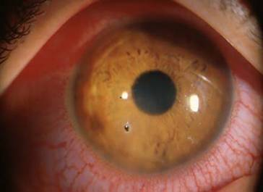

Slide 16
Mecs urgent / mecs routine
A “MECS Referral Form for GPs” document has been uploaded to the Map of Medicine. This lists the inclusion/exclusion criteria for the service to GPs and to their staff.
All participating MECS practices must triage the referral within 48 hours. As a minimum, the patient will be seen by the MECS service within 2 weeks (MECS ROUTINE). However, urgent referrals shall be seen within 24 hours (MECS URGENT)
The GP may specify that you see the patient either as MECS URGENT or as MECS ROUTINE, depending on the perceived urgency.

Slide 17
MECS URGENT MECS ROUTINE
(To be seen within 24 hours)
Moderate ocular pain / discomfort
Recent onset transient vision loss / blurred vision <= 48 hours
Red eyes: which cannot be managed by GP
Corneal FB’s or abrasions
Recent onset flashes and Floaters
To be seen within 2 weeks)
Mild ocular pain / discomfort
Recent onset transient vision loss / blurred vision > 48 hours
Watery eyes
Dry eyes
Eyelid lumps and bumps
Ingrowing eyelashes

Slide 18
Referrals into mecs
Referrals from GPs/GP surgeries may be:
Phoned through to MECS practices
The patient given a handwritten note of referral and told to self-present to the optical practice reception.
Referrals may also be faxed to MECS practices
In addition, a minority of MECS practices have their own NHS Mail accounts.
MECS central hub...

Slide 19
THIS PEATS HUB IS NO MORE!! ...Nah, nah, it’s resting!!

Slide 20
PEATS CENTRAL HUB
From 1 April 2017, the PEATS central hub ceased to exist. However, SASPEC is now providing an NHS.net address as a route into MECS for electronic referrals from GPs.
A triage clinician will pick up the referral and gauge the urgency, before instructing admin to fax it to one of the participating practices.
The practice would then be responsible for fitting the MECS referral into its clinics with the appropriate urgency, or finding an alternative provider if it does not have the capacity.

Slide 21
PEATS HUB - FAILSAFES
1) Practices would be required to confirm with Alison that they have fitted the MECS referral into its clinics with the appropriate urgency, or else find an alternative provider.
2) Alison will keep a log of electronic referrals, and chase up practices if she doesn’t hear back from them.
3) If patient can’t be contacted by the MECS practice, or DNA’s twice, then the referring GP must be informed.
In addition, MECS referrals will continue to be sent directly to your practice via GPs, pharmacists, and occasionally from non-accredited opticians, plus self-referrals from patients.

Slide 22
Mecs - exclusions
Sudden, persistent loss of vision < 48 hours – urgent to ARC or Queens (< 24 hours)
Sudden, persistent loss of vision > 48 hours – urgent to ARC or Queens (< 72 hours)
Sudden onset diplopia – urgent to ARC or Queens (< 72 hours)
Injuries: chemical, penetrating or post-operative infection – urgent to ARC or Queens (< 24 hours)
Severe ocular pain requiring immediate attention – urgent to ARC or Queens (< 24 hours)
Suspected retinal detachment - urgent to ARC (< 24 hours)
Suspected vascular abnormality - urgent referral to secondary care to rule out cardiovascular cause if acute onset

Slide 23
MECS - Exclusions
Severe eye conditions which need hospital attention, e.g. Temporal arteritis / Anterior Ischaemic Optic Neuropathy, Orbital Cellulitis
Eye problems relating to Herpes zoster
Suspected cancers of the eye
Patients more suitable for South Staffs DAC pathway
Patients more suitable for GRR pathway
Patients more suitable for Staffordshire DESP

Slide 24
LOCAL QUALITY REQUIREMENTS (a.k.a. KPI’s)
“OMG!! You’ve breached a KPI threshold!!”

Slide 25
PEATS – LOCAL QUALITY REQUIREMENTS (lqr’S)
Under Schedule 4C of the contract, the Primary Eyecare Assessment and Treatment Service was measured against the following KPIs:
95% of Service Users are triaged by the service within 48 hours of referral. (Measured monthly)
95% of Service Users are seen by the service for an initial appointment within 4 weeks of referral. (Measured monthly)
95% of Service Users report positive experience of the service (responses to be either ‘extremely likely’ or ‘likely’). (Measured annually).
100% of Optometrists achieve PEARS accreditation from the WOPEC. (Measured monthly)
<40% of Service Users which are referred onto secondary care. (Measured monthly)
1:0.13 first to follow-up ratio (i.e. 13%). (Measured monthly).

Slide 26
Ref. | Local Quality Requirement | Threshold | Jul-15 | Aug-15 | Sep-15 | Oct-15 | Nov-15 | Dec-15 | Jan-16 | Feb-16 | Mar-16 | Apr-16 | May-16 | Jun-16
PEATS_LQR_1 | Service Users are Triaged within 48 hours of referral | 95% | 100% | 90% | 53% | 57% | 85% | 84% | 86% | 89% | 87% | 91% | 91% | 90%
PEATS_LQR_2 | Service Users are seen by the service for an initial appointment within 4 weeks of referral | 95% | 100% | 100% | 100% | 100% | 100% | 100% | 100% | 100% | 100% | 100% | 100% | 100%
PEATS_LQR_3 | Service Users report positive experience of the service (annual) | 100% | 100% | 100% | 100% | 100% | 100% | 100% | 100% | 100% | 100% | 100% | 100% | 100%
PEATS_LQR_4 | Optometrists achieve PEARS accreditation from the WOPEC (annual) | 100% | 100%
PEATS_LQR_5 | Service Users are referred onto secondary care | <40% | 8% | 17% | 30% | 28% | 25% | 18% | 13% | 23% | 21% | 19% | 22% | 27%
PEATS_LQR_6 | First to follow-up ratio | 1:0.13 (13%) | 15% | 9% | 6% | 1% | 5% | 6% | 6% | 7% | 4% | 3% | 5% | 6%

Slide 27
Schedule 4C (Local Quality Requirements)
Ref. | Local Quality Requirement | Threshold | Apr-16 | May-16 | Jun-16 | Jul-16 | Aug-16 | Sep-16 | Oct-16 | Nov-16 | Dec-16 | Jan-17 | Feb-17 | Mar-17
PEATS_LQR_1 | Service Users are Triaged within 48 hours of referral | 95% | 91% | 91% | 90% | 96% | 89% | 91% | 90% | 96% | 98% | 97% | 98%
PEATS_LQR_2 | Service Users are seen by the service for an initial appointment within 4 weeks of referral | 95% | 100% | 100% | 100% | 100% | 100% | 100% | 100% | 100% | 100% | 100% | 100%
PEATS_LQR_3 | Service Users report positive experience of the service (annual) | 100% | 100% | 100% | 100% | 100% | 100% | 100% | 100% | 100% | 100% | 100% | 100%
PEATS_LQR_4 | Optometrists achieve PEARS accreditation from the WOPEC (annual) | 100% | 100%
PEATS_LQR_5 | Service Users are referred onto secondary care | <40% | 19% | 22% | 27% | 23% | 22% | 23% | 19% | 20% | 16% | 16% | 21%
PEATS_LQR_6 | First to follow-up ratio | 1:0.13 (13%) | 3% | 5% | 6% | 6% | 7% | 7% | 7% | 7% | 11% | 7% | 6%

Slide 28
LESSONS LEARNED...
We use reception triage form for all MECS self-referrals: gauge urgency, deflect inappropriates
Ensure that patient details are entered on to MECS module, immediately following completion of reception triage form (so that the service meets LQR-1)
Once consultation finished, every patient given a E&D and PROMS form

Slide 29
PEATS – Commissioners’ view
They found it challenging to present PEATS to the CCG governing body as a cost-effective means of patient care...
The financial summary of first ophth outpatients and A&E ophth attendances showed a bigger reduction in cost in SE Staffs & SP (no PEATS!) between 15/16 and 16/17, compared to SAS and CC (PEATS).
Once PEATS was added to the financial outlay, the CCGs' spend in SAS and CC during 16/17 actually exceeded their spend in 15/16.

Slide 30
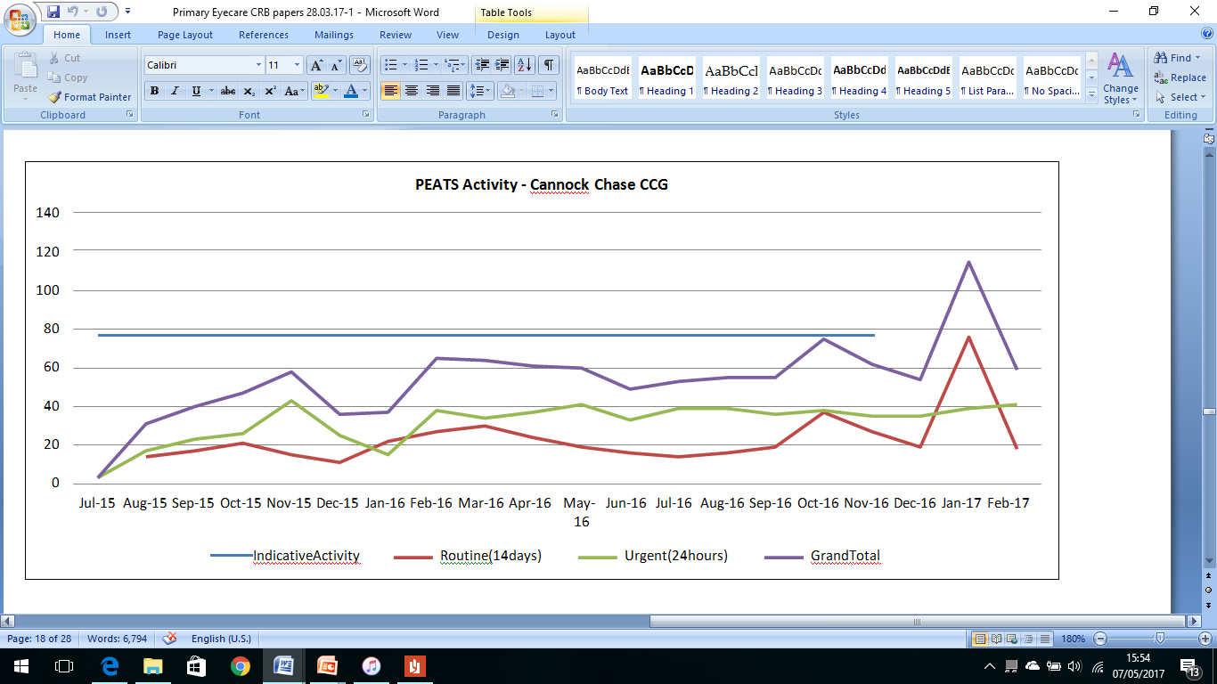

Slide 31
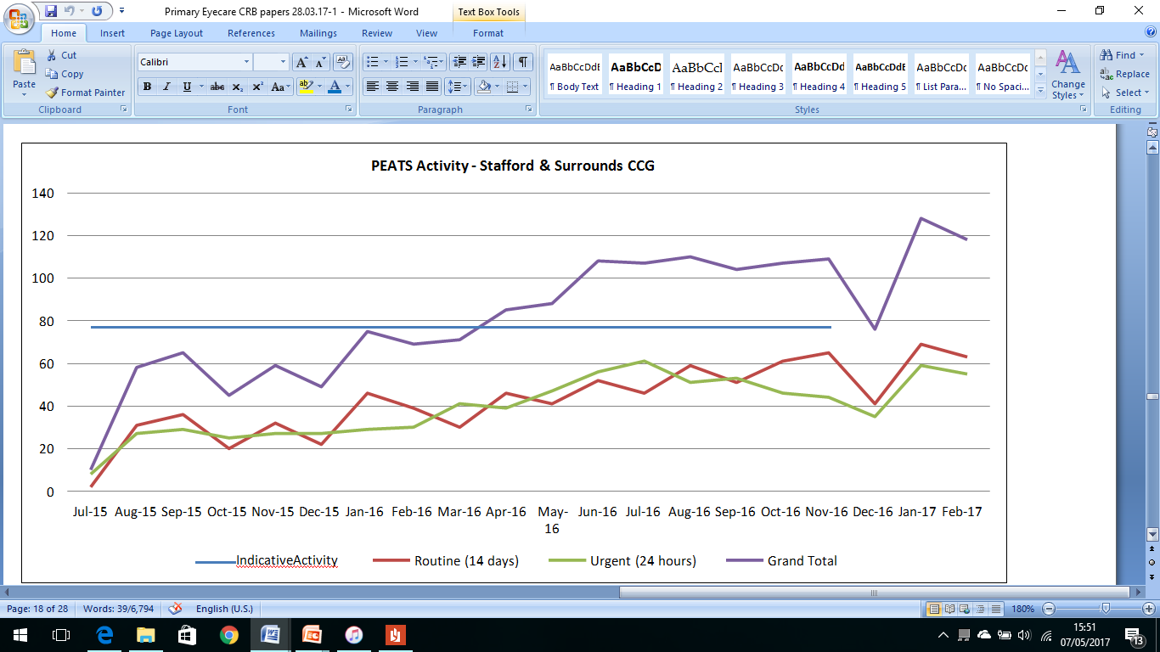

Slide 32
PEATS – COMMISSIONERS’ VIEW
In light of their £40million problem, commissioners weren’t sure if they were in a position to continue paying for additional services that are not reducing their spend elsewhere
The feeling from the GPs is that they were not seeing any less, patients were still coming to them for a referral to PEATS
The biggest concern from the GPs was the worry of self-generating activity.

Slide 33
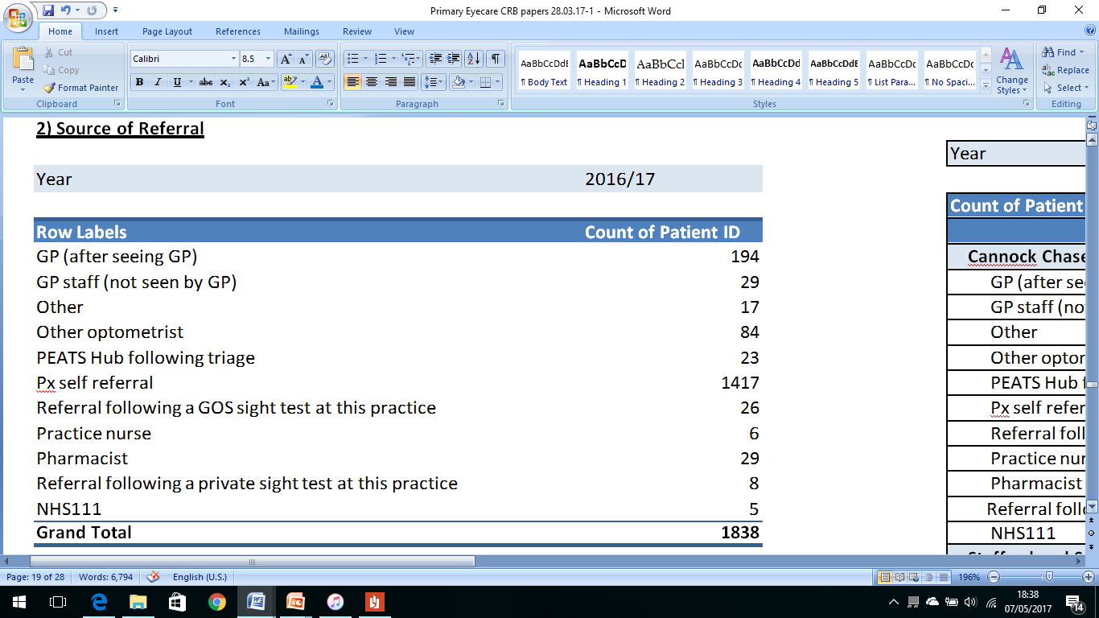

Slide 34
Peats – referral source

Slide 35
PEATS – COMMISSIONERS’ VIEW
BUT...
PEATS performed well against its LQRs
The membership boards supported the service continuing
Patient satisfaction is high (100%)
It’s safe (no SUI’s)
Commissioners want optometrists to be part of eyecare services redesign

Slide 36
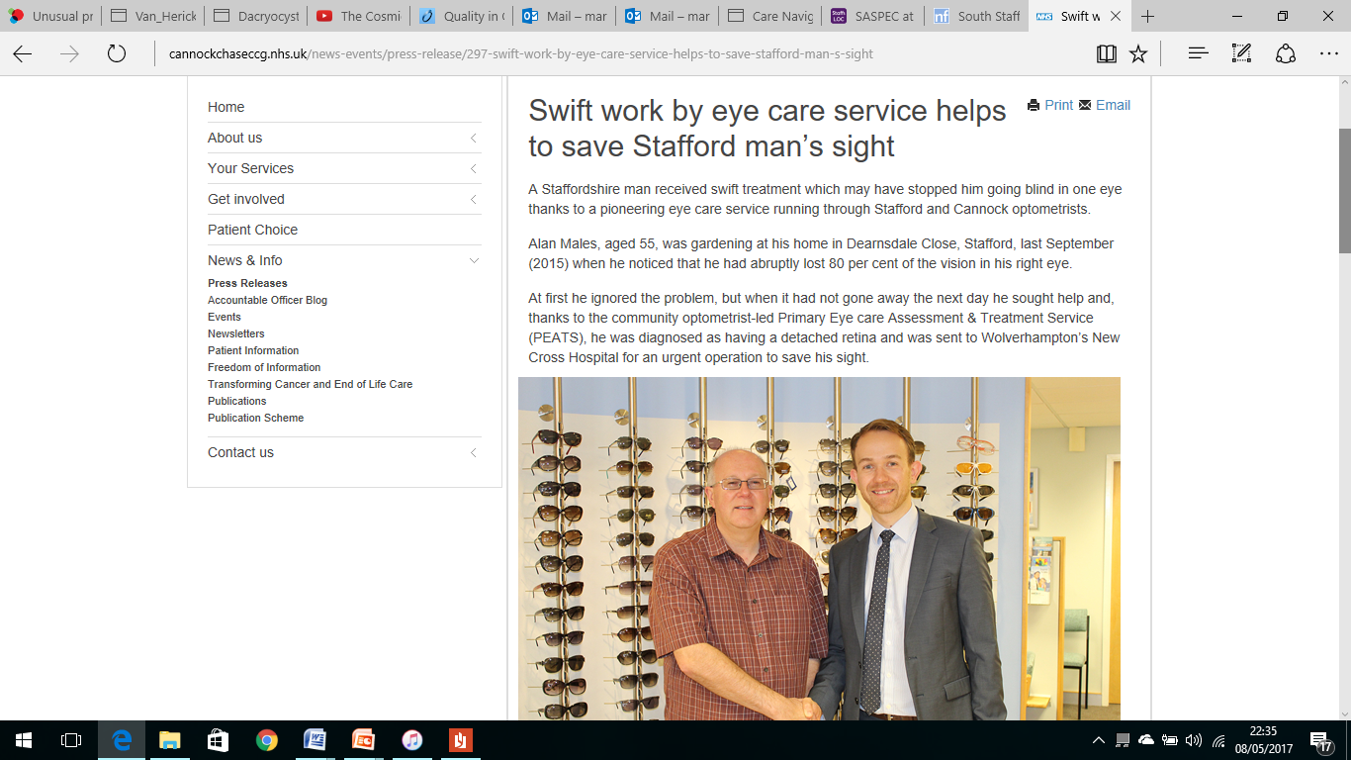

Slide 37
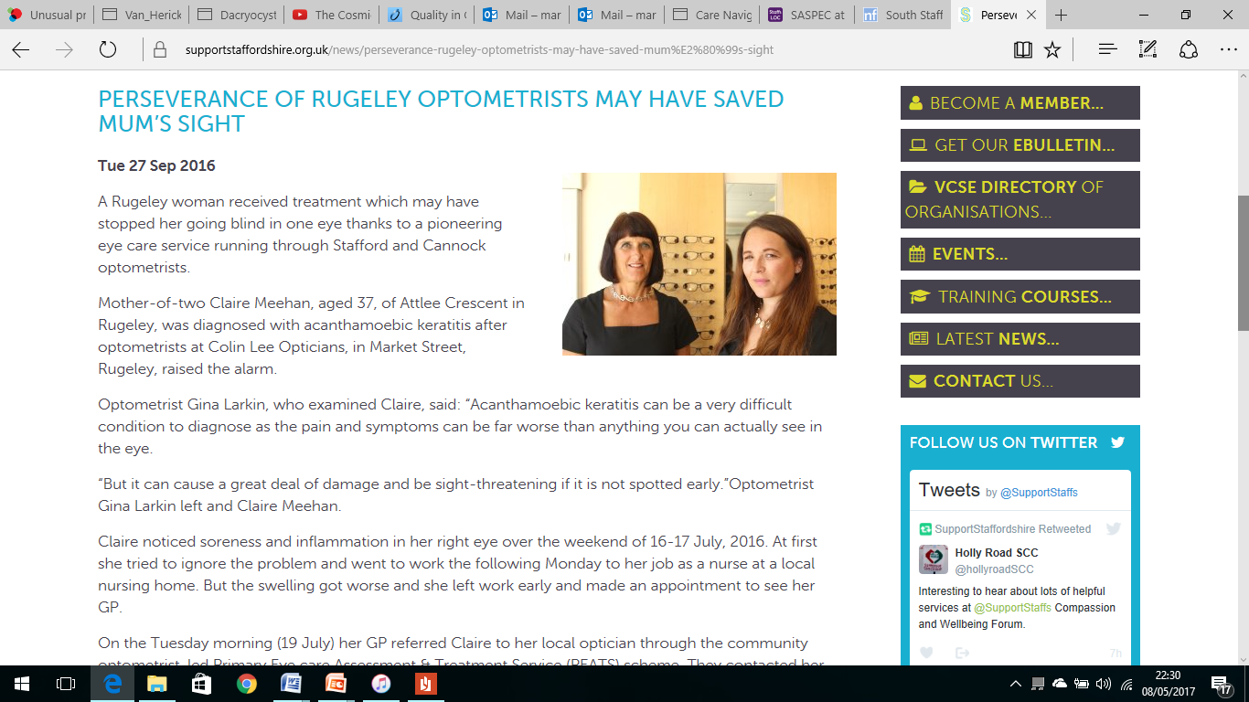

Slide 38
THE CASE FOR MECS - SASPEC
With increasing pressure on GPs and the drive for care navigation in GP practices, MECS schemes are proving increasingly invaluable
GPs should be encouraged to send all referrals from non-accredited optometrists (bar red flag conditions) into MECS
The implementation of a locally agreed formulary (and involving a locally funded agreement for pharmacy supply) will significantly reduce onward referral to GP surgeries for prescriptions, thus engendering goodwill and improving links with both GP and pharmacy.
Working to enable the direct referral into secondary care from MECS of both routines and urgents
Lambeth and Lewisham MECS (BMJ, 2016)

Slide 39
Peats: self-referrals
Given that typically 75% of referrals into PEATS are self-referrals, SASPEC understands the commissioners’ concern that this referral option is at risk of being over-used - particularly in relation to minor external eye disorders
We know that this is a cohort of patients who rarely requires referral into the acute trust.
With LOCSU’s help, SASPEC has developed two documents, “The Use of MECS and Sight Tests” and “Referrals from non MECS-accredited opticians into MECS”

Slide 40
THE USE OF MECS AND SIGHT TESTS
A MECS examination is not an adjunct to a sight test, it is an alternative for those cases where the symptoms do not seem to be obvious sight test material.
You choose and either perform a sight test and deal with what you find, or perform or refer for, a MECS.
It should be extremely rare (if ever) for a sight test to lead to a MECS examination.
Where minor conditions (e.g. Dry eye, Blepharitis) are identified during a sight test, all practitioners should continue to advise the patient in relation to these conditions during the course of the sight test.

Slide 41
Referrals from non-mecs accredited opticians into mecs
There are limited circumstances in which a non MECS-accredited registered optician may refer a patient to a MECS-accredited registered optician...
1) a patient presenting with recent onset flashes and floaters
2) a patient with mild-to-moderate ocular pain
3) a patient requiring differential diagnosis of the red eye
It is important that the non MECS-accredited practitioner understands that their duty of care to the patient under GOS is unaffected
The non MECS-accredited registered optician should not refer every single minor eye condition to the MECS-accredited registered optician

Slide 42
DON’T REFER INTO MECS IF...
Flashes & floaters < 1 month since first full MECS consultation
In-growing eyelashes < 4 months since first full MECS consultation
Repeat dry eye / blepharitis < 4 months since first full MECS consultation
Transient vision loss < 4 months since first full MECS consultation
Where symptoms suggest that a sight test is more appropriate
Adult squints, longstanding diplopia
Removal of suture
Repeat field tests following a sight test
AMD (unless recent-onset disciform lesion is suspected)

Slide 43
mecS – REFERRAL SOURCES (AMENDED)
GP
Self-Referral – Signposted from GP Receptionist
Self-Referral – Signposted from pharmacist
Self-Referral – From advertisement of service
Self-Referral – Other
Optician following routine eye test
Optician – not part of the MECS scheme

Slide 44
CARE NAVIGATION
GP often first port of call for patients
Can prove challenging, and often unnecessary
“Care Navigators” – GP receptionists with specialist training, helping px to get to the right service first time
Transforming access to primary care services, better active signposting for px
Significantly saves GP time, significantly improves patient care

Slide 45
ENHANCED PHARMACY SERVICE
We looked at pharmacy solutions elsewhere in England.
The consensus was that an Enhanced Pharmacy Service (pharmacist supplies prescribed preparation to a written order from a MECS optometrist), linked to the Common Ailments Service (CAS), would be a more workable and safer option than a Patient Group Directive (PGD).
South Staffs LPC is of the opinion that an Enhanced Pharmacy Service can be set up for MECS, in conjunction with Pharma Outcomes.
There are a couple of POM's on the list that the LPC will need to seek national guidance on.

Slide 46
MECS FORMULARY
Gt. Chloramphenicol 0.5% 10ml P for bacterial conjunctivitis, otherwise POM
Oc. Chloramphenicol 1.0% 4g P for bacterial conjunctivitis, otherwise POM
Fucithalmic 1% 5g POM
Sodium Cromoglicate 2% 10ml P as Opticrom for hayfever only, otherwise POM
Otrivine-Antistin 10ml P
Hypromellose 0.3% 10ml P/GSL/CE
Carbomer 980 0.2% 10g P
Lacrilube 5g P
Sodium Hyaluronate 0.15% 10ml CE

Slide 47
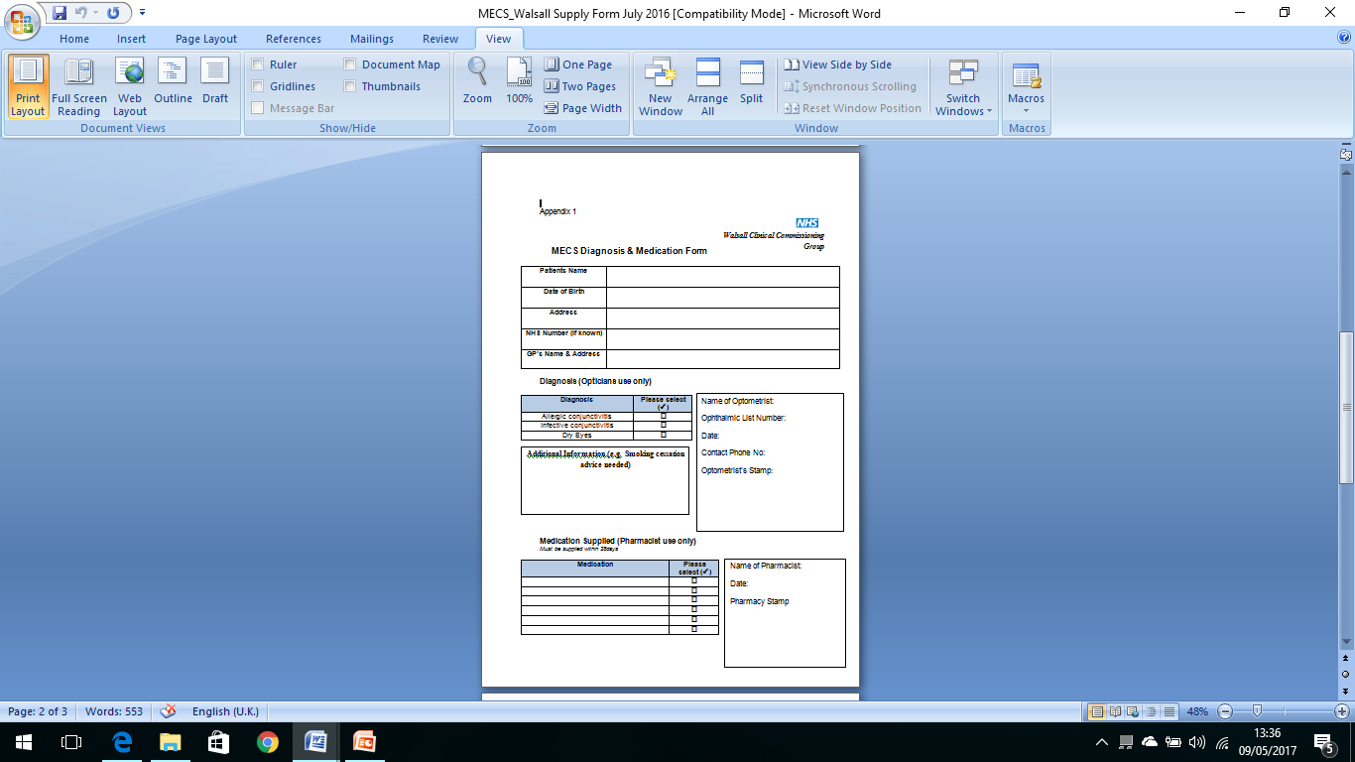

Slide 48
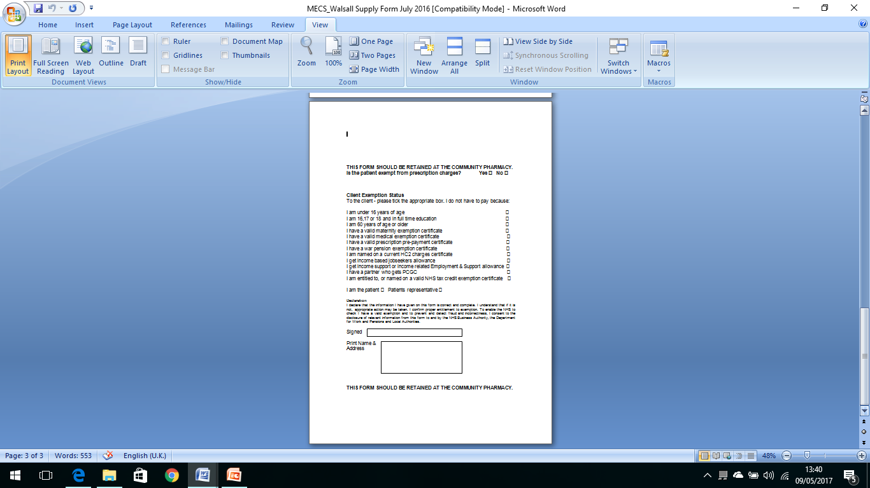

Slide 49
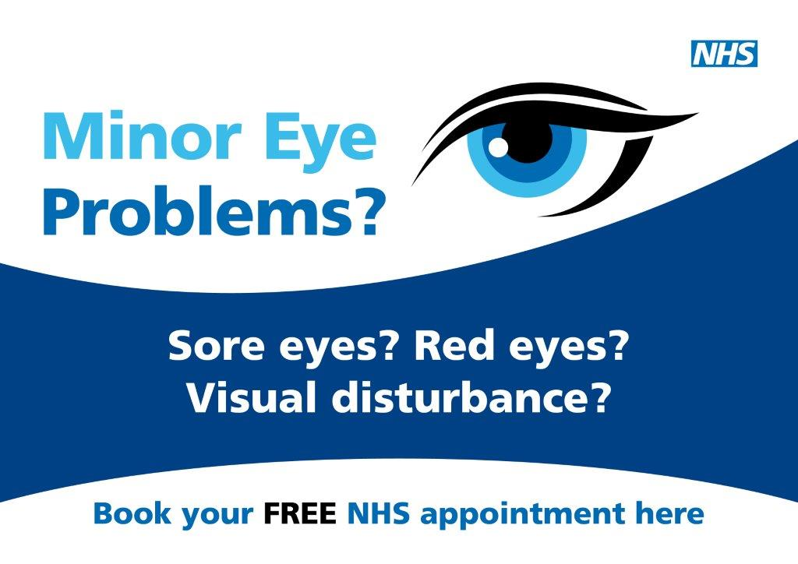

Slide 51
Mecs – clo’s
Contact lens opticians are suitably qualified to deal with most anterior eye conditions within MECS.
A modification to the MECS triage protocol would ensure the correct patients/conditions are seen urgently by the optometrist ie flashes and floaters/vision loss etc. While patients would see the CLO for anterior eye problems such as the red eye problem.
If the triage process fails and the CLO is presented with a condition falling outside their scope of practice, they have sufficient knowledge enabling them to hand the patients care over to the optometrist.
Statistics from established MECS/PEATS schemes identify 70-80% of patients who present for MECS/PEATS appointments have anterior eye problems, nearly all of which can be dealt with by the CLO. This will enable the scheme to be more effective, increasing capacity and enabling the optometrist to see more urgent cases within the required time scale.
In a situation where the patient was first seen by the CLO and then passed to the optometrist only one fee would be claimed.

Slide 52
Mecs – Electronic Referrals
The commissioners now wish to implement a CQUIN which reduces the number of ophthalmological referrals sent in via the GP, through the use of electronic means.
Although in practice electronic referrals can be sent from the MECS IT module, it relies on an automated emailing system which is still not sufficiently sophisticated. We could not guarantee that they would arrive within the required time window. So urgent MECS referrals would still need to be faxed.
However, electronic referral is still well suited to routine conditions from MECS.
Revisions will be made to ophthalmological referral guidance for South Staffs MECS practitioners.

Slide 53
Urgent opHTHALMOLOGICAL REFERRALS GUIDANCE
Conditions for urgent referral (<24 hours)
Painful red eye
Corneal ulcer
Anterior uveitis
Corneal FB
Acute angle closure
Chemical Injury
Sudden recent (<48 hrs) loss of vision
Retinal detachment (includes retinal tear with no RD)
CRAO (<12 hrs old)
Optic Neuritis / AION
Unexplained sudden loss of vision
Papilloedema
Orbital cellulitis
Penetrating Injury
Macula Fast-Track Referral
Wet macular degeneration with signs/symptoms that fit the fast track criteria

Slide 54
Urgent opHTHALMOLOGICAL REFERRALS GUIDANCE
Conditions for ARC Referral that should be seen in <72 hrs
Loss of vision (<1/12 duration)
CRVO / BRVO
Macular hole
CSR
Optic neuritis / AION
Recent onset binocular diplopia
PVD related symptoms with pigment in vitreous (<1/12)
Vitreous Hge (recent onset)
“Suspected cancer” referrals
Periocular Tumours
Basal cell carcinoma , Squamous cell carcinoma : No change from the current pathway. Refer as “urgent” to the oculoplastics clinic
Intraocular tumour (eg melanoma) – Refer to ARC to be seen within 72 hours

Slide 55
MECS URGENT (<24HRS, <72HRS)
Referral Options:
1. New Cross ARC (fax to 01902 695842, then phone 01902 695805 to make sure fax received)
2. Queens Hospital Burton (Mon-Fri and Sat to 12:00pm) - Phone for appointment, and fax referral: 01283 536760 (F), 01283 566333 x5085 (T), otherwise:
3. Birmingham and Midland Eye Centre (BMEC) City Hospital - Triage Tel: 0121 507 6780 Fax: 0121 507 6771

Slide 56
MECS ROUTINE
Referral Options:
1. New Cross Hospital (via GP, as per current protocol)
2. Stafford County Hospital (via GP, as per current protocol)
3. Queens Hospital Burton – Direct referrals have been enabled, but please inform GP. Email Patient Registration (medical.records@nhs.net), but only if you have an NHS.net account. Otherwise, post referral to: Ophthalmology Referrals, Eye Department, Treatment Centre, Queens Hospital, Belvedere Road, Burton-on-Trent, Staffordshire DE13 0RB.
4. Samuel Johnson Hospital Lichfield Tel: 01543 263858, and Sir Robert Peel Hospital Tamworth Tel: 01827 263858, and they share the same fax number: 01827 263882. Direct referrals have been enabled, but please inform GP.

Slide 57
Mecs – local quality requirements (lqrs)
Under Schedule 4C of the contract, South Staffordshire MECS is measured against the following KPIs:
>= 70% of Service Users shall be managed and discharged by the service, removing the need to attend secondary care (Measured monthly)
>= 90% of Service Users are triaged by the service within 48 hours of referral. (Measured monthly)
Minimum of 6 MECS locations per CCG (Measured monthly)
>= 90% of Service Users are seen by the service for an initial appointment within 2 weeks of referral. >= 95% of urgent patients to be seen within 24 hours of triage (Measured monthly)
>= 90% of Service Users report positive experience of the service (Measured monthly).
1:0.15 first to follow-up ratio (i.e. 15%). (Measured monthly).
100% of Optometrists achieve MECS accreditation from WOPEC. (Measured monthly)

Slide 58
Mecs - cquin
The purpose of this CQUIN is to reduce the number of referrals into secondary care which are delayed by the process of having to be processed via the GP.
To facilitate direct and timely access to secondary care, through the use of electronic referrals.

Slide 59
MECS - CQUIN
Baseline period/date | Baseline from March 16 – Feb 17 SUS First Outpatient Referral Source, Burton FT, UHNM, RWT & Rowley Hall Hospital Data:
 | GP Referral | Optometrist Referral
Cannock Chase CCG | 1621 | 706 - 30%
South East Staffs CCG | 1540 | 1238 – 44%
Stafford & Surrounds CCG | 2639 | 671 – 20%

Slide 60
Mecs – cquin - milestones
Milestones
Date/period milestone relates to | Rules for achievement of milestones (including evidence to be supplied to commissioner) | Date milestone to be reported | Milestone weighting (% of CQUIN scheme available)
30thSeptember 2017 | 50% of first ophthalmology outpatients are recorded as Optometrist referrals. | 15th working following end of Q2 | 33.33%
31st December 2017 | 70% of first ophthalmology outpatients are recorded as Optometrist referrals. | 15th working following end of Q3 | 33.33%
31st March 2018 | 90% of all referrals within this pathway to be referred directly from the optometrist to secondary care. | 15th working following end of Q4 | 33.33%
 |  | Total | 100.00%

Slide 61
MECS – FURTHER INNOVATIONS
Domiciliary MECS contractors
Referrals from Staffordshire DESP
Offer of CET workshops from DESP
Programme of lectures at Spire Hospital, Little Aston

Slide 62
IF YOU REMEMBER NOTHING ELSE FROM TONIGHT...
If you don’t have availability, find another MECS practice that does
Please work towards completion of IG Toolkit and obtaining your NHS.net accounts

Slide 63
GRR – test a guidance
These are patients who have been referred in with IOP >21 mmHg in the absence of any confirmed signs of Glaucoma. When dealing with your own patient, GAT should be performed immediately after eye examination. Please note that GAT tonometry is the preferred gold standard to deliver this service but Perkins tonometry is also accepted.
On receiving referral from unaccredited Optometrist, you/your practice must contact the patient within 48 hours to make an appointment. The patient should then be seen within 2 weeks
There are 4 possible outcomes from this first repeat of pressures:
1) All patients with IOP > 25mmHg should be referred for OHT diagnosis without further IOP refinement
2) Other patients with a pressure of 22 - 25 need to proceed to Test B
Pressures which differ between the eyes by 5 mmHg or more should proceed to Test B
All other IOP results are within normal limits and the patient can be discharged. (When patient is discharged at this stage, please ensure you inform the referring Optometrist).

Slide 64
GRR – TEST B GUIDANCE
The patient must be seen within 3 weeks of Test A where you will perform Test B. Do enquire about patient symptoms, family history of Glaucoma and measure VA. Then perform the following tests:
1) repeat GAT on a separate occasion
2) Repeat Fields (minimum 60 point central threshold test)Eg: Humphrey C24-2 or equivalent
3) Dilation of pupils & Volk optic disc assessment (stereo view) + document with photography
4) Van Herrick test (anterior angle assessment)

Slide 65
Grr – test b guidance
After repeat GAT, if angles open, normal fields and disc appearance, there are 3 possible outcomes:
Any patients with IOP <=21mmHg should be discharged
If there is a difference in IOP of >=5mmHg between the eyes then consider referral to secondary care HES.
The following patients are referred to HES for OHT diagnosis:
-Age <65 yrs, IOP >21mmHg
-Age 65-79yrs, IOP > 24mmHg
-Age 80yrs+, IOP > 25mmHg

Slide 66
GRR – FURTHER GUIDANCE
If there are any suspect glaucomatous disc signs &/or occludeable anterior chamber angles &/or glaucomatous field defects, you must refer this patient into HES.
Please note that the GRR pathway is IOP mediated so theoretically you should not be seeing many obvious glaucomatous discs. However, it is vital these are recognised when presented.
Do remember that Glaucoma is a neuropathy, so disc appearance is a vital sign to ensure early diagnosis.

Slide 67
PEATS IS DEAD (ok, not quite!)... ...LONG LIVE MECS!!!

Slide 68
...ANY QUESTIONS???

