Slide 1
PEATS Review MAY 2016
Mark McCracken
Clinical Governance & Performance Lead (PEATS)
Primary Eye Care (Shropshire & Staffordshire) Ltd

Slide 2
PEATS
PEATS = Primary Eyecare Assessment & Treatment Service
18 month pilot
Triaging of acute and non-acute referrals
Treatment of minor eye conditions
Minor eye procedures

Slide 3
PEATS
18 optical practices within or bordering the two CCG areas as subcontractors to SASPEC
“PEATS Referral Form for GPs” document uploaded to Map of Medicine. Inclusion/exclusion criteria
The PEATS service must triage the referral within 48 hours
Patient will be seen by the PEATS service within 2 weeks
Urgent referrals shall be seen within 24 hours

Slide 4
PEATS – Conditions
Distorted vision
Mild –to-moderate ocular pain
Systemic disease affecting the eye
Differential diagnosis of the red eye
Foreign body and emergency contact lens removal (not by the fitting practitioner)
Dry eye
Epiphora / watery eyes
Trichiasis / ingrowing eyelashes
Differential diagnosis of lumps and bumps in the vicinity of the eye
Flashes/floaters
Retinal lesions
Field defects
GP referrals *INCLUDING “RAISED IOP” FROM JAN 2016*

Slide 5
PEATS Urgent PEATS Routine
(To be seen within 24 hours)
Moderate ocular pain / discomfort
Recent onset transient vision loss / blurred vision <= 48 hours
Red eyes: which cannot be managed by GP
Corneal FB’s or abrasions
Recent onset flashes and Floaters
(To be seen within 2 weeks)
Mild ocular pain / discomfort
Recent onset transient vision loss / blurred vision > 48 hours
Watery eyes
Dry eyes
Eyelid lumps and bumps
Ingrowing eyelashes

Slide 6
PEATS - Exclusions
Sudden, persistent loss of vision < 48 hours – urgent to ARC (< 24 hours)
Sudden, persistent loss of vision > 48 hours – urgent to ARC (< 72 hours)
Sudden onset diplopia – urgent to ARC (< 72 hours)
Injuries: chemical, penetrating or post-operative infection – urgent to ARC (< 24 hours)
Severe ocular pain requiring immediate attention – urgent to ARC (< 24 hours)
Suspected retinal detachment - urgent to ARC (< 24 hours)
Suspected vascular abnormality - urgent referral to secondary care to rule out cardiovascular cause if acute onset

Slide 7
PEATS - Exclusions
Severe eye conditions which need hospital attention, e.g. Temporal arteritis / Anterior Ischaemic Optic Neuropathy, Orbital Cellulitis
Eye problems relating to Herpes zoster
Suspected cancers of the eye
Patients more suitable for South Staffs DAC pathway
Patients more suitable for GRR pathway
Patients more suitable for Staffordshire DESP

Slide 8
PEATS - Activity
This contract commenced on the 20th July 2015 and is due to run for an 18 month period.
Since the contract started there have been 747 cases seen by the PEATS Pilot. Of these cases, 355 were classified as routine cases and 392 were urgent cases.
The next two slides demonstrate the split of cases by CCG.

Slide 9
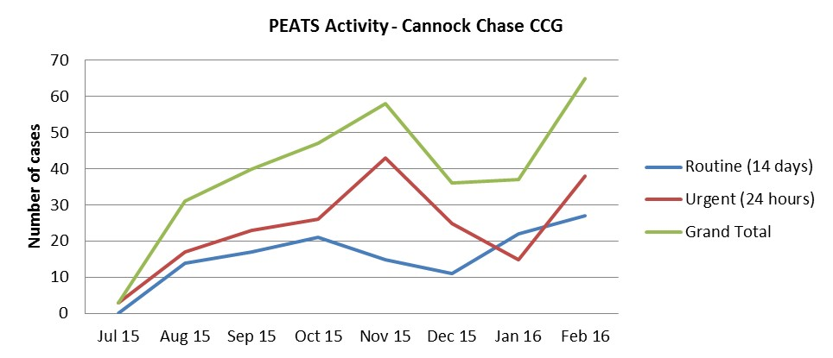

Slide 10
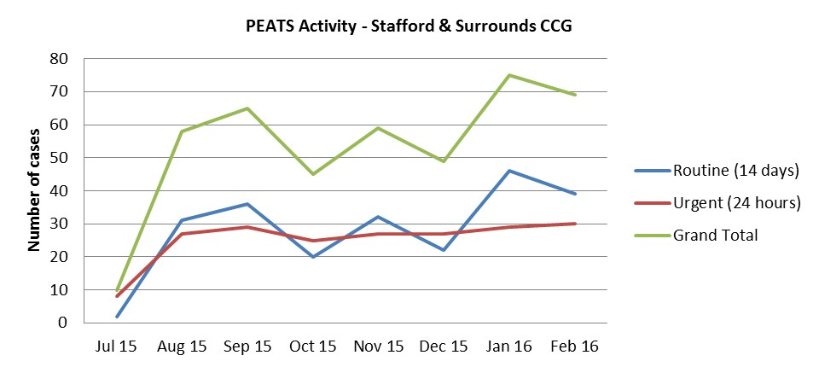

Slide 11
PEATS – Local Quality Requirements
Under Schedule 4C of the contract, the Primary Eyecare Assessment and Treatment Service is measured against the following KPIs:
95% of Service Users are triaged by the service within 48 hours of referral. (Measured monthly)
95% of Service Users are seen by the service for an initial appointment within 4 weeks of referral. (Measured monthly)
95% of Service Users report positive experience of the service (responses to be either ‘extremely likely’ or ‘likely’). (Measured annually).
100% of Optometrists achieve PEARS accreditation from the WOPEC. (Measured monthly)
<40% of Service Users which are referred onto secondary care. (Measured monthly)
1:0.13 first to follow-up ratio (i.e. 13%). (Measured monthly).

Slide 12
Ref. | Local Quality Requirement | Threshold | Jul- 15 | Aug- 15 | Sep- 15 | Oct- 15 | Nov- 15 | Dec- 15 | Jan- 16 | Feb- 16 | Mar- 16 | YTD
PEATS_ LQR_1 | Service Users are Triaged within 48 hours of referral | 95% | 100% | 79% | 78% | 82% | 78% | 76% | 73% | 83% |  | 81%
PEATS_ LQR_2 | Service Users are seen by the service for an initial appointment within 4 weeks of referral | 95% | 100% | 100% | 100% | 100% | 100% | 100% | 100% | 100% |  | 100%
PEATS_ LQR_3 | Service Users report positive experience of the service (annual) | 100% | N/A | N/A | 100% | 100% | 100% | 100% | 100% | 100% |  | 100%
PEATS_ LQR_4 | Optometrists achieve PEARS accreditation from the WOPEC (annual) | 100%
PEATS_ LQR_5 | Service Users are referred onto secondary care | <40% | 8% | 17% | 30% | 28% | 25% | 18% | 13% | 23% |  | 20%
PEATS_ LQR_6 | First to follow-up ratio | 1:0.13 (13%) | 15% | 9% | 6% | 1% | 5% | 6% | 6% | 7% |  | 7%

Slide 13
PEATS: Service User Outcomes
One of the primary aims when commissioning this Primary Eyecare Assessment and Treatment Service was to safely manage and discharge 60% of cases referred to the service, without need for referral to secondary care.
Since this contract commenced, 65% of cases have been discharged from the service or are being managed via a follow up.
13% of cases were referred back to the Service User’s GP without the need for onward referral and 22% of cases were referred on to alternative ophthalmology services.

Slide 14
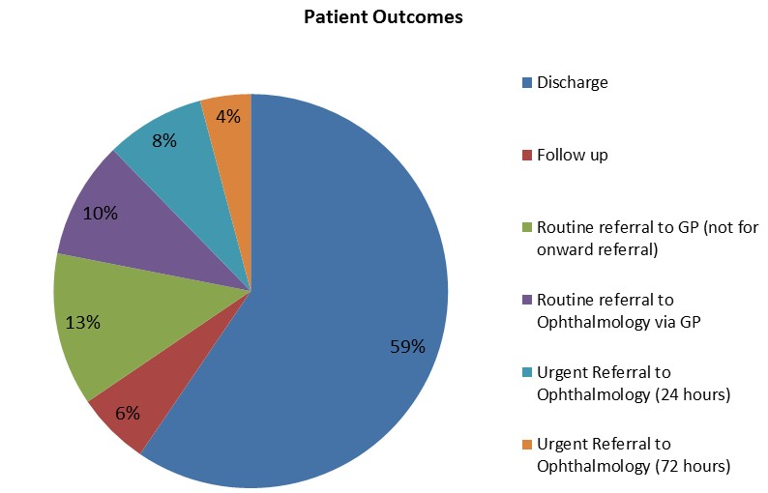

Slide 15
PEATS: Amendments to Guidance (January 2016)
Raised IOP referrals (or suspected raised IOP referrals) from GPs into PEATS central hub, or directly to PEATS practices, can be seen by the service *GP REFERRALS ONLY*
Referrals into PEATS for blurred vision, or recent onset transient vision loss, <= 48 hours to be seen as PEATS URGENT (within 24 hours)
Referrals into PEATS for blurred vision, or recent onset transient vision loss, > 48 hours to be seen as PEATS ROUTINE (within 14 days), regardless of source of referral

Slide 16
Don’t refer into PEATS if…
Flashes & floaters < 1 month since first full PEATS consultation
In-growing eyelashes < 4 months since first full PEATS consultation
Repeat dry eye / blepharitis < 4 months since first full PEATS consultation
Transient vision loss < 4 months since first full PEATS consultation
Where symptoms suggest that a sight test is more appropriate
Adult squints, longstanding diplopia
Removal of suture
Repeat field tests following a sight test (unless referred in by a non-accredited optometrist from a different practice)
AMD (unless recent-onset disciform lesion is suspected)

Slide 17
PEATS: Take Home Message
Use reception triage form for all PEATS self-referrals: gauge urgency, deflect inappropriates
Ensure that patient details are entered on to PEATS module, immediately following completion of reception triage form (so that the service will meet LQR-1)
Once consultation finished, give every patient a E&D and PROMS form

