Slide 1
Pigmented Choroidal Lesions – UHNM Choroidal Naevus clinic
Dr Andrew Brown
November 2016

Slide 2
Differentiating between benign and malignant choroidal lesions
When to refer urgently
When to refer routinely
How to refer
UHNM choroidal Naevus Clinic

Slide 3
Problem
Naevi are present in 4.6 -7.9% of the Caucasian population – common
Malignant transformation of naevi occurs in approximately 1 in 8,845 – rare
Can be difficult to tell apart

Slide 4
Definitions
Naevus – Thickness < 2mm (USB) and no other risk factors
Melanoma – Thickness > 2.5 mm (USB) and 2 other risk factors
Indeterminate – Fitting into neither of the above categories

Slide 5
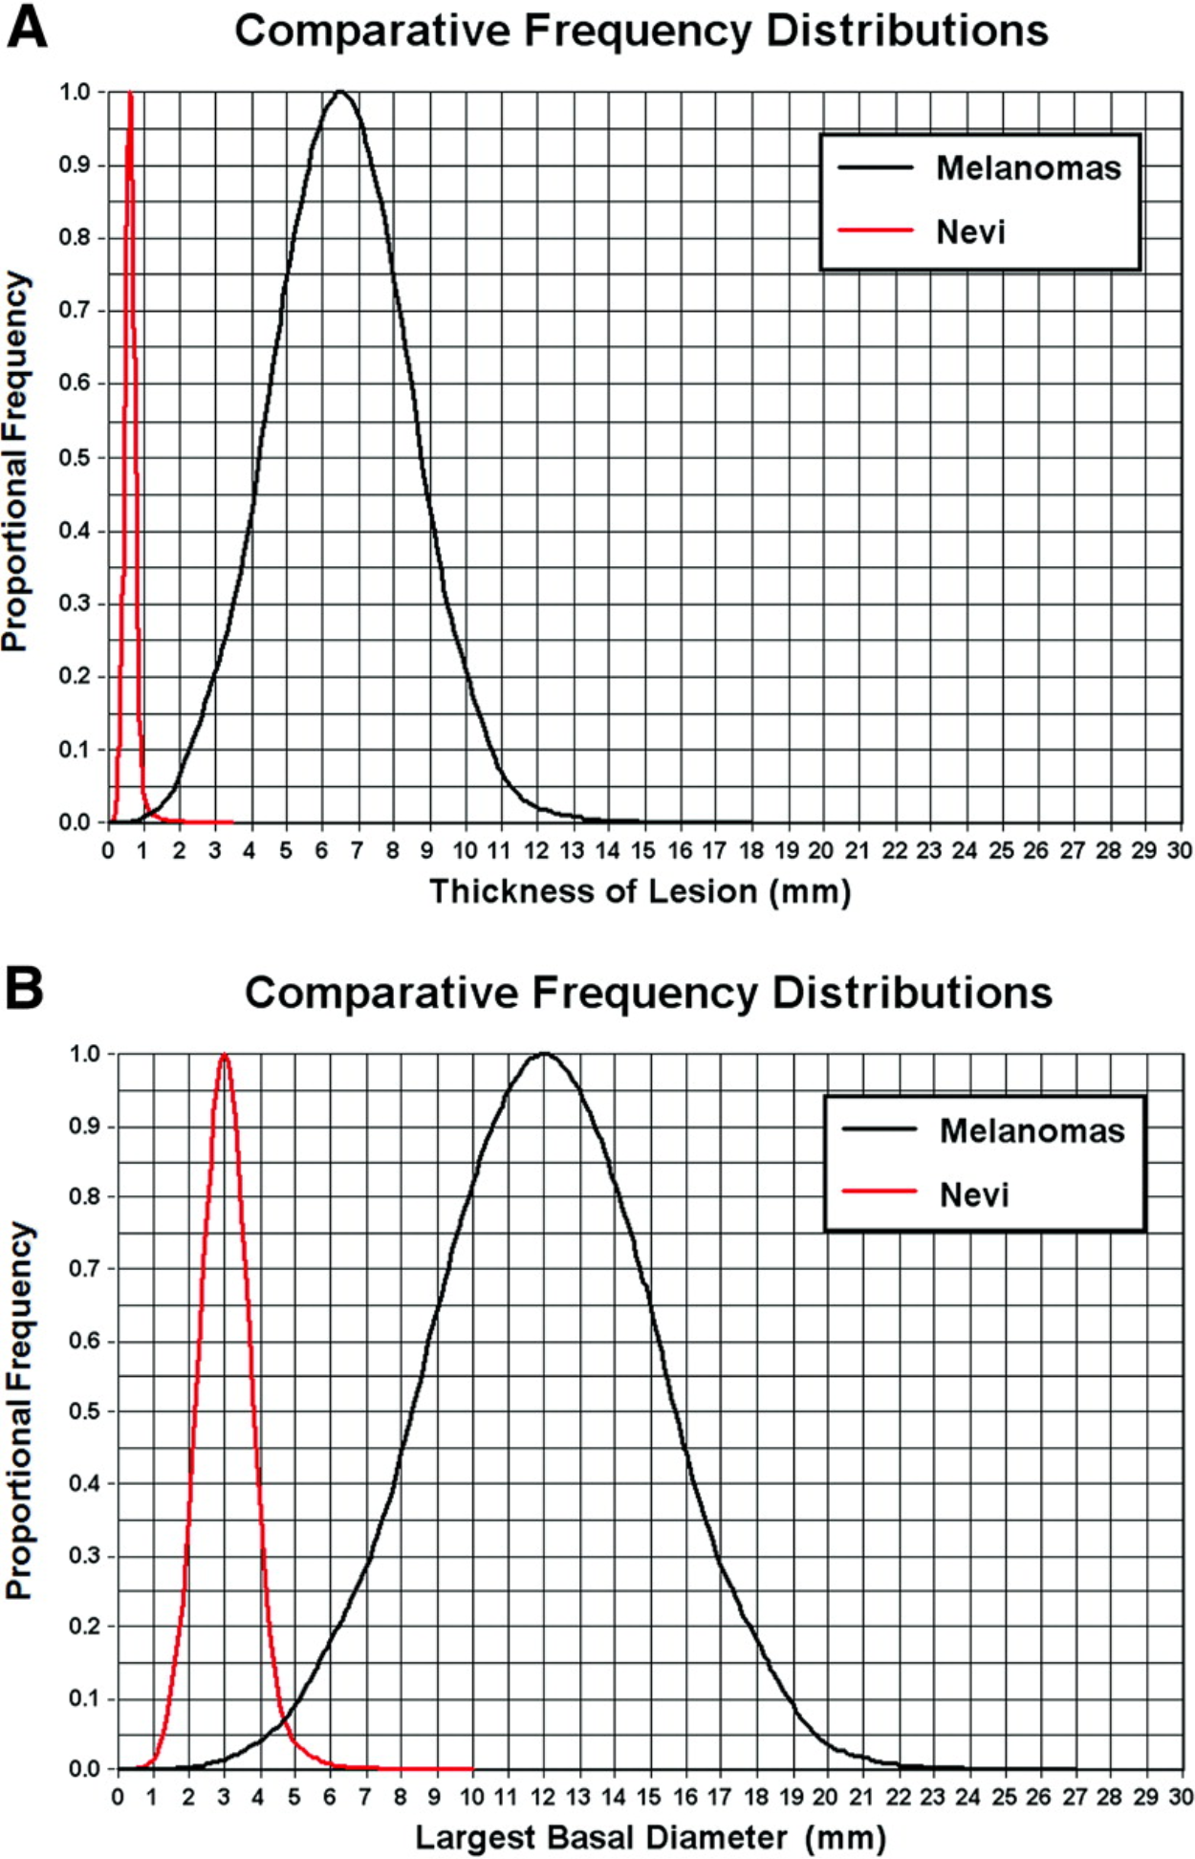
From: Size Overlap between Benign Melanocytic Choroidal Nevi and Choroidal Malignant Melanomas
Invest. Ophthalmol. Vis. Sci.. 2008;49(7):2823-2828. doi:10.1167/iovs.07-1603

Slide 6
Lesions smaller than 3mm unlikely to be melanoma
Lesions larger than 6 mm unlikely to be naevus
1 disc diameter approx 1.5 mm
Lesions less than 1.5 mm thick unlikely to be melanoma
Lesions greater than 2 mm thick unlikely to be naevus
Impossible to determine thickness to this degree of accuracy clinically

Slide 7
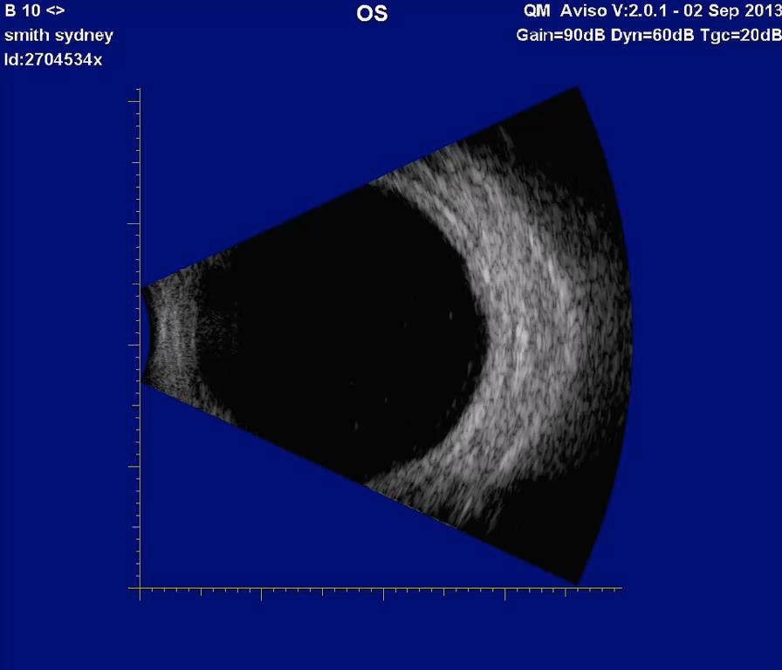

Slide 8
Learning point
Flat lesions 3mm or less – observe in community (digital imaging preferable)
Lesions 6mm or more urgent referral
Lesions 3mm – 6mm asses risk factors to determine urgency of referral
Lesions that are raised clinically require referral regardless of diameter
Initial assessment must include pupil dilation

Slide 9
Risk factors
Symptoms (p=0.002)
Sub-retinal fluid (p=0.002)
Orange pigment (autofluoresent) (p<0.001)
Tumour within 3mm optic Disc (p=0.001)
Absence of Halo (p=0.009)
Amelanotic

Slide 10
Other risk factors
Ultrasonographic hollowness (p<0.001)
Thickness > 1.5mm
Suspicious OCT findings

Slide 11
Suspicious OCT findings
Intra retinal oedema (p=0.003)
Shaggy photoreceptors (p=0.005)
Loss of photoreceptors (p=0.005)
Loss of ELM (p=0.008)
Loss of IS/OS junction (p=0.02)

Slide 12
Risk Factors
1 risk factor = 38% chance of growth
2 risk factors = 50% chance of growth
Risk factors only relevant for flat lesions larger than 3mm largest diameter

Slide 13
Learning Point – Lesions 3-6mm size
0-1 risk factor – routine referral
2 or more risk factors – urgent referral

Slide 14
Community Referral Guidelines
Lesions over 3mm diameter
Any lesion with documented growth
Any raised lesion, regardless of size
Risk factors should be indicated to allow effective referral triage
Any lesion with a high suspicion of melanoma should be referred urgently via the emergency eye clinic

Slide 15
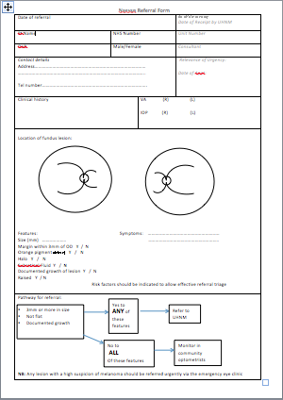

Slide 16
UHNM Clinic
Measurement of visual acuity
Dilation and Retinal examination of new patients
B ultrasound
Colour photographs
OCT autofluorescence
OCT-EDI
Optos wide field imaging
Optos autofluoresence

Slide 17
Ultrasound vs OCT-EDI
OCT-EDI measurements are approximately 50% less thick than USB measurements (i.e. a 3mm lesion on USB will measure 1.5 mm on OCT-EDI)
USB cannot detect/measure lesions <0.75 mm thick – these can be measured with OCT-EDI
OCT-EDI less helpful as tumours enlarge (>3mm)
The lesion must be at least 1.5mm thick on USB measurement before meaningful comments on echogenicity can be made
USB echogenicity is determined by the density of cellularity of the tissue comprising the lesion (the denser the tissue the lesser the internal reflectivity)
OCT-EDI appearance is determined by the amount of pigment in the lesion and does not correlate to ultrasonic internal reflectivity
OCT-EDI offers a better estimate of the true dimensions of the lesion compared to USB

Slide 18
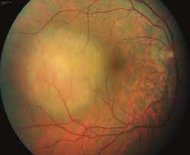

Slide 19
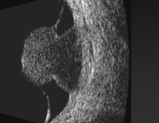
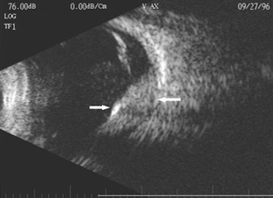

Slide 20
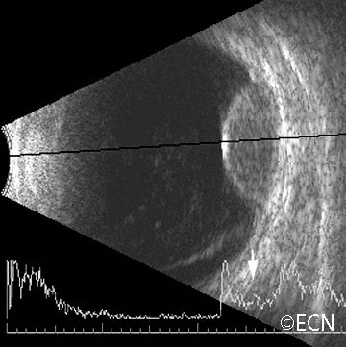

Slide 21
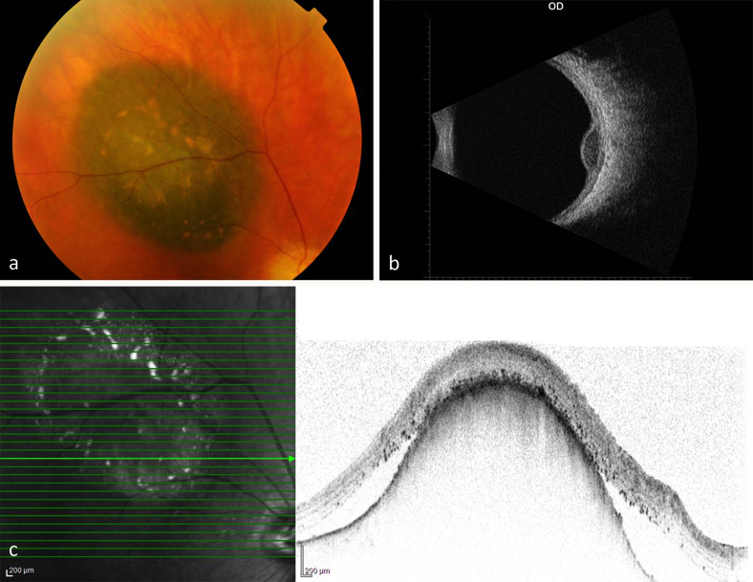

Slide 22
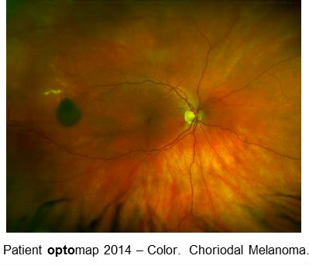

Slide 23
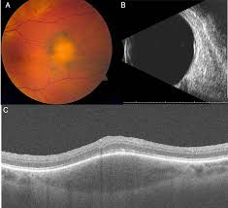

Slide 24
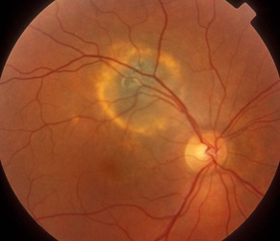

Slide 25
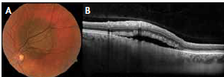

Slide 26
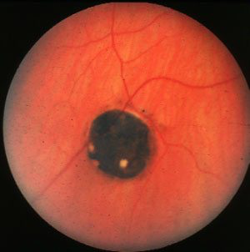
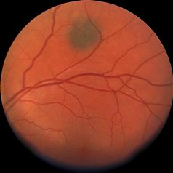

Slide 27
Thank You Questions?

