Slide 1
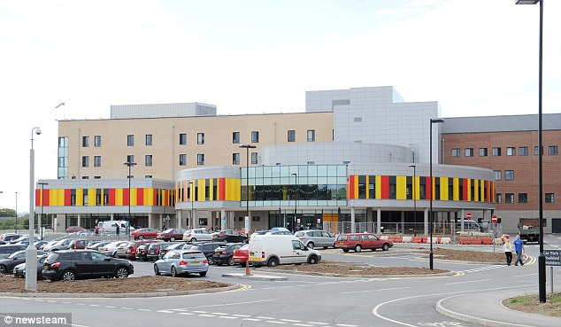
Glaucoma Diagnosis face- off: slit-lamp vs OCT
Lynval Jones
Consultant Glaucoma Specialist
University Hospital North Midlands
160516

Slide 2
Glaucoma history
Anterior segment signs
ACA assessment – VH vs AS-OCT
CCT- implications
Disc and RNFL imaging
Visual fields

Slide 3
Glaucoma History
History of presenting complaint
Past ophthalmic history
Past medical history
Drug history
Social History – including driving
Family history

Slide 4
Anterior Segment signs of Glaucoma

Slide 5
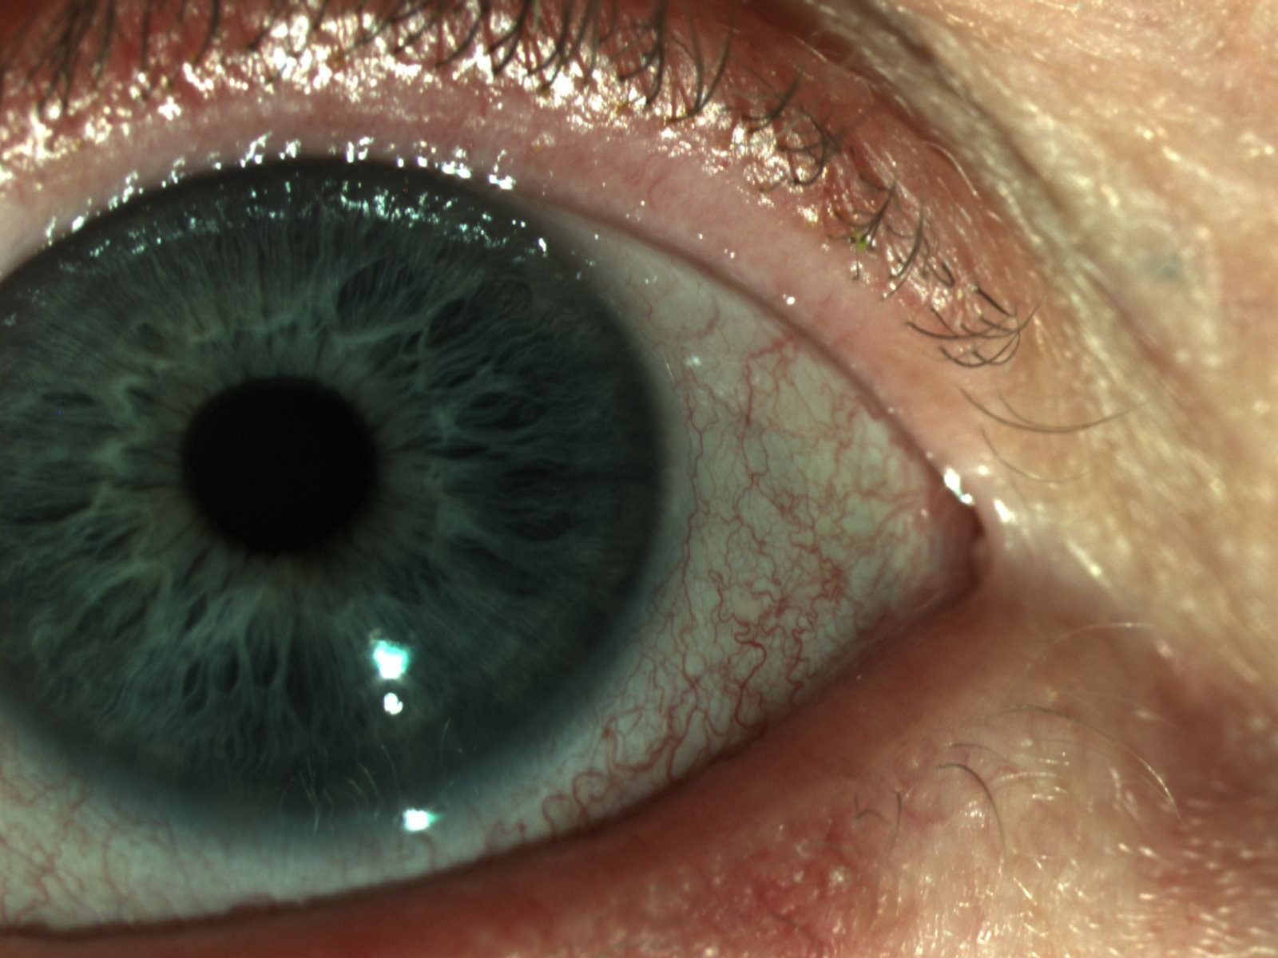

Slide 6
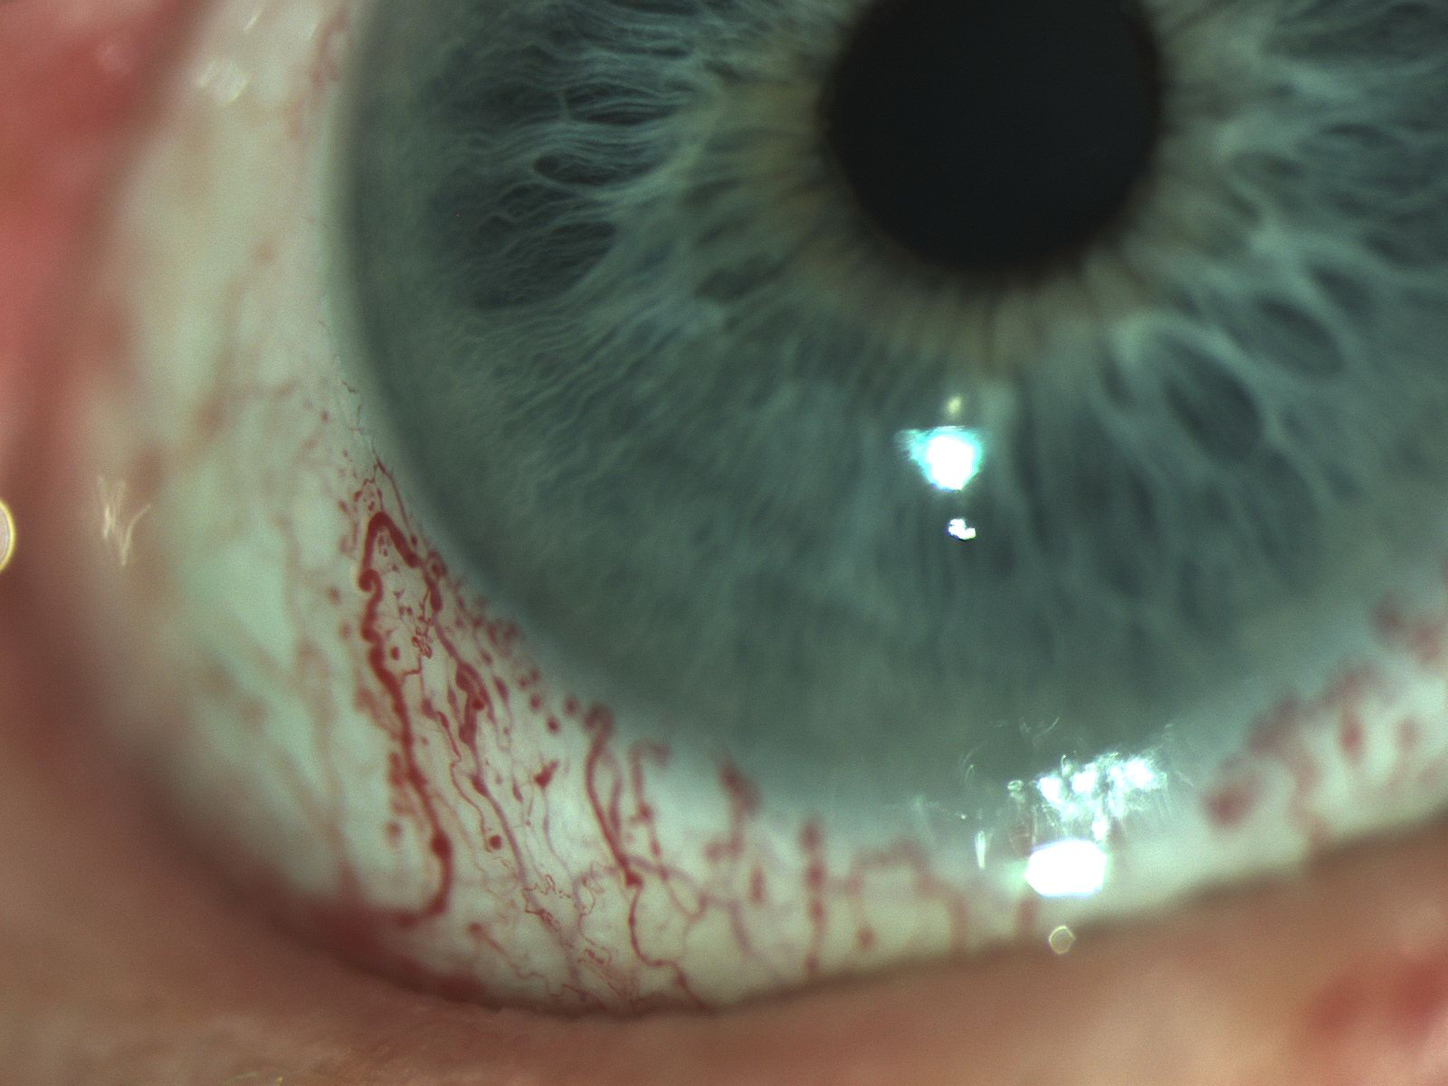
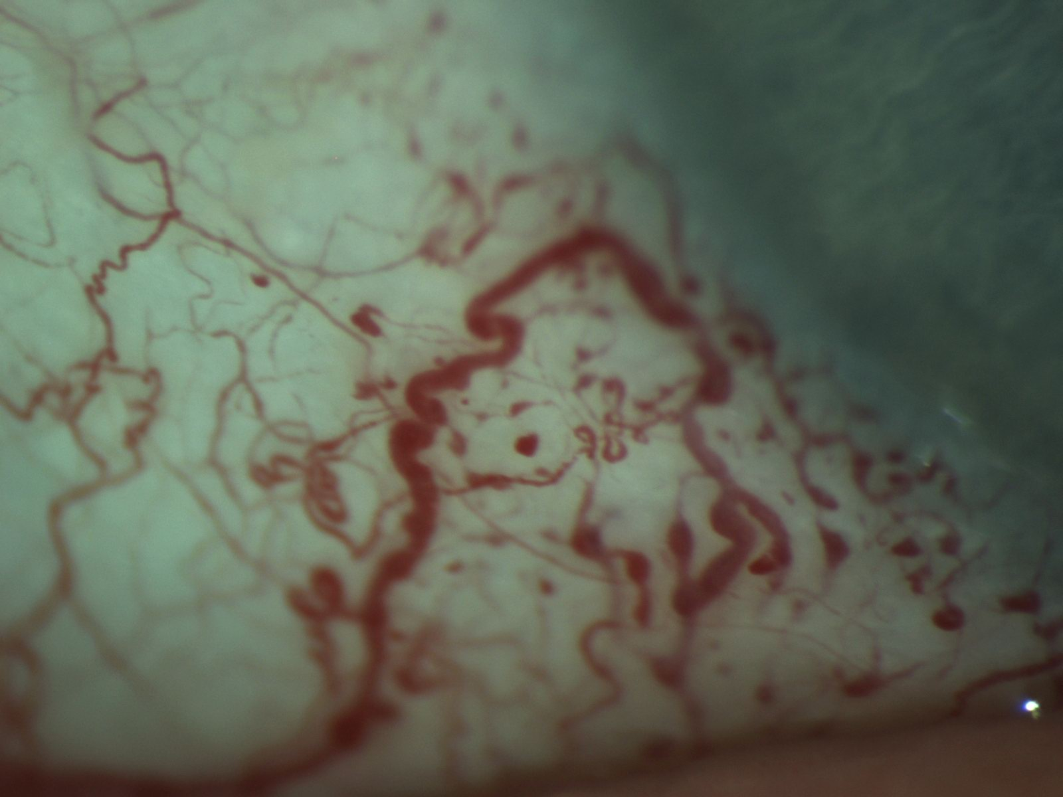

Slide 7
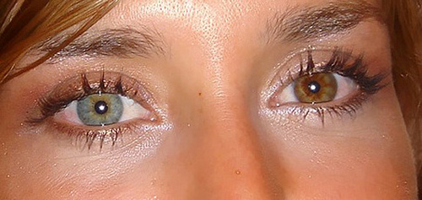

Slide 8
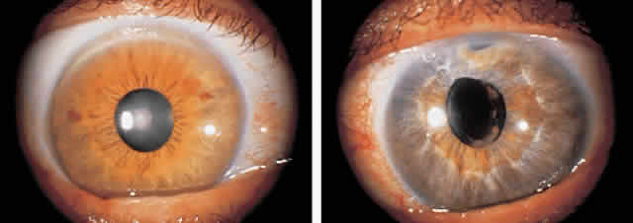

Slide 9
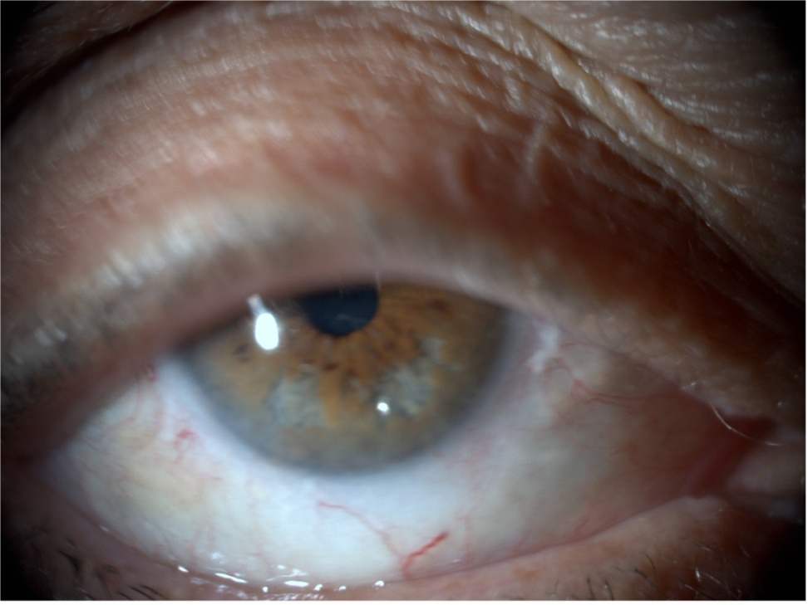
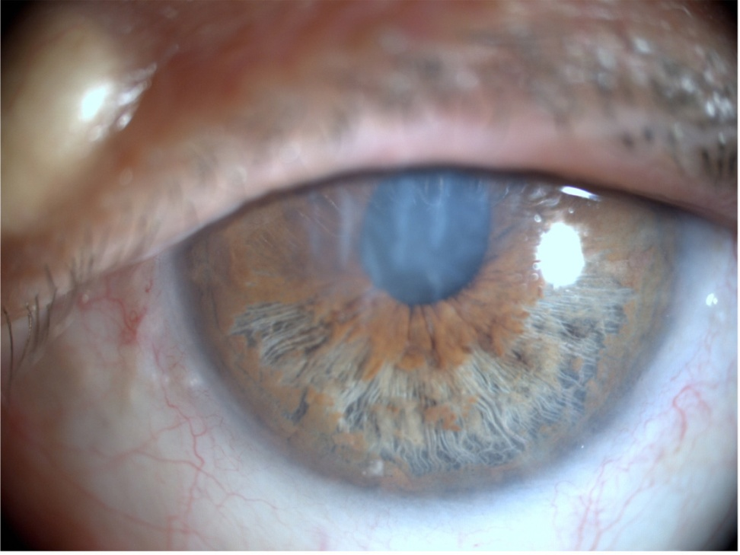

Slide 10
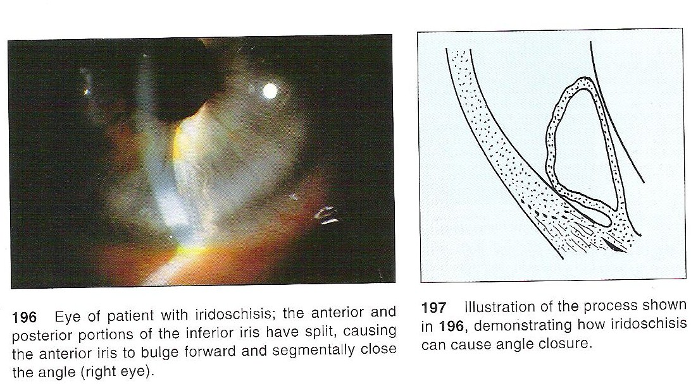

Slide 11
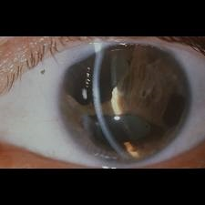
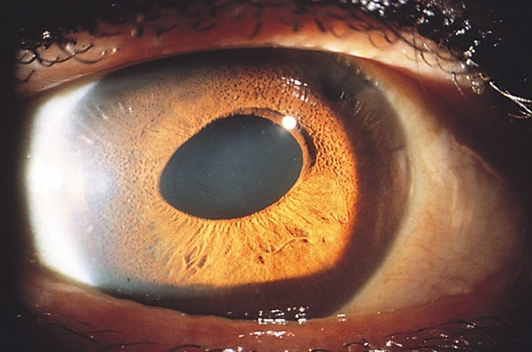
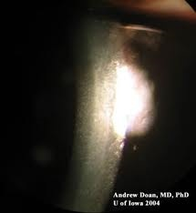
Notes:
ICE(3/4th decade) – unilateral- essential iris atrophy, Iris naevus (Cogan-Reese) syndrome, Chandlers (endothelial changes)

Slide 12
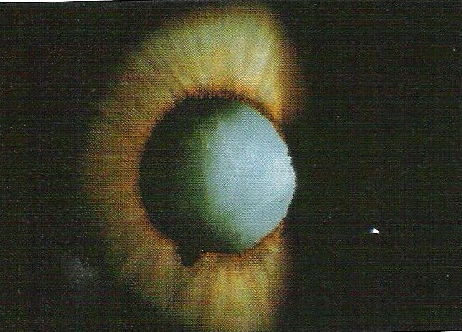

Slide 13
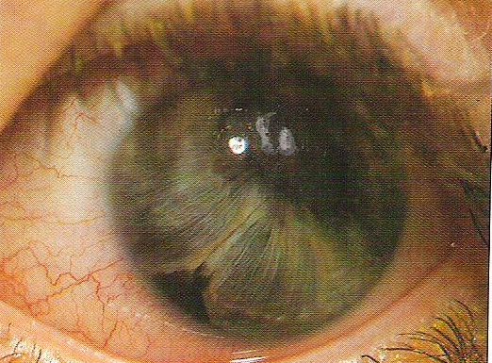

Slide 14
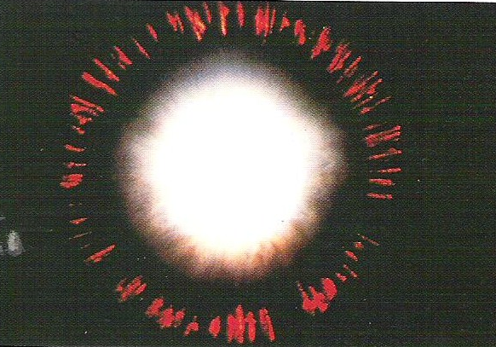

Slide 15
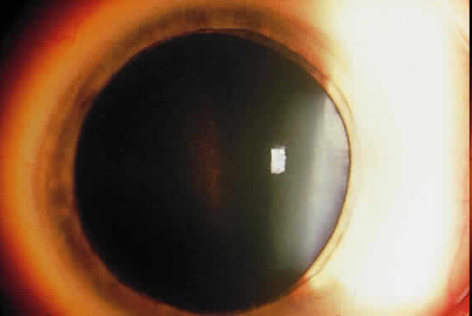

Slide 16
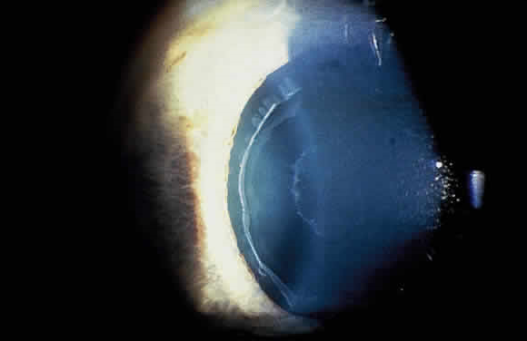

Slide 17
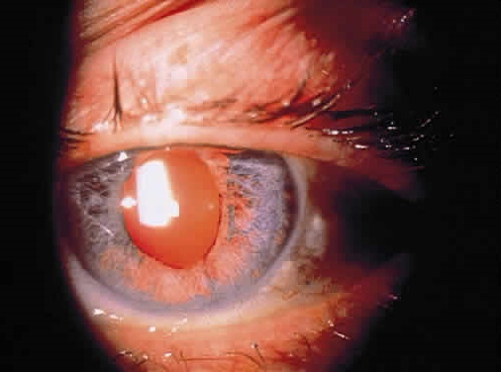

Slide 18
Van Herick

Slide 19

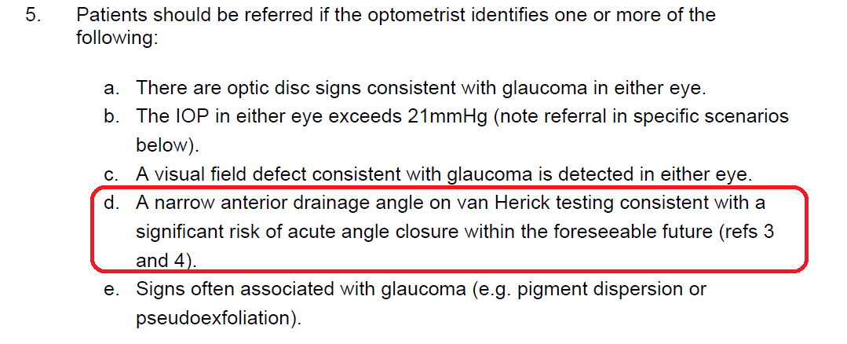

Slide 20
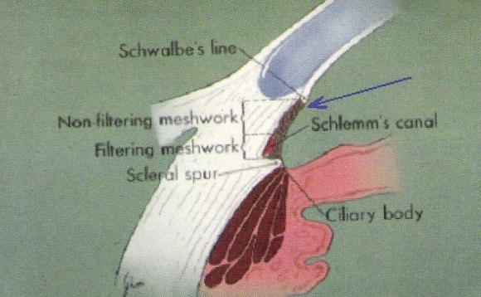
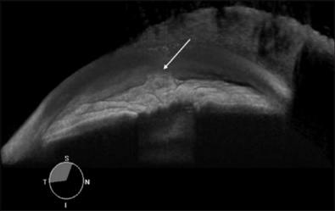
AS-OCT
Notes:
The Casia SS-1000 OCT is a Fourier-domain, SS-OCT designed specifically for imaging the anterior segment. This system achieves high resolution imaging of 10΅m (Axial) and 30΅m (Transverse) and high speed scanning of 30,000 A-scans per second. With a substantial improvement in scan speed, the anterior chamber angles can be imaged 360 degrees in 128 cross sections (each with 512 A-scans) in about 2.4 seconds.
The SS is one such anatomical landmark that is customarily used. It also serves as a landmark for the trabecular meshwork, which cannot be easily distinguished on AS-OCT images. The trabecular meshwork is located approximately 250–500 μm anterior to SS along the angle wall.
Angle closure in > 1 quadrants was detected by AS-OCT in 142 (71%) patients (228 [66.7%] eyes) and by gonioscopy in 99 (49.5%) patients (152 [44.4%] eyes).
Ophthalmology. 2007 Jan;114(1):33-9.
50% of variation between observers in measurements of angle area (ARA, TISA) and 10% variation in linear measurements (AOD, anterior chamber angle) is due to poor reproducibility of the scleral spur location.

Slide 21
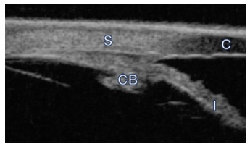
Anterior segment- OCT vs UBM
Could not locate the scleral spur in 30% of patients
Arch Ophthalmol. 2008 Feb;126(2):181-5.
Assessment of the scleral spur in anterior segment optical coherence tomography images. Sakata LM¹, Lavanya R, Friedman DS, Aung HT, Seah SK, Foster PJ, Aung T.

Slide 22
Van Herick
Subjective
Uncertainty – some will refer but some will ask pt to keep a diary of symptoms and review patient
OCT is objective
Even the misclassified will be referred

Slide 23
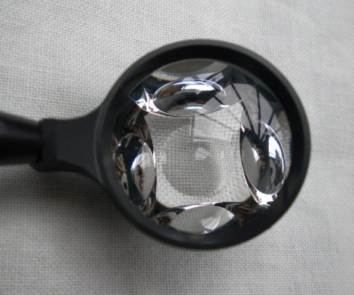
Gonioscopy
Gold standard
Classification of Glaucoma
  Primary
    POAG
    PACG
      PACS
      PAC
      PACG
  Secondary
    SOAG
    Others

Slide 24
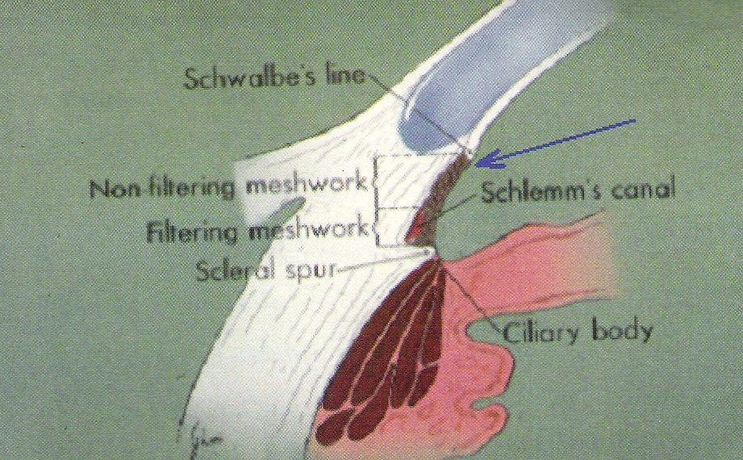
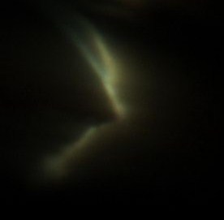
Corneal wedge

Slide 25
Shaffer classification
0 | No structures visible
1 | Schwalbe line visible
2 | Schwalbe line + pigmented TM
3 | Scleral spur visible
4 | All structures to ciliary body band visible
Primary angle closure suspect (PACS) = occludable angle
≥ 180⁰ of iridotrabecular contact – pigmented TM is not visible.

Slide 26
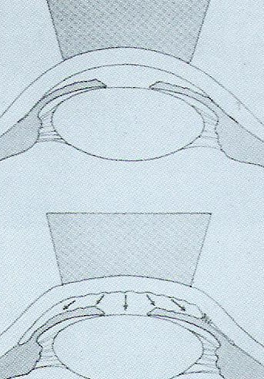
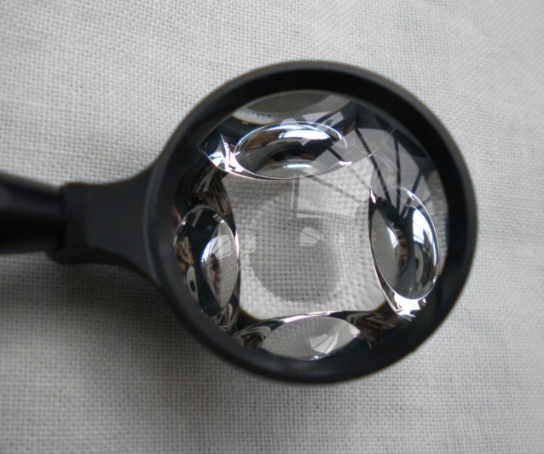
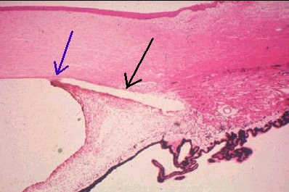
Appositional vs synechial closure

Slide 27
Natural history & classification
3 conceptual stages
Primary angle closure suspect (occludable angle)
  ≥ 180⁰ iridotrabecular contact (ITC)
  NO PI only if; frequent dilation, poor access, strong FH
  PACS PAC = 5%/yr
  PACS AAC = 1%/yr
Primary angle closure (PAC)
  Occludable angle with ; symptons of intermittent angle closure, evidence of trabecular obstruction: PAS, ↑IOP, iris whorling, glaucomafleken
Primary angle closure glaucoma
  PAC with evidence of optic disc damage/ visual field defect

Slide 28
CCT
CCT | More than 590 micrometres |  | 555–590 micrometres |  | Less than 555 micrometres |  | Any
Untreated IOP (mmHg) | > 21 to 25 | > 25 to 32 | > 21 to 25 | >25 to 32 | > 21 to 25 | > 25 to 32 | > 32
Age (years)ª | Any | Any | Any | Treat until 60 | Treat until 65 | Treat until 80 | Any
Treatment | No treatment | No treatment | No treatment | BB^{b} | PGA | PGA | PGA
BB: betablocker
PGA: prostaglandin analogue
Notes:
NOTES FOR PRESENTERS:
Key points to raise:
ª Treatment should not be routinely offered to people over the age threshold unless there are likely to be benefits from the treatment over an appropriate timescale. Once a person being treated for OHT reaches the age threshold for stopping treatment but has not developed COAG, healthcare professionals should discuss the option of stopping treatment.
The use of age thresholds is considered appropriate only where vision is currently normal (OHT with or without suspicion of COAG) and the treatment is purely preventative. Under such circumstances the threat to a person’s sighted lifetime is considered negligible. In the event of COAG developing in such a person then treatment is recommended.
^{b} If beta-blockers (BB) are contraindicated offer a prostaglandin analogue (PGA).

Slide 29
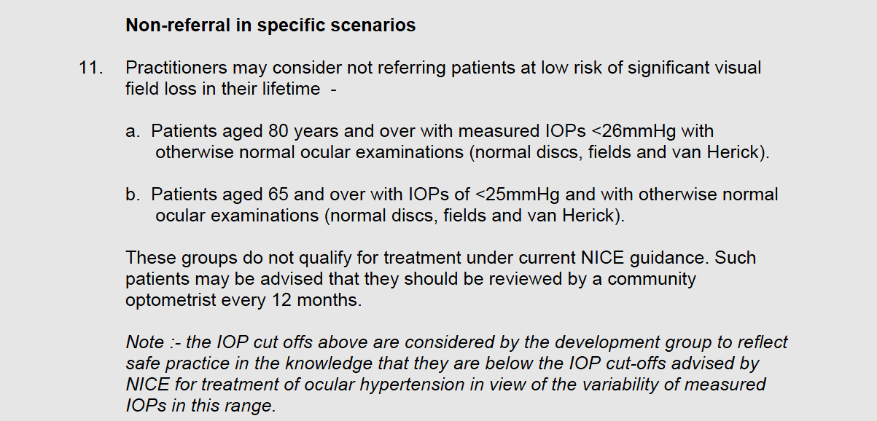

Slide 30
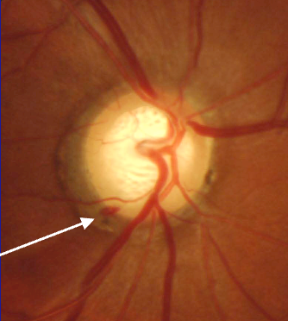
Examinations & investigations
Assessment of the optic disc
Photographs by Ki Ho Park, courtesy of South East Asia Glaucoma Interest Group (SEAGIG). www.seagig.org
Notes:
Optic nerve head (ONH) and retinal nerve fibre layer (RNFL) evaluation can be divided into two parts¹:
Qualitative
Contour of the neuroretinal rim
Optic disc haemorrhages
Peripapillary atrophy
Bared circumlinear vessels
Appearance of the RNFL
Quantitative
Optic disc size (vertical disc diameter)
Cup/disc ratio (vertical)
Rim/disc ratio
RNFL height
Careful study of the optic disc neural rim for small haemorrhages is important as these may precede visual field loss and further optic nerve damage.²
References
European Glaucoma Society. Terminology and Guidelines for Glaucoma (3rd ed), 2008.
Drance S et al. Am J Ophthalmol 2001;131:699–708.
30

Slide 31
Define a Visual Field defect

Slide 32
VFD definition - 2 of ;
A cluster of ≥ 3 points with p < 5% on a PD plot in at least 1 hemifield and including at least 1 point with p < 1% or a cluster of 2 points with p < 1% on at least 2 reliable consecutive tests.
GHT “outside normal limits” confirmed on 2 consecutive tests.
A PSD outside 95% of the normal limit (PSD p < 5%)
Sung et al. IOVS, 2011:52;737-743

Slide 33
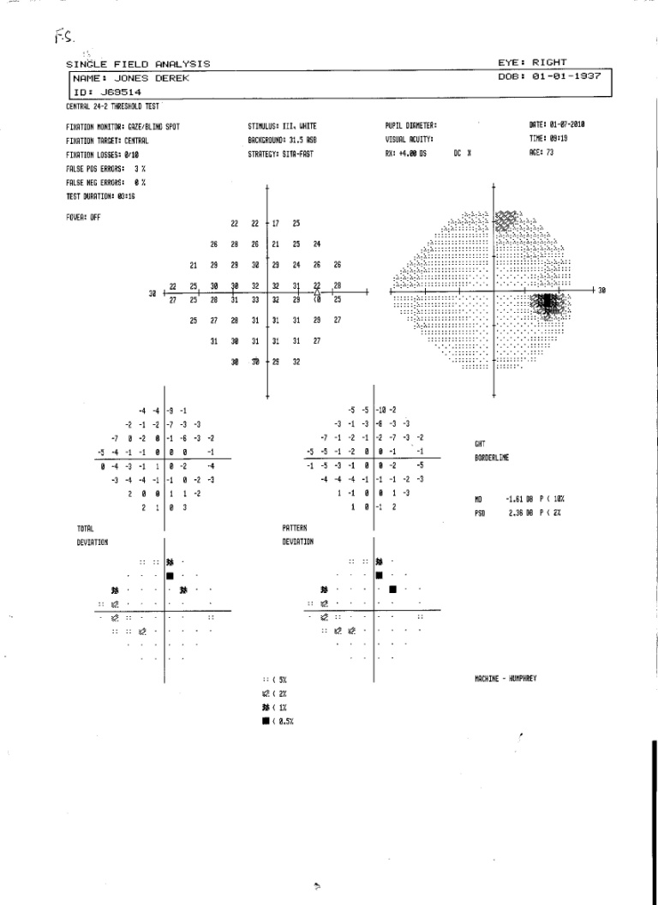
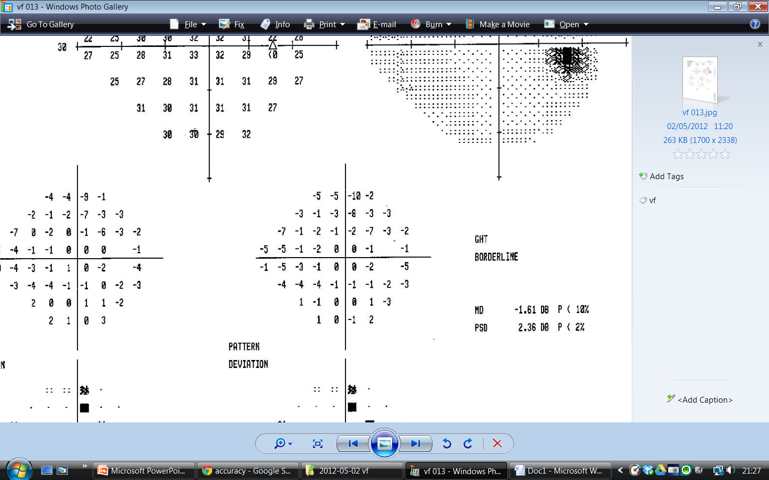
Early VFD

Slide 34
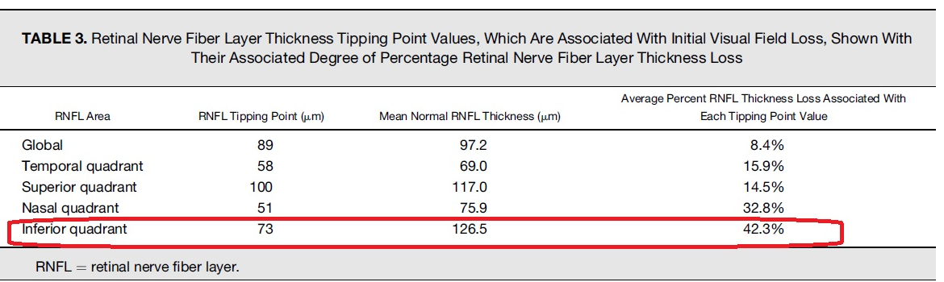
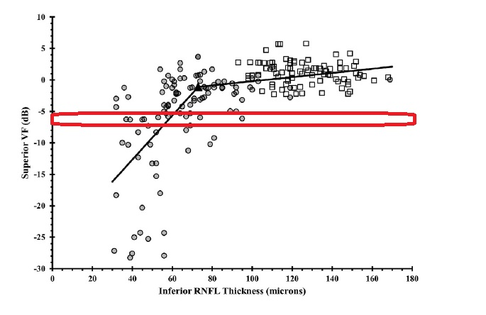
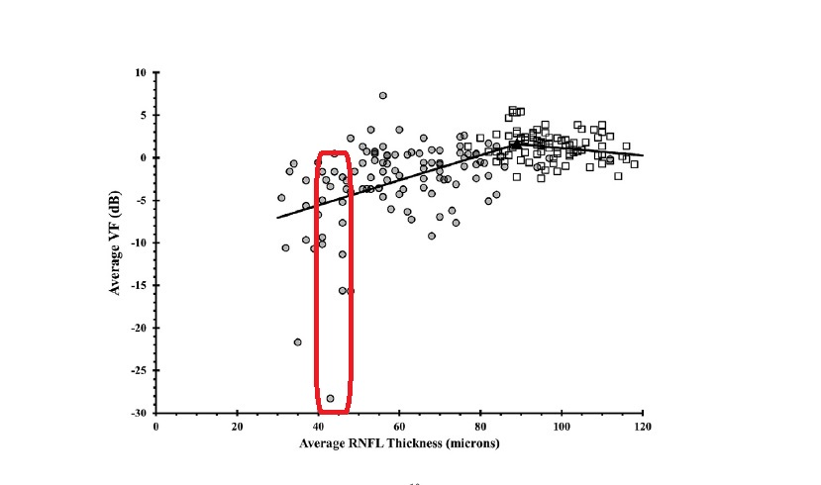
Structure/Function Relationship

Slide 35
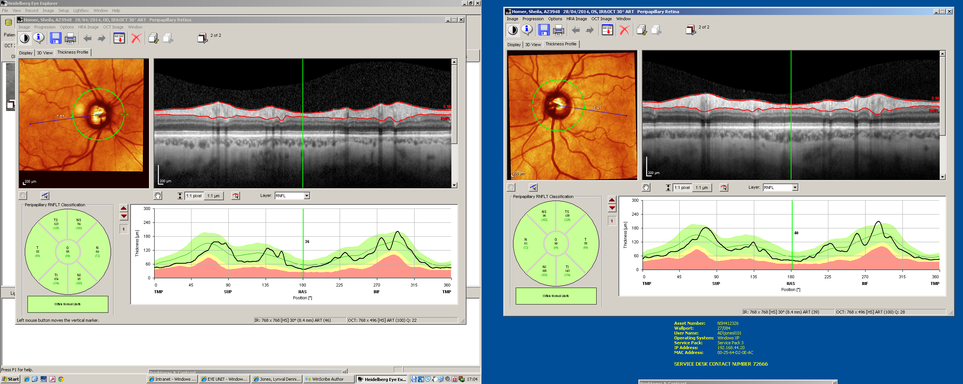
Revolutionised Glaucoma Management
Case 1
80 y/o woman
2007 OO referral
15 IOP 16mmHg
550 CCT 565
Normal HVFs
Phasing –IOP=16mmHg
CDR?
Diagnosis?
Management?

Slide 36
Case 1

Slide 37
BUT-New technology
- new problems-
  Increase OCTs in optometry
  Increase incidence of False⁺ (RED DISEASE)
  Risks associated with False⁻ (GREEN DISEASE)
  in community – progression/late presentations
  Glaucoma “resource allocation paradox”
The need for correct interpretation of “variations”

Slide 38
Causes of False positives
“Red Disease”

Slide 39
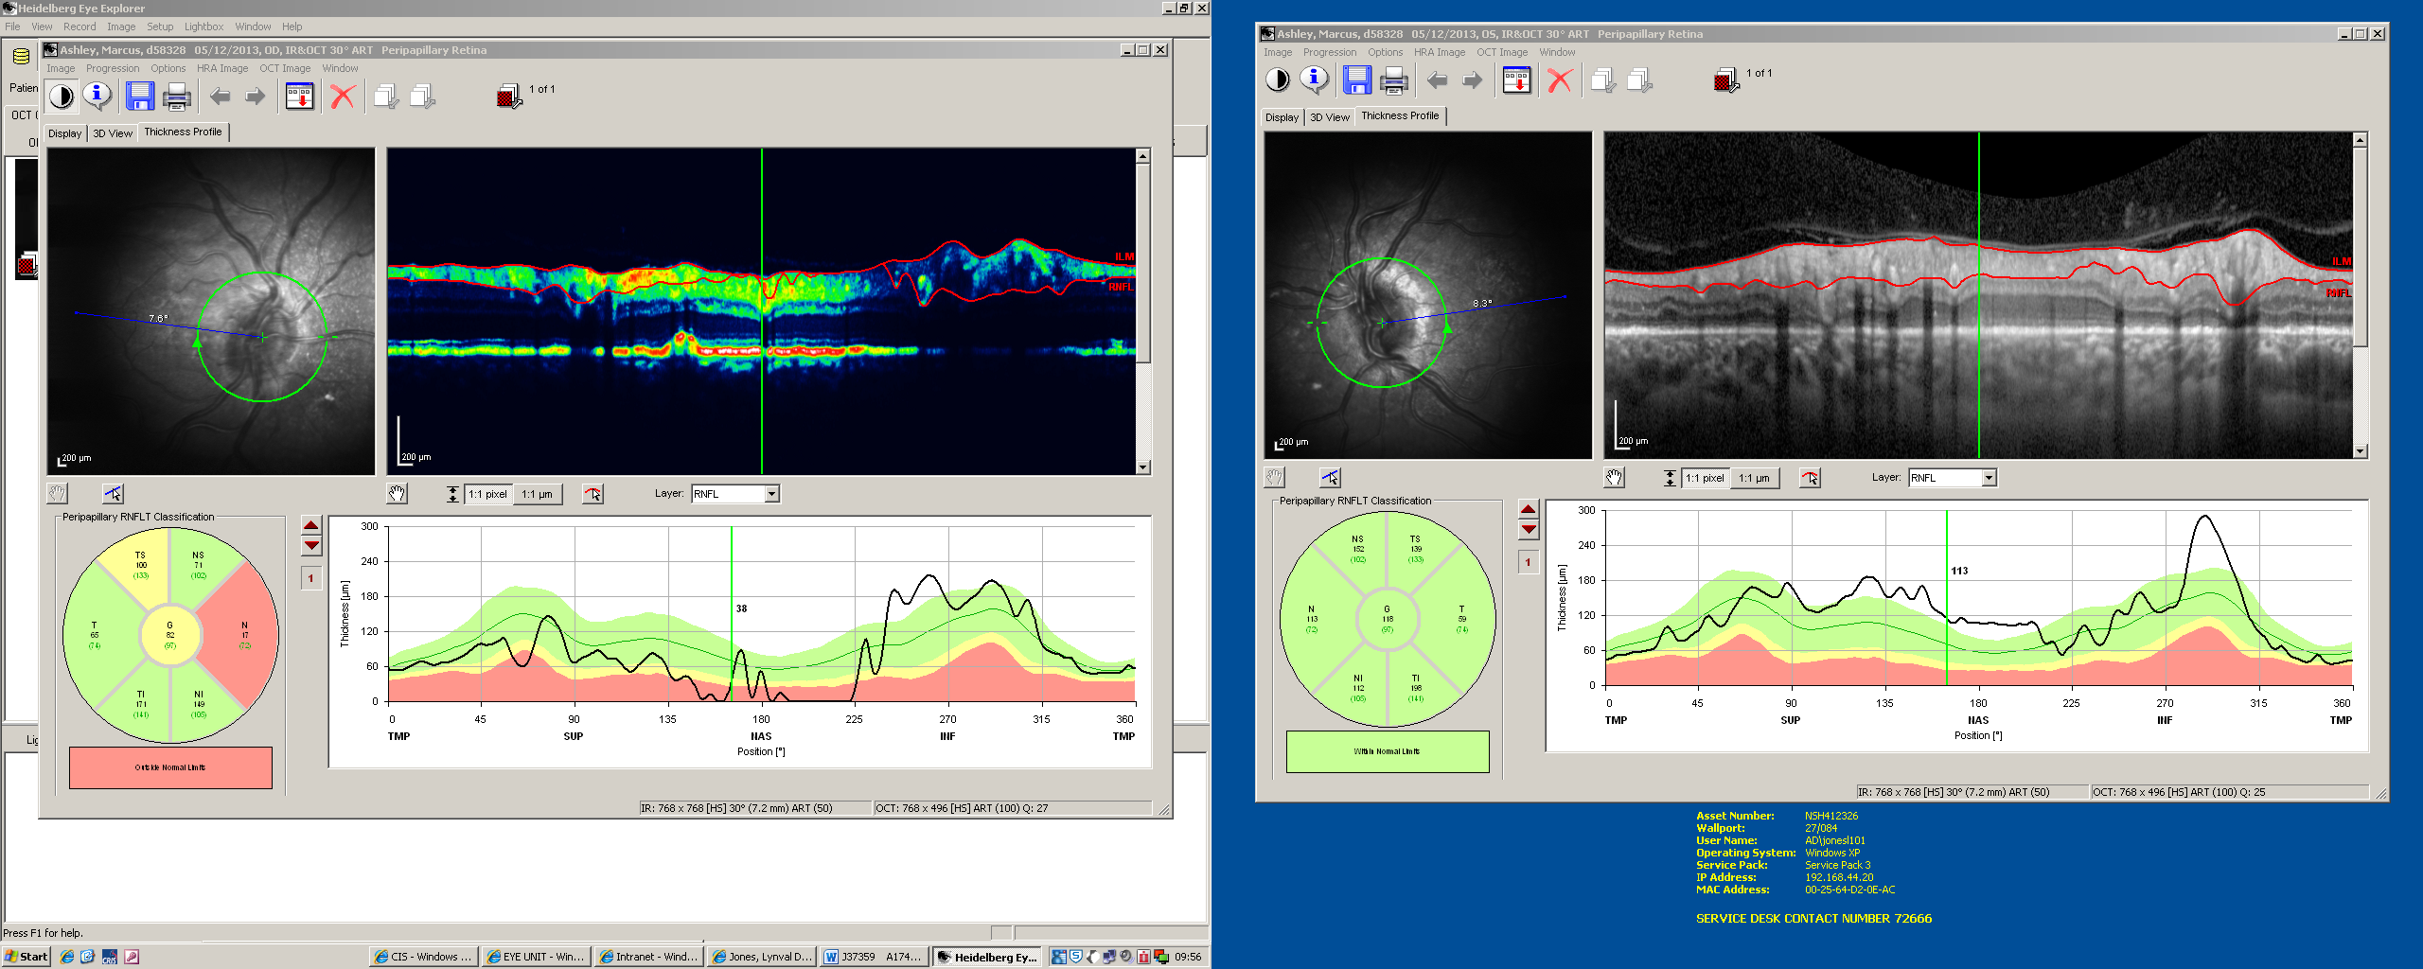
Case 2

Slide 40
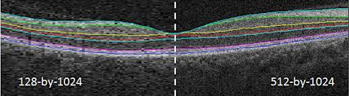
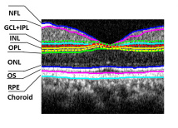
Inaccurate segmentation

Slide 41
Inaccurate segmentation- false positive

Slide 42
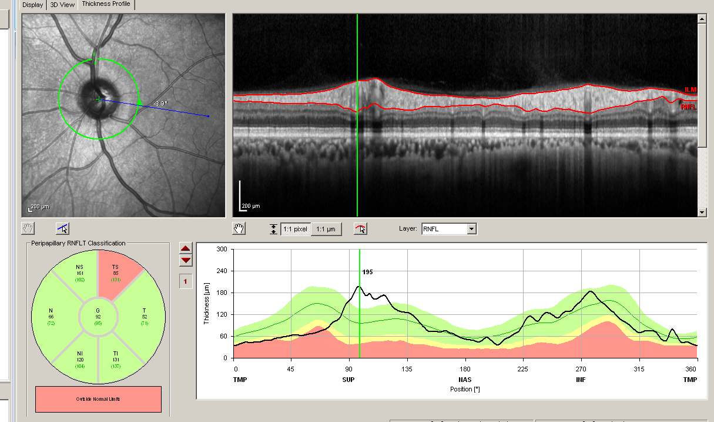

Slide 43
Position of major vessels

Slide 44
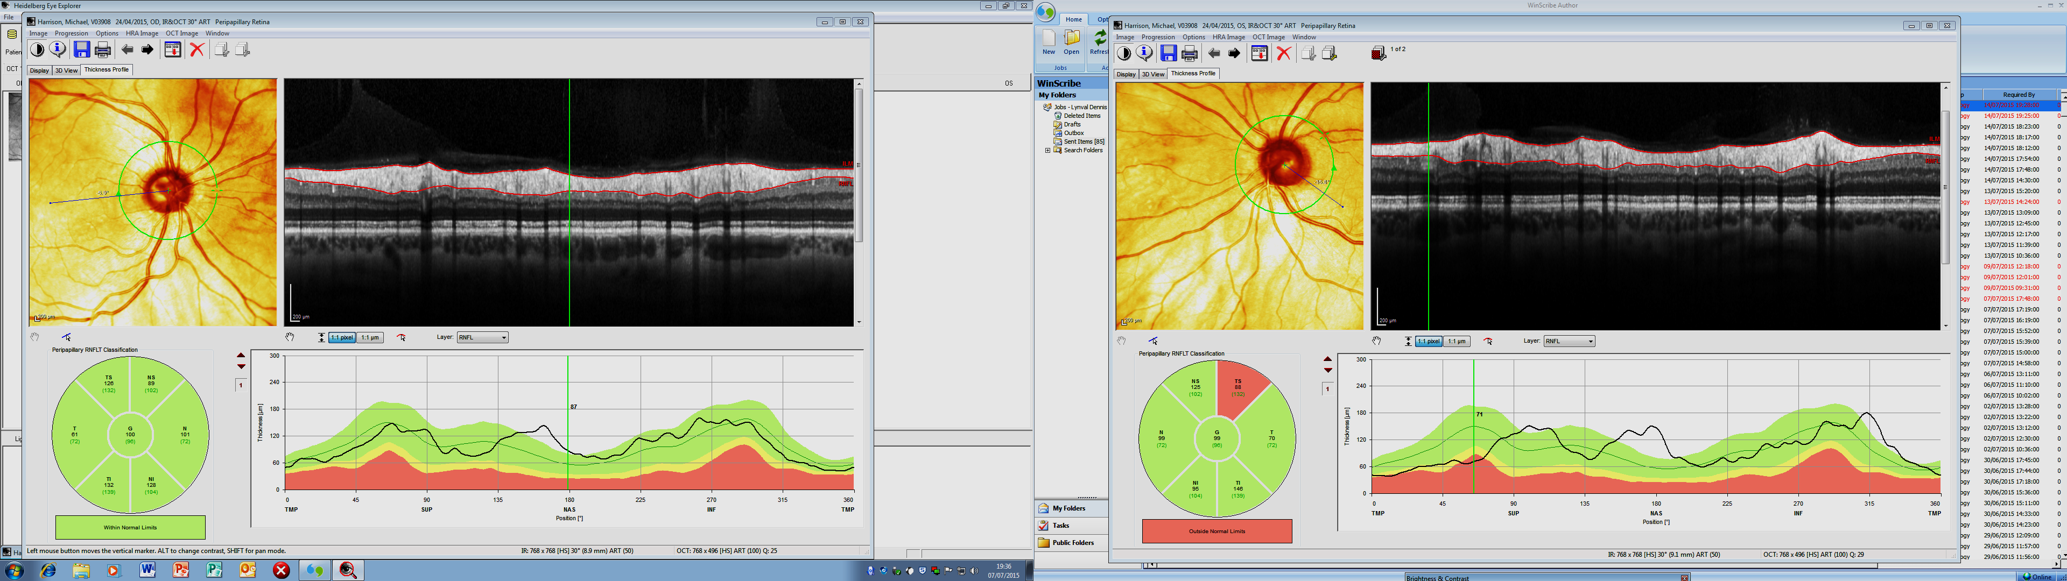

Slide 45
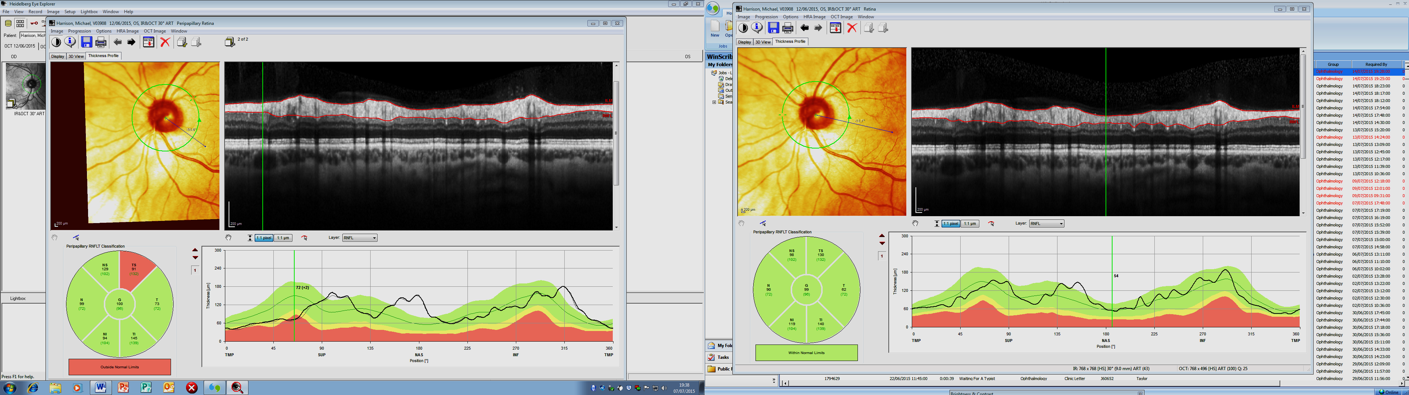
FoDi misalignment

Slide 46
Causes of False negatives
“GREEN DISEASE”

Slide 47
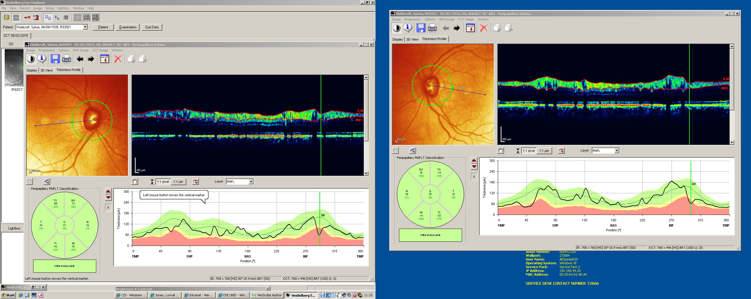

Slide 48
Summary Measures- false negative
Notes:
For VFD =(-6dB) wide variation in mean RNFLT, so profile is more accurate.

Slide 49
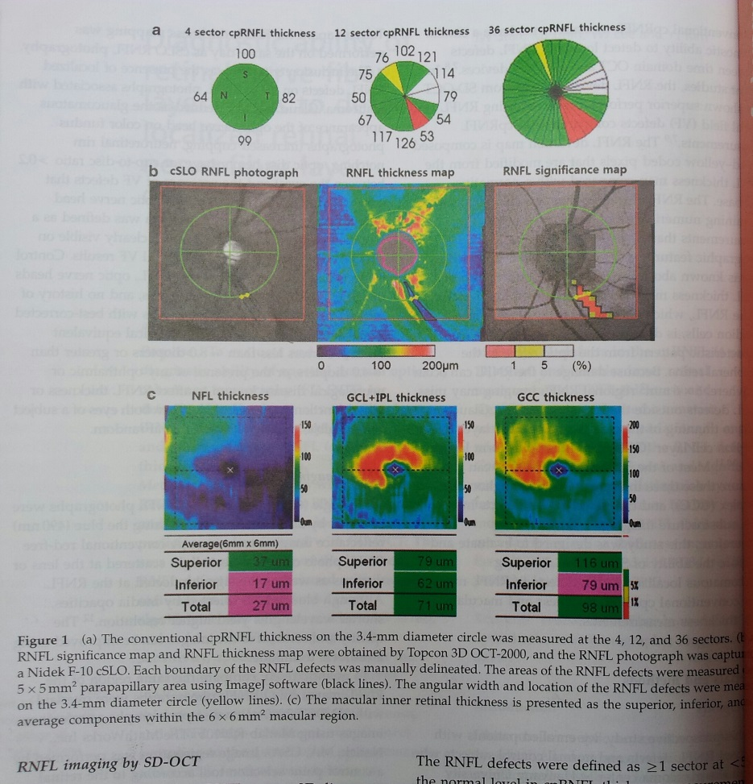
Summary measures

Slide 50
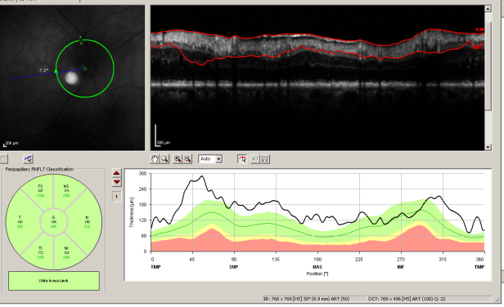
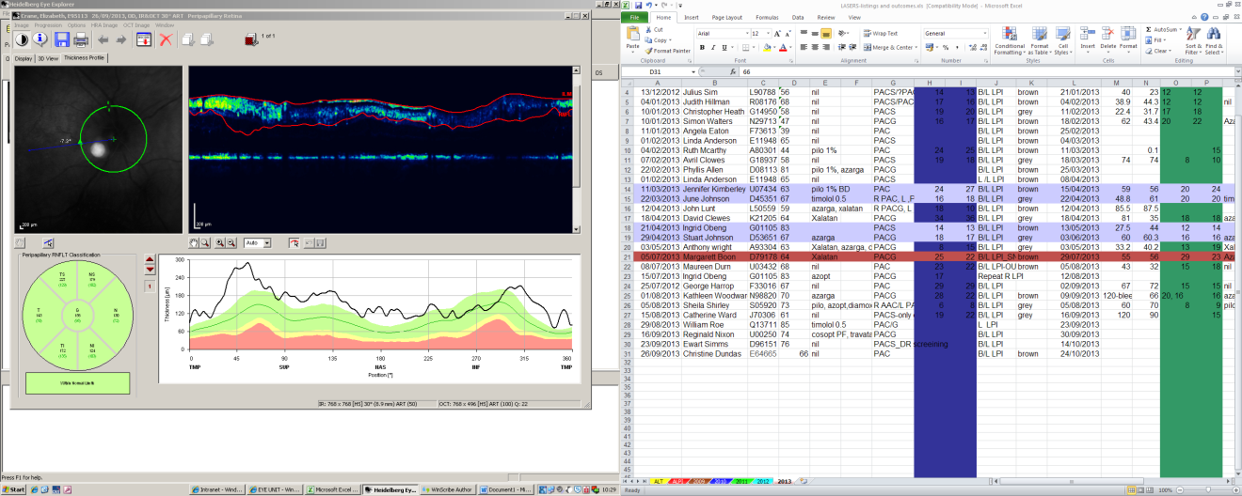
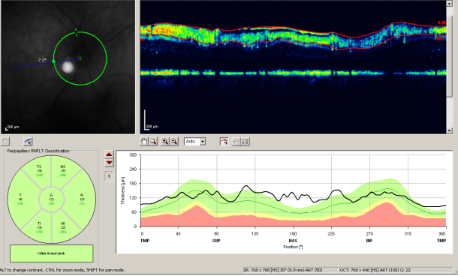

Slide 51
Inaccurate segmentation

Slide 52
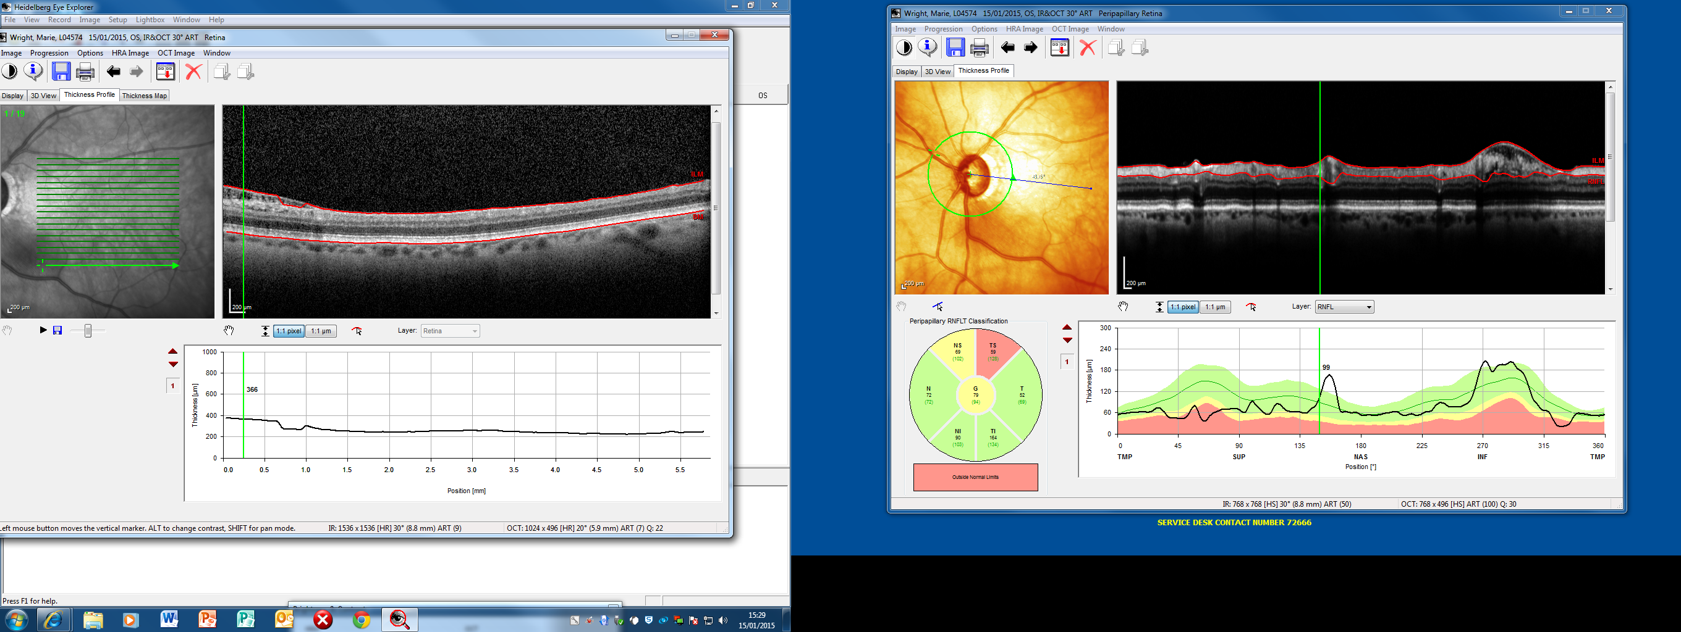
Disc assessment?
ST sector loss
But IT sector loss?
Both?

Slide 53
Parapapillary retinoschisis

Slide 54
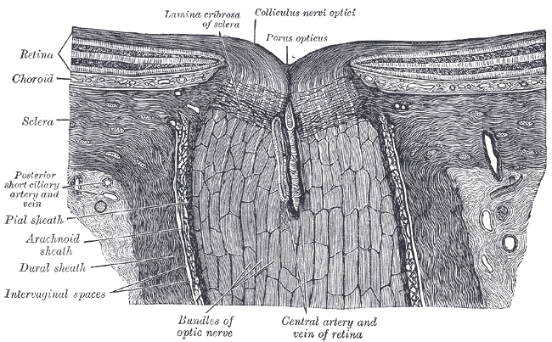
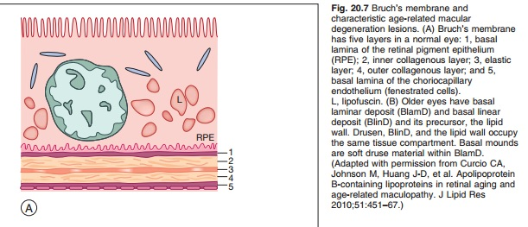
Anatomy of the optic nerve head
Basement membrane opening

Slide 55

OCT BMO rim analysis

Slide 56

OCT BMO rim analysis

Slide 57


Slide 58


Slide 59


Slide 60


Slide 61


Slide 62

OCT angiography (ONH perfusion)

Slide 63
Optic Disc Pit (En Face OCT)

Slide 64
Conclusion
Clinical assessment is still an art
Technology classify
Clinicians diagnose
Know our instrument
Diagnose OHT/glaucoma not red/green disease.

Slide 65


UBM images

Slide 66

Glaucoma Hemifield Test
Very sensitive in detecting early glaucomatous field loss
GHT
  Normal
  Borderline –upper & lower differ < 3% of normals
  Outside normal limits –upper & lower differ < 1% of normals

Slide 67


