Slide 1
GRR Service Review MAY 2016
Irfan Razvi BSc (Hons) MCOptom
Clinical Governance & Performance Lead(CGPL) for Glaucoma Services
DIRECTOR Primary Eye Care (Shropshire & Staffordshire) Ltd
INDEPENDENT OPTOMETRIST

Slide 2
GRR
GRR = Glaucoma Referral Refinement Service; response to NICE guidelines 2009 to root out false positives referrals.
Locally, began life as a pilot in 2011, involving 5 Stafford practices
Expanded to 13 Stafford and Cannock practices & 23 Optoms in July 2015
2 levels of refinement for IOPs>21 - Test A and Test B*
Notes:
*Accred vs Non-accred number

Slide 3
GRR – Service Exclusions
Please note that the GRR pathway is IOP mediated so theoretically you should not be seeing many ‘obvious’ glaucomatous discs.
Any suspect glaucomatous disc signs &/or occludeable anterior chamber angles &/or glaucomatous field defects, you must refer this patient into HES - not into GRR!
IOPs>31 = same day referral EEC
Unexplained VF loss (may be suitable for PEATS)
RCOpht & College Optom guidance for non-referral of patients with low risk of significant visual loss in their lifetime
- Age > 80 & IOP<26, Age > 65 & IOP <25
Notes:
Glaucoma=neuropathy

Slide 4
GRR – Test A Guidance
These are patients who have been referred in with IOP >21 mmHg in the absence of any confirmed signs of glaucoma. Ideally, GAT should be performed immediately after eye examination. Please note that GAT tonometry is the preferred gold standard to deliver this service but Perkins tonometry is also accepted.
On receiving referral from unaccredited Optometrist, you/your practice must contact the patient within 48 hours to make an appointment. The patient should then be seen within 2 weeks.

Slide 5
GRR- Test A Guidance (2)
There are 4 possible outcomes after Test A:
All patients with IOP >25 mmHg should be referred for OHT diagnosis without further IOP refinement
Other patients with a pressure of 22 - 25 need to proceed to Test B
Pressures which differ between the eyes by 5 mmHg or more should proceed to Test B
IOPs < 21 mmHg are within normal limits and the patient can be discharged. (When patient is discharged at this stage, please ensure you inform the referring Optometrist).

Slide 6
GRR- Test B Guidance
For Test B, the patient must be seen within 3 weeks of Test A. Do enquire about patient history & symptoms, risk factors, family history of glaucoma and measure VA. Then perform the following tests:
Threshold Visual field exam (min. 60 point central threshold test) eg: Humphrey SITA 24-2 or equivalent
Van Herrick test (anterior angle assessment)
Repeat GAT
Dilation & Volk optic disc assessment (stereo view)

Slide 7
GRR – Test B Guidance (2)
After Test B, there are 3 possible outcomes:
Any patients with IOP <=21mmHg should be discharged
If there is a difference in IOP of >=5mmHg between the eyes then consider referral to secondary care HES.
The following patients are referred to HES for OHT diagnosis:
-Age <65 yrs, IOP >21mmHg
-Age 65-79yrs, IOP > 24mmHg
-Age 80yrs+, IOP > 25mmHg
(IF you do note positive signs of Glaucoma, angle closure etc at this stage, then refer to secondary care)

Slide 8
GRR - Activity
This contract commenced on the 20th July 2015 and is due to run for a three year period.
Activity for the GRR scheme has been consistently below the indicative activity used when developing the contract which suggested an average of 138 Service Users would access the GRR scheme per month across both CCGs.
However, as the following graph illustrates, activity has been steadily increasing, particularly for Service Users within the boundaries of Stafford & Surrounds CCG.

Slide 9
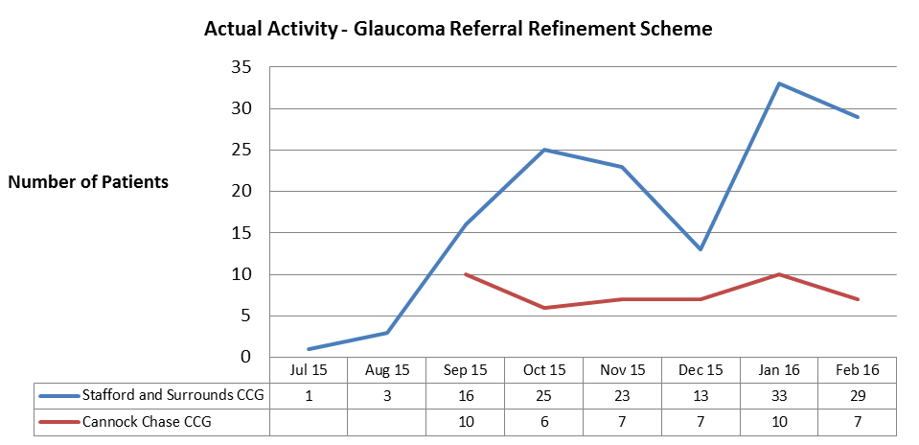

Slide 10
GRR – Service Activity
Since the contract started, 29.5% of Service Users who underwent Test A also completed Test B:
23.1% of Service Users completing Test B – Stafford & Surrounds CCG
6.4% of Service Users completing Test B – Cannock Chase CCG

Slide 11
GRR – Service Activity
There are currently 13 practices accredited under this contract to provide services under the GRR scheme. However, according to the data submitted by Webstar, only 7 practices have been delivering services so far under this contract!

Slide 12
GRR – Local Quality Requirements
Under Schedule 4C of the contract, the Glaucoma Referral Refinement Scheme is measured against the following KPIs:
95% of Service Users are contacted by the service within 48 hours of referral. (Measured monthly)
95% of Service Users are seen by the service within 2 weeks of referral. (Measured monthly)
95% of Service Users report positive experience of the service (responses to be either ‘extremely likely’ or ‘likely’). (Measured annually).

Slide 13
Ref. | Local Quality Requirement | Threshold | Jul-15 | Aug- 15 | Sep- 15 | Oct- 15 | Nov- 15 | Dec- 15 | Jan- 16 | Feb- 16 | Mar- 16 | YTD
GRR_ LQR_ 1 | Service Users are contacted by the service within 48 hours of referral | 95% | 100% | 100% | 100% | 100% | 97% | 100% | 100% | 97% |  | 99%
GRR_ LQR_ 2 | Service Users are seen by the service within 2 weeks of referral | 95% | 100% | 100% | 100% | 87% | 87% | 90% | 81% | 83% |  | 91%
GRR_ LQR_ 3 | Service Users report positive experience of the service (annual) | 100%

Slide 14
GRR contract– Service User Outcomes
One of the primary aims when commissioning this GRR scheme was to reduce unnecessary referrals into secondary care for OHT and suspected glaucoma by 75%.
Since this contract commenced, 80% of patients were discharged from the service. Resulting in only 18% of Service Users being referred to secondary care (Table follows):

Slide 15
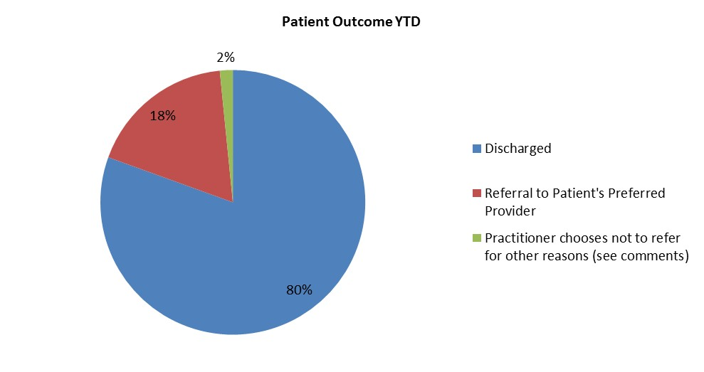

Slide 16
GRRS – Take Home Message 1
Firstly, well done to you all for your support and input to date. The commissioners are impressed with the significant deflection of referrals into secondary care demonstrated by both the PEATS and GRR pathways. However, they are disappointed with the low uptake of GRR by newly-accredited practices so far.
SASPEC fully understands that the time taken to complete the GRR form on the IT module exceeds the time taken to perform Test A, which can be a disincentive to its use. However, GRR and PEATS subcontractor practices are advised to make full use of both services, as they are pilot schemes only, and there is a very real risk that they could be withdrawn by the commissioners if they are not fully utilised (& in the correct way).

Slide 17
GRR – Take Home Message 2
Such an outcome would be a great shame, not least as SASPEC’s directors and clinical leads have taken a significant amount of time out of their busy practices in order to mobilise both services.
It would also negatively impact upon SASPEC’s current and future efforts to seek commissioning of the same/new services via the company model elsewhere in Staffordshire.
Last message is for those not yet part of the GRR scheme - GRR, PEATS are an excellent opportunity to use the full spectrum of your clinical skills (and get paid for it!*). They also provide a welcome variation to routine sight testing regime. JOIN THE REVOLUTION!
Notes:
* Vs GOS burden

Slide 18
...and not forgetting...
Once consultation finished, give every patient a PROMS form to complete!
Ensure that patient episode details (including PROMS!) are entered on to GRR module, immediately following completion of Test A, to avoid skewing of data (eg LQR 2: Test A within 2 weeks after sight test)

Slide 19
For all GRR needs, contact…
Secretary: Alison Lowell (admin@staffsloc.co.uk)
Tel: 01785 - 887937
CGPL: Irfan Razvi (sihrazvi@yahoo.co.uk)
THANK YOU FOR LISTENING!..

Slide 21
Notes:
random

Slide 22
Welcome!
Lynval Dennis Jones FRCOphth MBBS MMedSc
Consultant Ophthalmologist at RSUH (UHNM)
Glaucoma Consultant & Cataract specialist
Instrumental in working with LOC to launch GRR & OHT/suspect COAG monitoring pathways in North Staffs (2009)*
Current Ophthalmology mentor for SASPEC with GRR & Glaucoma enhanced services.
Todays talk: Glaucoma diagnosis - Face off: Slit lamp vs OCT
Warm welcome please!!

