Slide 1
Angle Closure Glaucoma
Mrs Punitha Ranjit
MS FRCS Consultant Ophthalmologist/Glaucoma
Royal Stoke University Hospital

Slide 2
ACG
Nearly half of all glaucoma blindness worldwide.
Wright C, Tawfik MA, et al. PACG : An Update. Acta Ophthalmol. 2016 May:94(3):217-25.
PACG is a more visually destructive form of disease than primary open-angle glaucoma
Major demographic risk factors
Older age
Female gender
Asian ancestry
Zhang, Wang et al. Prevalence of PACG in the last 20 years. Front Med (Lausanne)2020;7:624179.

Slide 3
ACG
Classification should identify the mechanism responsible for angle closure and the stage of disease in terms of its natural history

Slide 4
ACG
Ocular biometric risk factors:
Hypermetropic refraction with smaller anterior segment dimensions
Narrower drainage angle with shallow AC
Smaller corneal diameter
A thicker lens, a more anteriorly positioned lens, a shorter axial length, all acting to form a shallower anterior chamber.
Amerasinghe N, Aung T. Angle-closure:risk factors, diagnosis and treatment. Prog Brain Res. 2008;173:31-35.

Slide 5
ACG
All these signs should be considered in the management plan
Good grading system of the anterior segment
Complex process – needs training and experience

Slide 6
ACG
Classification of ACG
Based on presence or absence of symptoms
Acute
Sub-acute or Intermittent
Chronic
For use in prevalence Surveys
Primary angle closure suspect – Irido-trabecular Contact with normal IOP, disc and visual field
Primary angle closure – ITC + raised IOP with symptoms
Primary angle closure glaucoma – ITC + ↑IOP + disc changes with field loss
NICE Guidelines

Slide 7
ACG
Gonioscopy
key diagnostic skill in detection and management of PACG
All ophthalmologists and Optometrists with specialist interest in Glaucoma should aspire to master this.
Useful references: www.gonioscopy.org
www.wopec.co.uk
Van Herricks assessment of Anterior Angle in clinical practice is a common method, easily done using a slit lamp.
Can be accomplished by all Optometrists.

Slide 8
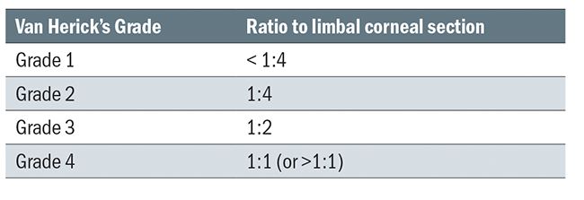
Van Herick’s Technique
It involves comparing the size of an optic section width on cornea to the gap between the section and reflection of iris, when a beam is just within the limbus at an angle of 60°
Gd 2 and below- angle closure possible/very likely.
Gd 0 – Angle closure indicated.
Original Angle Grading: A Decimal Scale for Accuracy Optician Online Published August 2014

Slide 9
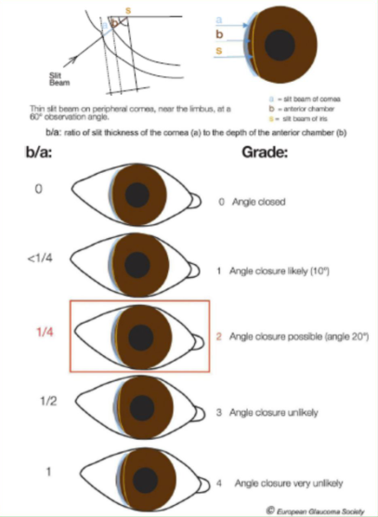
Van Herick’s Technique European Glaucoma Society Terminology and Guidelines for Glaucoma, 4th Edition - Part 1 Supported by the EGS Foundation British Journal of Ophthalmology 2017;101:1-72.

Slide 10
Gonioscopy Grading of Angle
Schaffer system
Grades are given from I to IV. A grade one means the angle is very narrow (about 10 degrees) and the patient is at risk for an angle closure attack. A IV means the angle is wide open
Spaeth system
more complex
It offers more information
Angle degree,
Iris contour
Area where the iris inserts into the eye Wallace L M, Alward MD, Reid A Longmuir MD. Colour Atlas of Gonioscopy. Second Edition. Gonioscopic Grading Systems. American Academy of Ophthalmology.

Slide 11
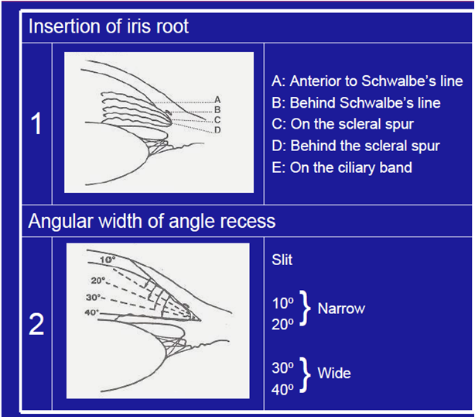
Spaeth Classification Images from Royal Stoke University Hospital Teaching Library

Slide 13
ACG
Occludable angle
Posterior pigmented trabecular mesh-work is obstructed by the peripheral iris for three quarters or more
Real challenge – identifying and effectively managing the asymptomatic chronic angle closure
Missing the opportunity to diagnose narrow angles due to appositional closure

Slide 14
ACG
Trabecular-meshwork damage
Appositional closure
causing a pre-trabecular outflow obstruction
Long term low-grade contact – alteration of TM structure and function
Synechial closure
Extent of closure associated with degree of increased IOP
Irido-trabecular and trabecular Meshwork dysfunction – elevated IOP – Glaucomatous optic neuropathy – Glaucomatous functional loss - blindness

Slide 15
Causes of ACG
Anatomic levels
Iris – Pupillary block – 75% of cases
Ciliary body – Plateau Iris
Lens – Phacomorphic
Vitreous – Malignant glaucoma
More than one mechanisms
Quigley H, Friedman D, Congdon N. Possible Mechanisms of Primary Angle Closure and Malignant Glaucoma. J Glaucoma. 2003 Apr;12(2):167-80.

Slide 16
Angle width in light and dark Images from anonymous patient Royal Stoke Hospital

Slide 17
Effects of angle closure
Corneal endothelial loss
Trabecular meshwork damage
Lens damage (glaukomfleken and cataract)
Iris damage
A flat, pale optic disc
Glaucomatous optic neuropathy
College Of Optometrists Clinical Guidelines is an excellent resource for overview of signs and symptoms as well and management.

Slide 18
Pupillary Block
Iris and Pupil – Pupillary Block
Most common form – 75% of the cases
Resistance to aqueous flow through pupil
Relative pressure gradient between the anterior and posterior chambers → ant iris bowing → convex configuration
Narrowing the angle – acute or chronic ITC/ACG
Ahram D, Alward W, Kuehn M. The genetic mechanisms of PACG. Eye 29, 1251-1259 (2015)

Slide 19
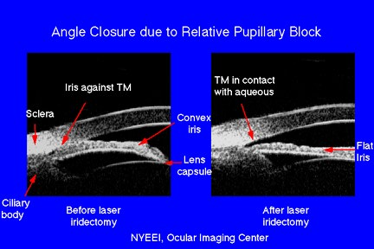

Slide 20
Plateau iris
Ciliary body architecture – Plateau iris
Abnormal ciliary body position – anteriorly positioned ciliary process – force the peripheral iris into the angle
Extent to which the plateau rises determines whether the angle will close completely or partially
Quigley H, Friedman D, Congdon N. Possible Mechanisms of Primary Angle Closure and Malignant Glaucoma. J Glaucoma. 2003 Apr;12(2):167-80.

Slide 21
Plateau iris
Indentation gonioscopy - double-hump sign
Peripheral hump - by the ciliary body propping up the iris root,
more central hump - central third of the iris resting over the anterior lens surface.
The space between the humps - the space between the ciliary processes and the endpoint of contact of the iris to the anterior lens capsule
Closure of the iridociliary sulcus is the hallmark of plateau iris on UBM
Wallace LM, Alward, Review Of Ophthalmology April 2008.

Slide 22
Plateau iris
Angle can narrow further with age – enlargement of lens
PI – relieves the pupillary block not the narrowing due to the abnormal ciliary body position
Plateau iris syndrome
Angle closure
Spontaneously
After pupillary dilatation
despite the presence of patent iridotomy

Slide 23
Plateau iris
complete or incomplete syndrome
Incomplete plateau occludes the angle to mid level, leaving the upper portion of the filtering meshwork open and IOP unchanged
patients with open angle after iridotomy should not be assumed to be cured. The angle can narrow further with age, and angle closure can occur years later.

Slide 24
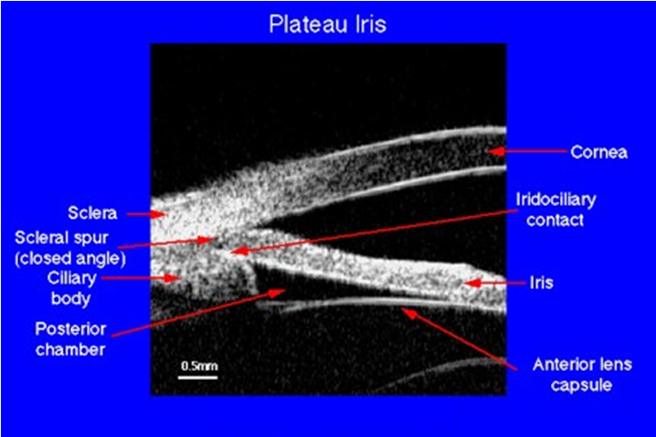

Slide 25
Plateau iris
Should be suspected –
In young or myopic patients
Angle narrowing persists despite iridotomy.
Plateau iris is seen most commonly in women.
Patients are younger than those with primary angle-closure (relative pupillary block) glaucoma.

Slide 26
Phacomorphic glaucoma
↑ lens thickness in cataract - ↓AC depth
Gradual narrowing of the angle – CNAG
Acute angle closure with pupillary block
Anterior position of lens –
“Lowe” found shallower AC in ACG and developed an index of RLP
Relative lens position(RLP) = AC depth + ½ axial length
66% - anterior position of lens
33% - increases lens thickness
Tarongoy P, Ching Lin Ho, Walton D. Angle-closure Glaucoma; The Role of the lens in the Pathogenesis, Prevention and Treatment. Survey of Ophthalmology. 54(2), March-April 2009

Slide 27
Phacomorphic glaucoma
Also noticed shorter axial length
In Europeans close correlation between thickness of the lens and ant curvature of the lens
Lens become more steeply curved with advancing age.

Slide 28
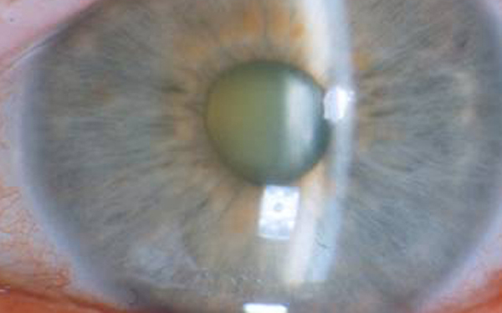
Phacomorphic lens with shallow AC Following images from Royal Stoke University Hospital Teaching Library

Slide 29
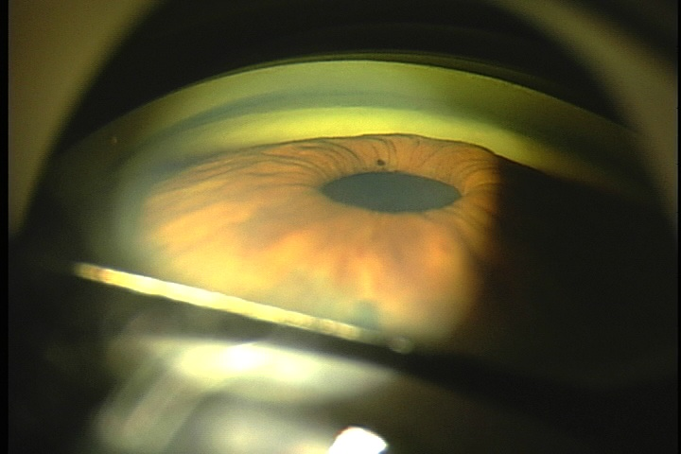

Slide 30
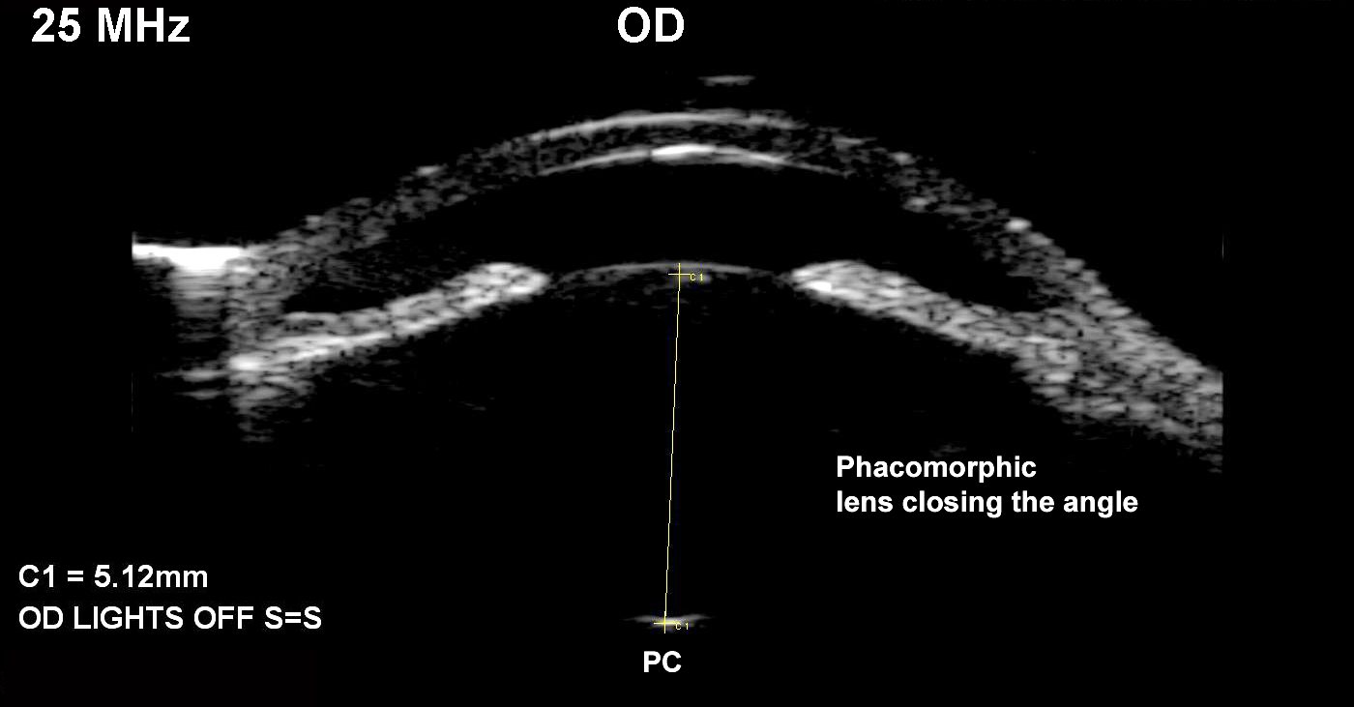

Slide 31
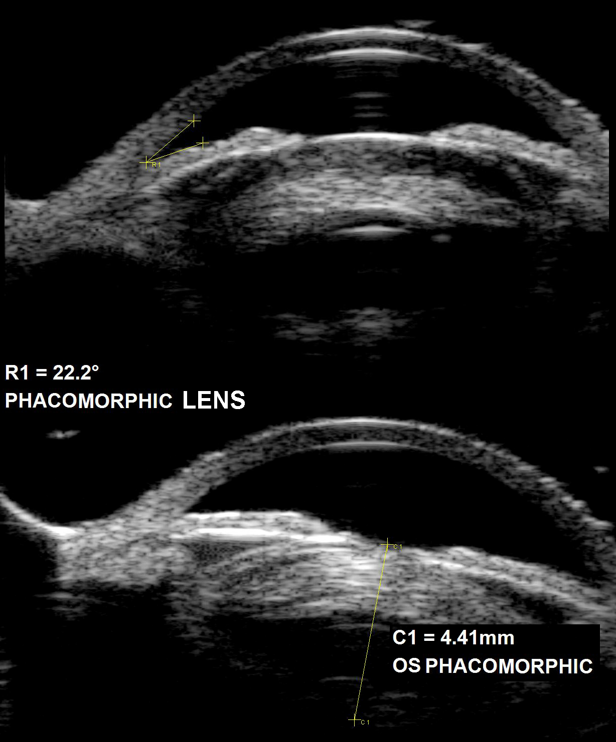

Slide 32
Treatment
Angle closure with significant cataract – extraction of lens is the first intervention
Pupillary block is the predominant mechanism- laser iridotomy
20 to 25% still have residual appositional angle closure afterwards.
Lens thickness and position – lens extraction
Lens extraction with gonio synechialysis may be effective even after 6 months.
Combined cataract extraction with trabeculectomy
Bell P.B, Nguyen D. Managing Primary Angle Closure. Lens extraction or peripheral iridotomy? Sept/Oct2012. Accessed from https://glaucomatoday.com/articles/2012-sept-oct/managing-primary-angle-closure. [Accessed May 2021]
Nolan W. (2006) Lens extraction in primary angle glaucoma. Br J. Opthalmology. 90(1):1-2

Slide 33
Prognosis ACG
Untreated angle closure glaucoma can cause blindness in one eye – 33 to 75% compared to 11 to 27% in COAG.

Slide 34
Summary
Primary angle-closure glaucoma is responsible for half of all glaucoma blindness worldwide
Older people, women and Asians are high risk demographic groups
Most angle closure is asymptomatic
Laser iridotomy is very effective in the early stages of disease.

