Slide 1
LOCSU Presentation 2022
Staffordshire LOC
Fionnuala Kidd Optical Lead
30/06/22

Slide 2


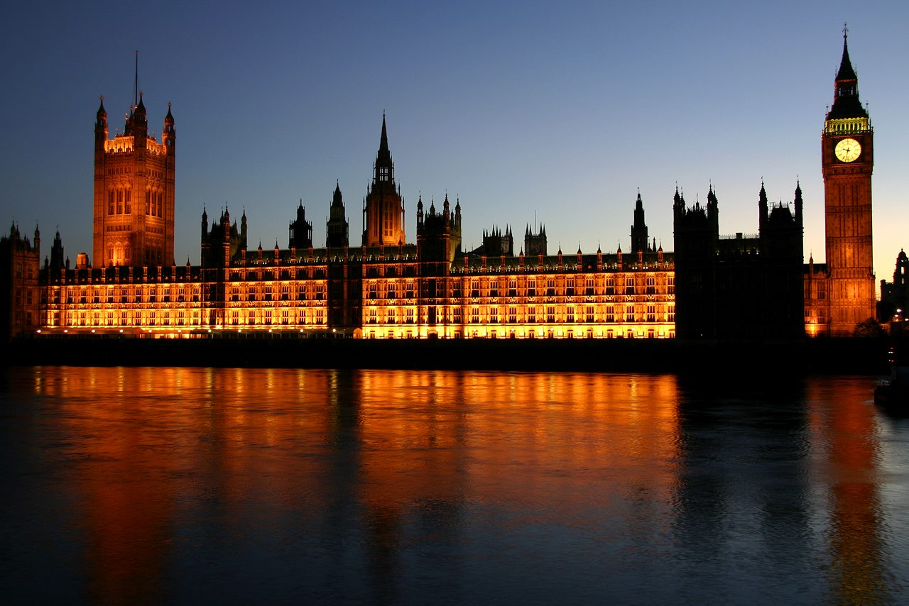
NHS 2.0
  Top-to-bottom reform
  Meet demographic and technological change
  Reforms must work – no Plan B
Notes:
As of March 2022, Bill is at latter stages of Lords’ scrutiny and the core objectives (as per LTP and White Paper) remain.
Competition to be replaced by cooperation (removal of mandatory tenders)
Commissioner-provider split to be eroded
CCGs being replaced by ICSs
Government wants significant ‘system’ budget devolution to ‘place’)
National commissioning (GOS) going to ICSs? Future of regional (area) teams uncertain

Slide 3

Optometry First
Continuity of care for existing conditions
Comprehensive first contact care
Notes:
Support from whole sector:
Primary/secondary collaboration
End-to-end pathway redesign
Includes cataract; glaucoma; medical retina; urgent care; LD.
Sixteen areas expressed an interest: three now chosen (Bassetlaw; Sefton; Isle of Wight):
Build evidence base
Test operational and financial model
Service blueprint being developed for 2023 implementation.

Slide 4
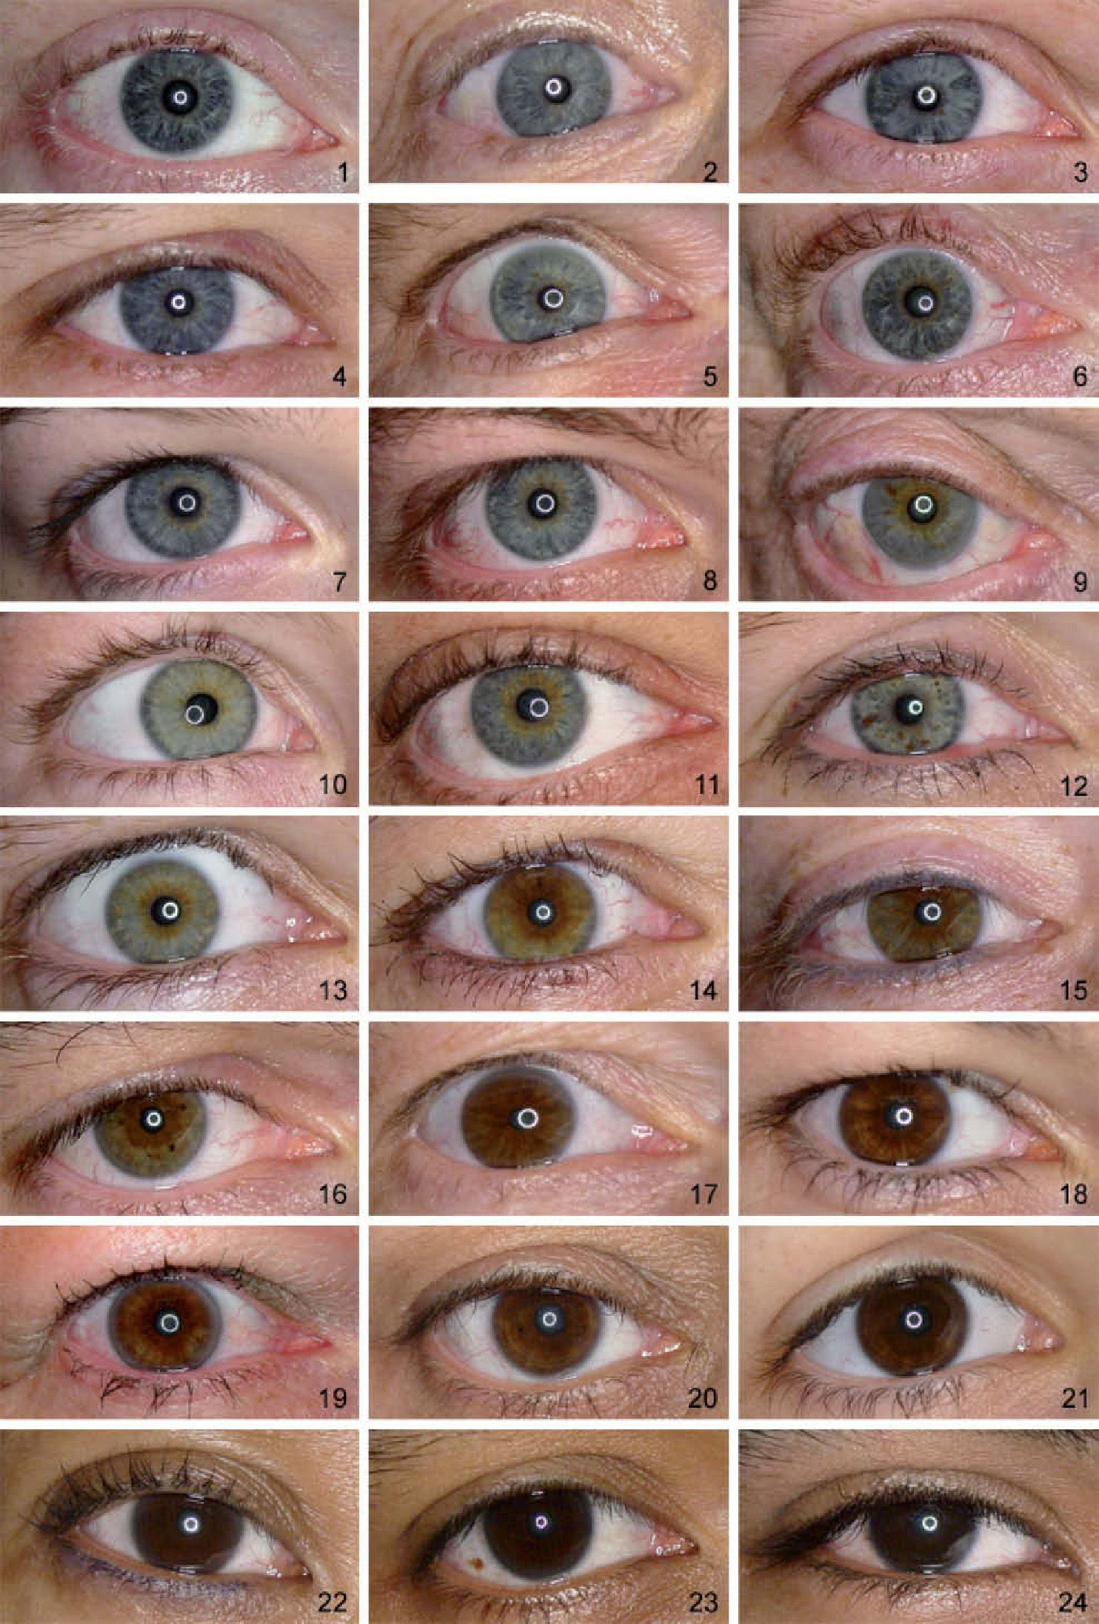
National Eyecare Recovery Transformation Programme (NECRTP)
NECRTP born of NHS 2019 Long Term Plan and 2021 White Paper:
  More primary care/out of hospital care
  Integration and prevention.
NECRTP aims:
  Improve patient outcomes
  Develop integration
  Serve as an exemplar: ophthalmology first specialism.
Notes:
NECRTP Guidance 22/23
care navigation
referral triage/redirection
Signposting
discharge into existing services

Slide 5
Planning Guidance 22-23
25% FU reduction (on 19/20 levels) by March 2023
Shift to patient-initiated follow-up (PIFU)
Focus and increase on elective (30% increase by 24/25)
Targets particularly relevant to ophthalmology:
Notes:
Priority areas from 21/22 retained:
Eye care diagnostic and digital services
Enabling optometry (primary care)
Efficient injections
Routine post-op cataract discharge
Reducing multiple cataract pre-ops
Reduce unnecessary FUs

Slide 6
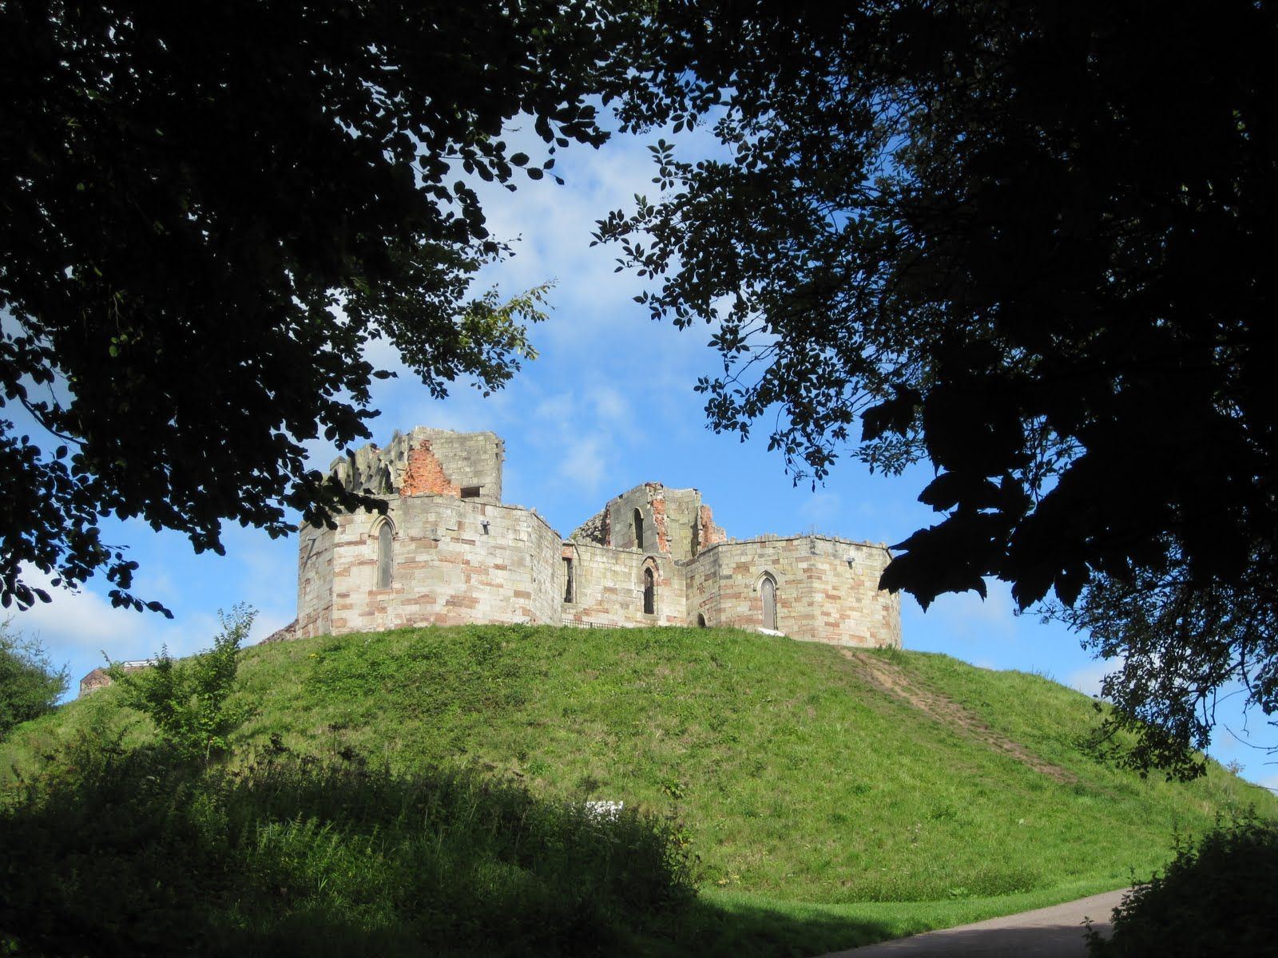
LOCAL PICTURE
Really good engagement with LOCs Locally and within ICS
Enhanced Case Finding
AMD Filtering service
PCN Engagement – LOC Leads

Slide 7
Thank you
Fionnuala Kidd
Email:fkidd@locsu.co.uk
Phone: 07929354714
Twitter: @kiddoptom

