Slide 1
Referral Refinement Event
24th January 2019
North Staffs
Staffordshire LOC

Slide 2
Why does it matter
Effective communication is paramount for both legal and patient care requirements
Effective communication contributes to our patients experience
It helps to build on our close working relationship with our ophthalmology colleagues
Too much/irrelevant information can be as unhelpful as a poor referral.
With the correct information, our patients are more likely to be seen in the correct clinic and the right timeframe.

Slide 3
General Referral rules to follow
Be concise
Be legible
Give an idea of action required and reason for referral
Follow College clinical management guidelines
Be decisive

Slide 4
Medical Retina Update
Dr Andrew Brown
24/1/2019

Slide 5
Naevus Clinic Update
Diabetic Retinopathy Update
Hydroxychloroquine Screening

Slide 6
Naevus Update
Lesions over 2 DD refer as usual
Lesions greater than 1DD and less than 2DD need annual imaging
Lesions 1DD or less – routine eye care
Documented growth?

Slide 7
Diabetic Retinopathy
Referrals hesdiabetic.referrals@uhnm.nhs.uk
Acutely symptomatic – refer as normal
Referable retinopathy?
Two yearly EE – what tests should I do?
No need to inform the GP

Slide 8
Diabetic Referrals
Vitreous Haemorrhage – contact EEC – review 2/7
Proliferative retinopathy – urgent referral HES – review timescale 6/52
Maculopathy and Pre-proliferative DR – routine referral HES – review timescale 13/52
Referral of diabetic maculopathy to macula clinic is inappropriate
Sending images with refrerals?
Grading definitions? – LOC website?

Slide 9
GOS for patients under HES
Two yearly refraction
All will have referable DR – some advanced – how to manage?

Slide 10
Hydroxychloroquine Screening
Virtual Clinic at UHNM
Referrals – medicalretina.uhnm@nhs.net
Wednesday – Friday Evenings

Slide 11
Hydroxychloroquine Screening
Base line – 6/12 of starting ideally
Annual Screening after 5 years taking HCQ
Annual Screening from beginning
Tamoxifen
Reduced eGFR
High does HCQ - > 5mg/Kg per day
Chloroquine

Slide 12
Baseline Examination
Colour Fundus Photograph
Macula SD-OCT
Wide-field AF (at UHNM – not part of RCOphth Guidance)
Baseline 10-2 VF if above abnormal

Slide 13
Annual Screening
10-2 VF
Widefield AF
SD-OCT

Slide 14
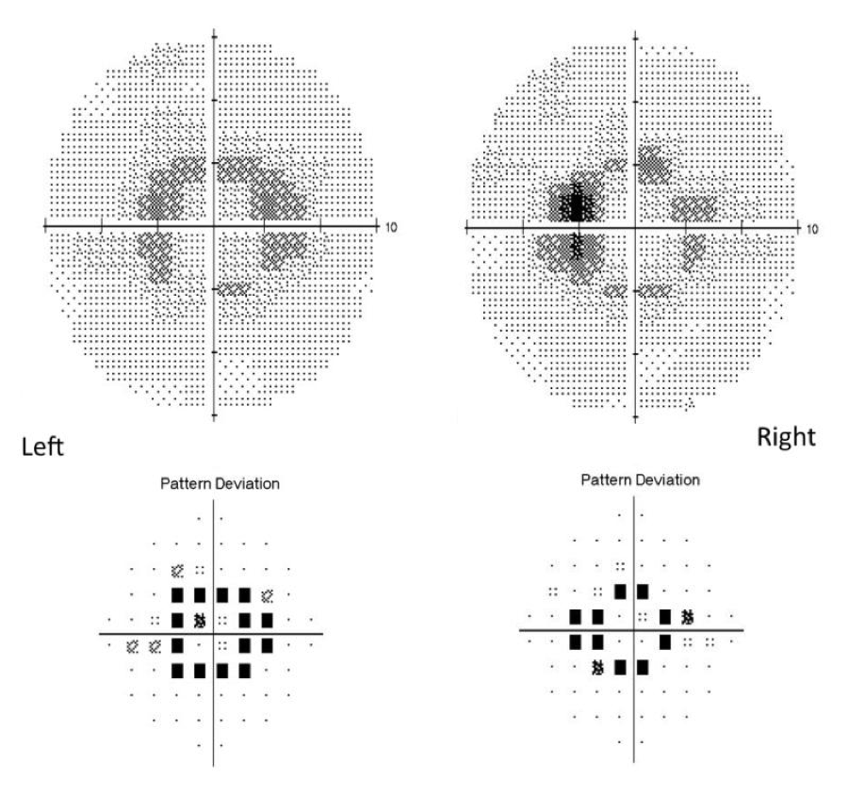

Slide 15
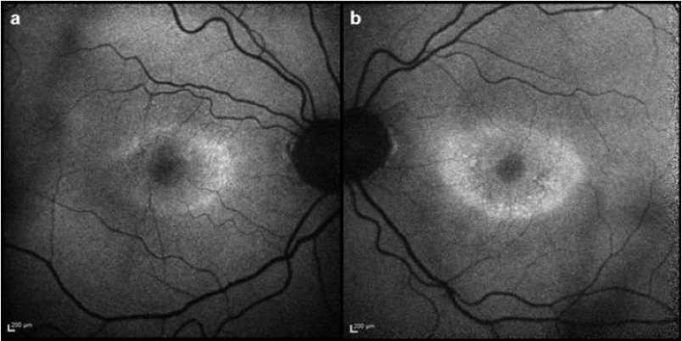

Slide 16
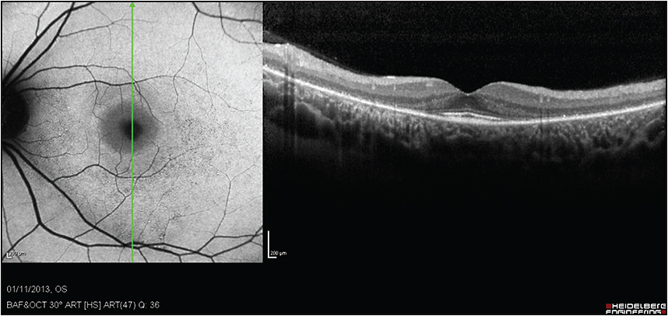

Slide 17
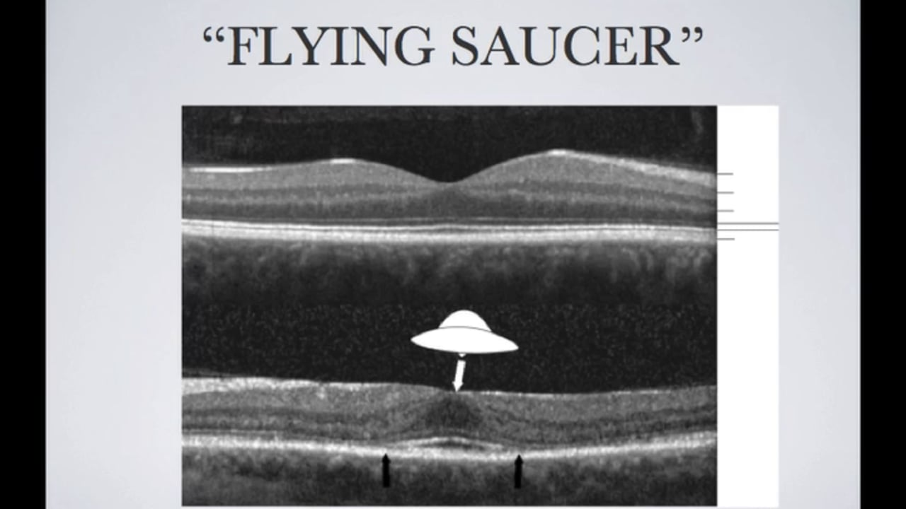

Slide 18
Break out for discussion of referrals

Slide 19
Questions

