Slide 1
Post-operative Cataract Service
John Hollins
Clinical Governance and Performance Lead (cataract services) Primary Eyecare (Shropshire and Staffordshire) Ltd
A SASPEC presentation

Slide 2
Purpose of this evening
To introduce a post-operative cataract service to South Staffordshire
To explain how the scheme will be utilised
To explain what is required of participating clinicians
So you can ask any questions

Slide 3
Aim of the Scheme
Reduce NHS costs
Free up Ophthalmologists’ clinic time
More convenient and comfortable for patient
Making use of all our skills and equipment
Notes:
Cheaper to pay us than Ophthalmologists – but still more to us than an NHS sight test our fee will be £40 per check
Because ophthalmologists time is more valuable than our own :P
Patients get to come and see us (who they know) and don’t have to drag to hospitals that can, even as nice as Rowley hall is, be daunting places to go.
We have to be forward thinking as a profession and become part of the wider healthcare system. In order to stay relevant we must offer our expertise. Look at how well pharmacies promote themselves and people are starting to think of them as frontline services, the more we do the more people will come to see us

Slide 4
About the scheme
The post-operative cataract service is initially a 12 month pilot supporting Rowley Hall Hospital
The participating Ophthalmologists at Rowley Hall will be Mr Manoj and Mr Ilango – their clinic days in Rowley Hall are Monday and Tuesday
Notes:
Stafford and surrounds, Cannock chase ccg, south staffs ccg and east staffs ccg all supporting pilot
Hopefully with a successful pilot more hospitals will become part of the scheme in 12 months time
Monday and Tuesday – ill explain why that’s important later
The other ophthalmologists at Rowley are not going to be involved initially

Slide 5
How will it work?
Patient has sight test with their Optometrist
Patient’s visual acuity is reduced due to cataract
Optometrist discusses options with patient leading to referral for cataract extraction
Patient is referred to Rowley Hall hospital
Notes:
How will it work if everything goes perfectly
From the beginning, it’s a very good place to start.
VA reduced currently 6/9 but could be 6/12 etc
Cataract extraction by phacoemulsification. Optom should be on DAC scheme hopefully anyone not contact Alison and lets get on it

Slide 6
How will it work?
Patient attends appointment at Rowley Hall for the pre-operative assessment and consents to surgery
Patient is operated on as a day case procedure by Mr Manoj or Mr Ilango
After a successful operation the patient is discharged the same day
Notes:
Discharged with drops and information as to what to do in emergency

Slide 7
How will it work?
Patient will be given forms following surgery and told to make appointment with an accredited Optometrist
Patient presents to Optometric practice to make appointment. Appointments for post-operative cataract checks should be 4 weeks following surgery and no later than 6 weeks. Once booked please add to Webstar immediately so that it is known that the patient has made an appointment
Notes:
Alison will be able to see that patients that have been operated on have made appointments
No later than 6 weeks
Switch to Walsall form

Slide 8
How will it work?
Optometrist performs post-op check and:
Everything is fine, patient either does not want/need 2nd eye operating on or this was the 2nd extraction – patient is discharged and GOS sight test to be performed
Or list for 2nd eye
Notes:
Gos sight test can be done at 4 week check but in my personal experience it is better to wait 6-8 so rebook patient is usually best

Slide 9
But…. The world is not perfect
Not all post-op cataract checks will be problem free!!
Therefore we need a couple of extra outcomes to choose from:
Routine referral
Urgent referral (to be seen within 1 week)
Emergency (same day) referral
(Refer to GP only in exceptional circumstances)

Slide 10
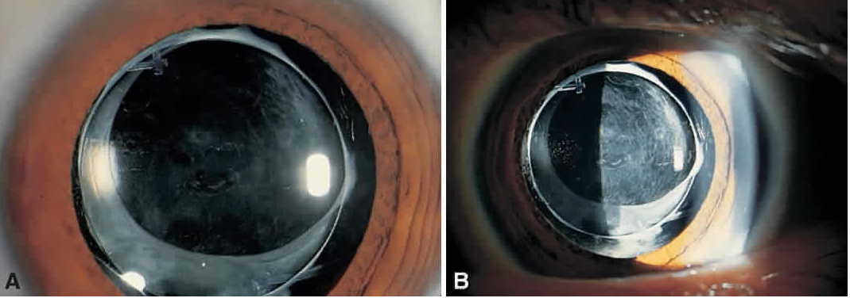
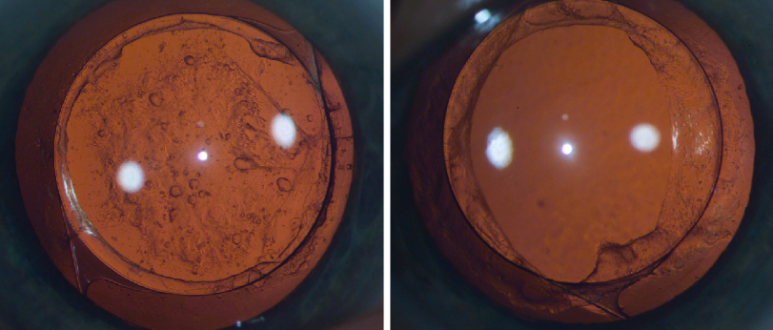
Posterior capsular Opacification
Refractive surprise

Slide 11
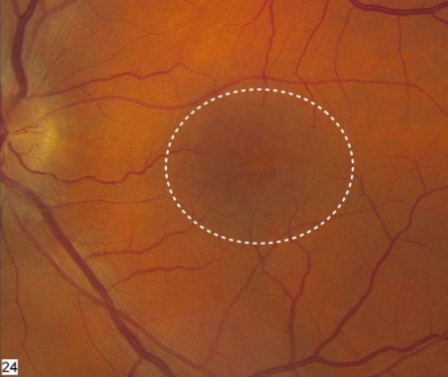
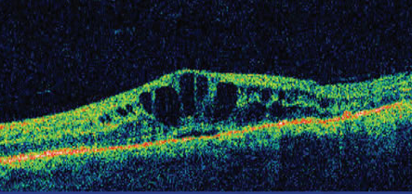
Cystoid Macular Oedema
Reduced Visual acuity (from expected)
IOP 22-30mmHg
Corneal haze/oedema
Notes:
IOP 22 – 30mmHg
Also any corneal oedema/haze following surgery

Slide 12
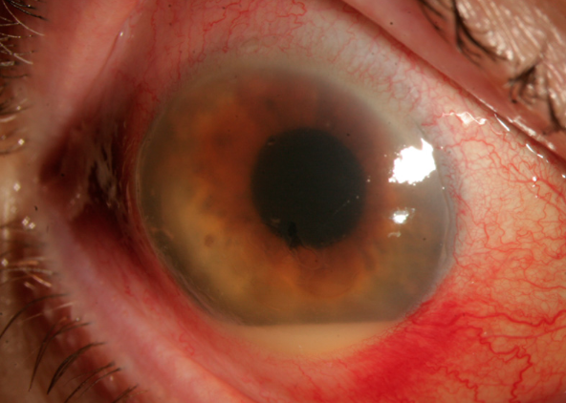
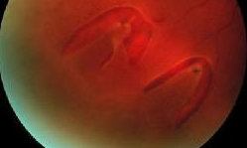
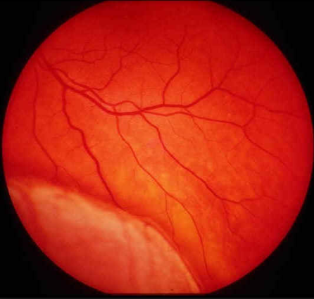
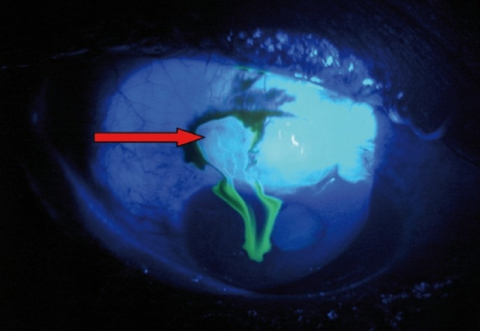
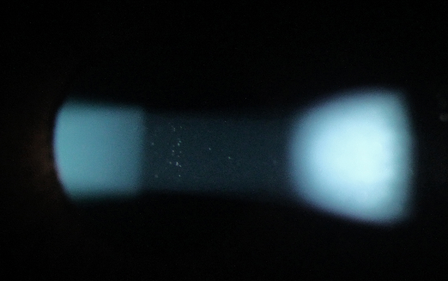

Slide 13
Emergency (same day) referrals
Retinal tears/detachments
Wound leak – positive seidel test
Unexplained hypotony
Raised IOP above 30mmHg
Sight threatening corneal problems
Sympathetic ophthalmia
Endophthalmitis
*post-op anterior uveitis

Slide 14
Seidel Test
Fluorescein is instilled (best with patient looking down)
If there is wound leak the fluorescein dilutes and so will appear darker blue under cobalt blue filter – not yellow-green as
normal
Notes:
Down or away from site of wound/incision

Slide 15
Post-operative anterior uveitis
In most cases anterior uveitis needs clinical management same day
If Kanski grade 2 or symptomatic grade 1+ then patient to use topical medication and be referred urgently to Rowley Hall (<1 week)
Kanski grade 2+ with accompanying symptoms then MUST be referred to an emergency eye clinic
Post-operative anterior uveitis Kanski grade 1+ or less are not to be referred unless there are unusual circumstances
Notes:
Topical steroids normal maxidex or maxitrol
This criteria agreed with mr manoj

Slide 16
Post-operative anterior uveitis

Slide 17
Post-operative anterior uveitis
Dark room
1mm x 1mm slit beam – conical section
High magnification (x25 and up ideally)
High slit beam brightness
Viewing angle 45-60 degrees

Slide 18
Other considerations
Complicated surgery
Patient finishes their drops before they are supposed to
Patient does not attend post-op follow up – practice must firstly attempt to contact patient and rebook. If no contact can be made or if the patient fails to attend a 2nd appointment Alison is to be notified at Staffs LOC
Over 4 weeks since operation
Notes:
Patient will be kept under Rowley’s care and followed up in hes – no post cat follow up with us
Drops should last 4 weeks. Patient tend to run out sooner as they don’t always get it all in their eyes, they use more than 1 drop etc. Rowley does tell patients to go back to their gp if that happens to have prescription refilled so they are covered for at least 4 weeks – so if they see you and they are running out give them a letter to take to GP for the reissue of their drops!!
They don’t bother to come because they’ve had no problems, they can see alright without their specs and their eyes don’t hurt so they don’t need it checked
Keep post op checks below 4 weeks please and absolutely no more than 6

Slide 19
The post-op check itself
History and symptoms taken with extra questioning whether the patient has had any persistent pain/redness/watering/discharge since surgery or if they have had any lid swelling, light sensitivity or any new flashes or floaters
If the patient is new to your practice then a full history and symptoms should be taken
Measure unaided vision
Notes:
F+f signs of r.d.
Full h+s is always best practice anyway
Unaided vision bilateral esp. if considering 2nd eye

Slide 20
The post-op check
Retinoscopy and refraction (subjective if possible)
Tonometry
Dilate (1% Tropicamide)
Health checks once dilated
Notes:
Pinhole to be used if VA less than 6/12 and no pre exisiting pathology
Near va recorded as well
To check for abnormally low/ high iop

Slide 21
What to check (not exclusive)
Anterior Eye
Lids and lashes: post-op oedema; blepharitis/MGD
Wound site: any iris in wound; Seidel test; corneal staining
Cornea: post-operative/ chronic dry eye
Sclera/conjunctiva: any marked limbal/conjunctival injection or hyperaemia
Iris/pupil: check pupil is round and reactive to light; no iris transillumination unless already known; no damage to iris during operation
Notes:
Anterior or posterior bleph – manage in practice
Manage dry eye in practice as appropriate – refer to gp for ocular lubricants if required
Esp for signs of endophthalmitis

Slide 22
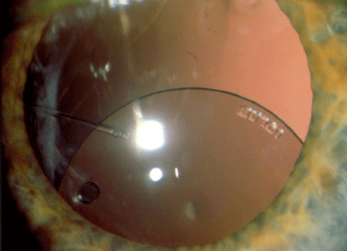
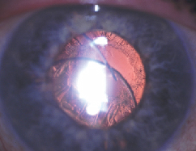
What to check (not exclusive)
Intra-ocular lens implant: central no dislocation; no PCO

Slide 23
What to check (not exclusive)
Anterior chamber: for cells and flare; hypopyon
Anterior vitreous: Shafers signs
Posterior checks
Peripheral fundus check for retinal tears/detachments
Macula: CMO
Notes:
Cells and flare signs of post op anterior uveitis as discussed previously. Hypopyon for endophthalmitis
Schaefers sign retinal tears detachment
So that’s how it should all work and then be eneterd onto the webstar module

Slide 24
Referring to GP
The service has been commissioned to try and reduce the overall cost to the NHS and free up Doctor’s time
Referring to a GP means using Doctor’s time and so the CCG has discouraged this
PLEASE try and use referral to the GP as a last resort
Notes:
However there will be cases that need referral to GP for example ocular lubricants for chronic/post op dry eye or some people as mentioned earlier will run out of their drops and need to see the GP for more

Slide 25
Emergency Referrals
As stated earlier Mr Manoj and Mr Ilango only work in Rowley Hall on Monday and Tuesday. So what happens if you see a patient for their post-op check on another day and need emergency (same day) intervention from an Ophthalmologist?
If the patient has a Stafford and Surrounds or Cannock Chase GP they are to be referred to New Cross, Wolverhampton for emergency appointments

Slide 26
Emergency appointments
If the patient has a South East Staffs or East Staffs GP then they are to be referred to Queens Hospital, Burton
Monday and Tuesday- refer back to Rowley Hall Fax 01785 241374 Tel 01785 238 601
Other days: New Cross: Fax 01902 695661 Tel 01902 695080
Queens: Fax 01283 536760 Tel 01283 566333 ext 5085
Notes:
Please try and only refer to other providers in a real emergency CCGs very concerned about continuity of service

Slide 27
Review
Why we have set up the scheme
What the scheme involves
What happens when all goes well (95+% of the time)
What to do when not everything goes to plan
Notes:
To make best use of our clinical skills and to ensure we look after our patients as best possible
H+s refraction dilation health check iop check
List 2nd eye or discharge
Referrals routine urgent emergency

Slide 28
Any questions?

