Slide 1







Stafford Meeting
October 2018
Hydroxychloroquine retinopathy:
More common than we thought?
Omar Mahroo
Moorfields Eye Hospital and St Thomas’ Hospital
UCL Institute of Ophthalmology and King’s College London

Slide 2
Financial disclosures
No conflicts of interest
I have received research funding from the following sources:
  Wellcome Trust
  Fight for Sight
  Birdshot Uveitis Society
  Thomas Pocklington Trust
  NIHR Biomedical Research Centre at Moorfields Eye Hospital and the UCL Institute of Ophthalmology
  Moorfields Eye Charity
  TFC Frost Charitable Trust
  [I co-supervise a PhD student funded by the College of Optometrists!]

Slide 3
Objectives
To understand how systemic drugs can affect the retina, with specific reference to hydroxychloroquine, so that advice can be given to patients regarding ocular side effects of medication
To be aware of current evidence and draft guidelines regarding hydroxychloroquine toxicity screening, and to understand when patients require hospital eye service assessment
To be aware of which investigations can be used to detect hydroxychloroquine retinopathy

Slide 4
Outline
A case
Overview of drugs which can affect the retina
Hydroxychloroquine: Why is it used and how can it affect the retina?
How can we detect toxicity? Key investigations
  Visual fields**
  OCT and autofluorescence imaging**
  Electrophysiology**
What is the prevalence of toxicity? Risk factors?
Guidelines for screening: RCOphth Feb 2018
Take home messages

Slide 5
Outline
A case
Overview of drugs which can affect the retina
Hydroxychloroquine: Why is it used and how can it affect the retina?
How can we detect toxicity? Key investigations
  Visual fields**
  OCT and autofluorescence imaging**
  Electrophysiology**
What is the prevalence of toxicity? Risk factors?
Guidelines for screening: RCOphth Feb 2018
Take home messages

Slide 6
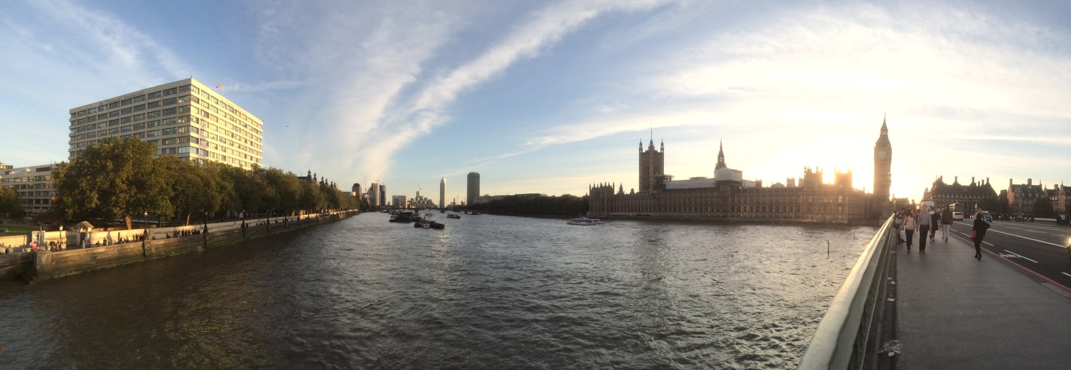

Slide 7
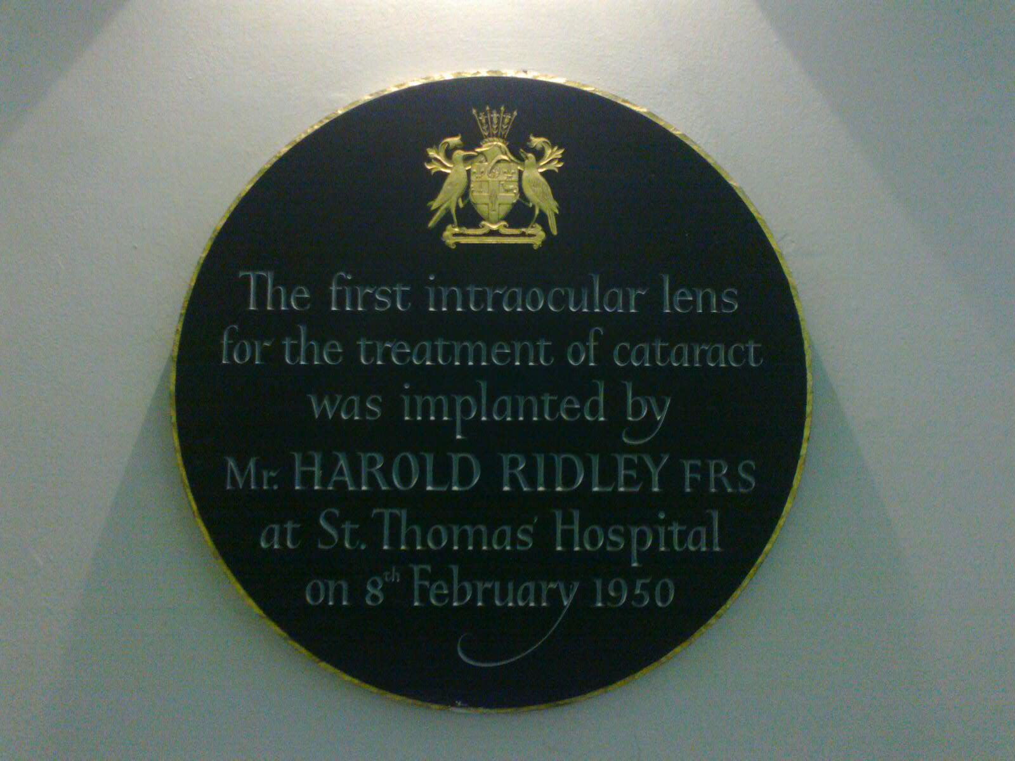

Slide 8
A case
45 year-old lady
  Referred due to abnormal visual field test
  History of lupus-like syndrome and ocular myasthenia
  On hydroxychloroquine treatment
  No visual symptoms reported
WHAT ELSE WOULD YOU LIKE TO KNOW?

Slide 9
A case
45 year-old lady
  Referred due to abnormal visual field test
  History of lupus-like syndrome and ocular myasthenia
  On hydroxychloroquine treatment
  No visual symptoms reported
More info relevant to hydroxychloroquine
  400 mg for over 10 years
  Weight 55 kg
  Dose is 7.3 mg/kg
  No tamoxifen use
  No renal problems
  Chinese origin
  Does not drive

Slide 10
Examination
Visual acuity:
  RE 6/5 LE 6/5
Anterior segments normal
Visual fields:
  Paracentral visual field loss in both eyes
  Previously attributed to possible ptosis?
Fundus examination at slit lamp
  Grossly normal

Slide 11
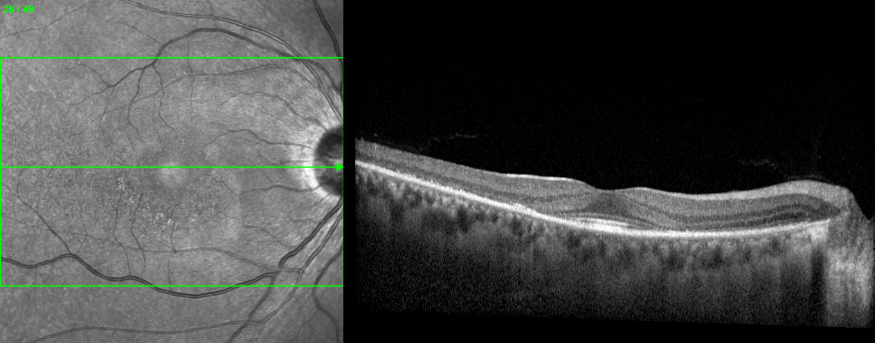

Slide 12
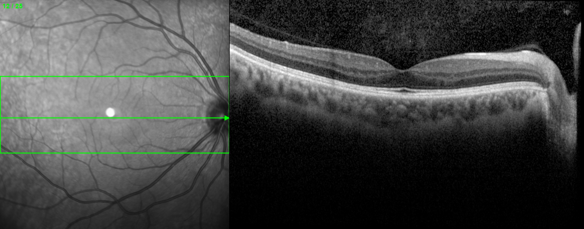
Patient
“Normal”

Slide 13
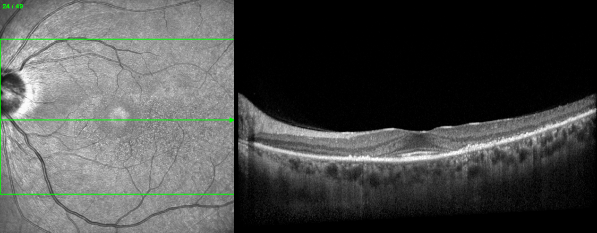

Slide 14
Diagnosis
Likely hydroxychloroquine retinopathy
Inherited retinal dystrophy possible, but unlikely
Action?
  Contact patient’s treating physicians to advise them to stop hydroxychloroquine
  Counsel patient

Slide 15
Outline
A case
Overview of drugs which can affect the retina
Hydroxychloroquine: Why is it used and how can it affect the retina?
How can we detect toxicity? Key investigations
  Visual fields**
  OCT and autofluorescence imaging**
  Electrophysiology**
What is the prevalence of toxicity? Risk factors?
Guidelines for screening: RCOphth Feb 2018
Take home messages

Slide 16
Retinal pathology | Drug | Indication
Retinal or choroidal degeneration | Chloroquine | Malaria
 | Hydroxychloroquine | Autoimmune conditions
 | Phenothiazines | Psychosis, schizophrenia
 | Desferrioxamine | Iron overload
 | Clofazimine | Leprosy
 | Didanosine, Ritonavir | HIV
Inner retinal toxicity | Quinine | Malaria
Retinal vasculopathy | Interferon | Hepatitis
 | Aminoglycosides | Antibiotic
Cystoid macular oedema | Nicotinic acid/niacin | Reduce cholesterol
 | Prostaglandin analogues (e.g. latanoprost) | Glaucoma
 | Paclitaxel | Cancer chemotherapy
 | Glitazones | Diabetes
 | Fingolimod | Multiple Sclerosis

Slide 17
Retinal pathology | Drug | Indication
Crystals | Tamoxifen | Breast cancer
 | Canthaxanthine | Tanning agent
 | Nitrofurantoin | Antibiotic
 | Methoxyflurane | Anaesthetic
 | Ritonavir | HIV
Subretinal fluid | Steroids | Inflammation
 | MEK inhibitors | Cancer chemotherapy
Central fovea outer retinal disturbance | Poppers | Recreational
Many other drugs can have other ocular adverse effects
(e.g. optic nerve and cornea)

Slide 18
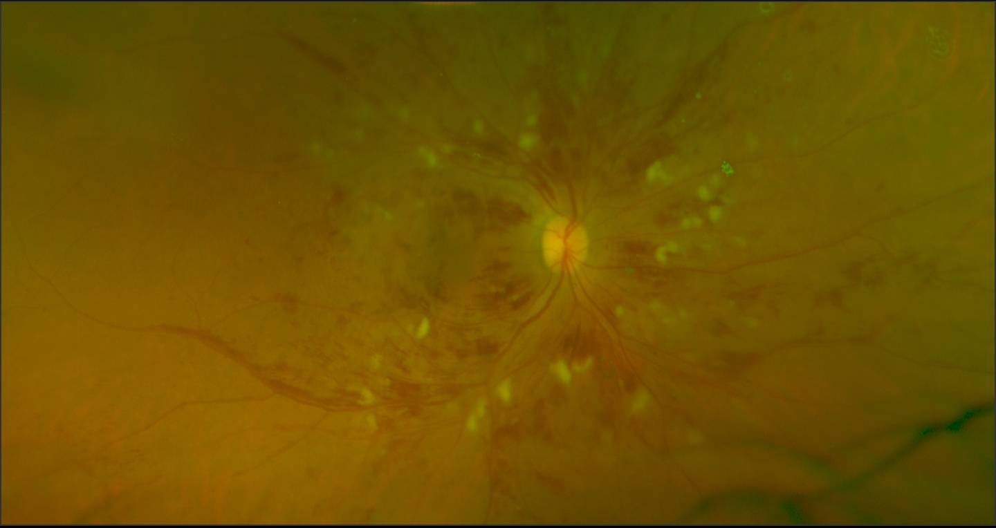
Interferon

Slide 19
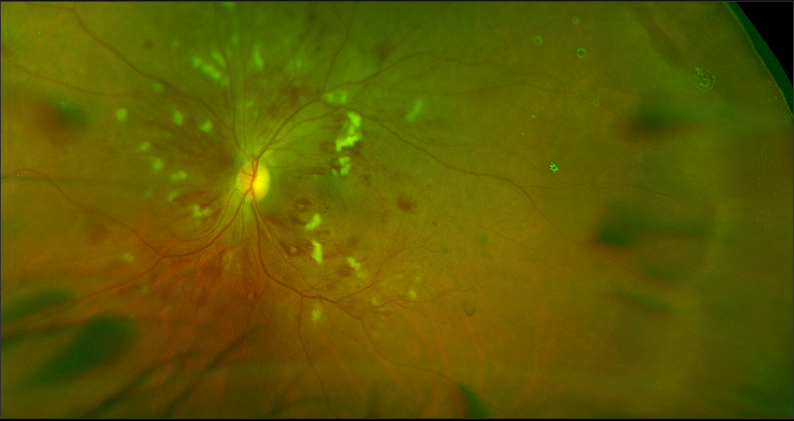
Interferon

Slide 20
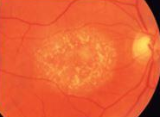
tamoxifen

Slide 21
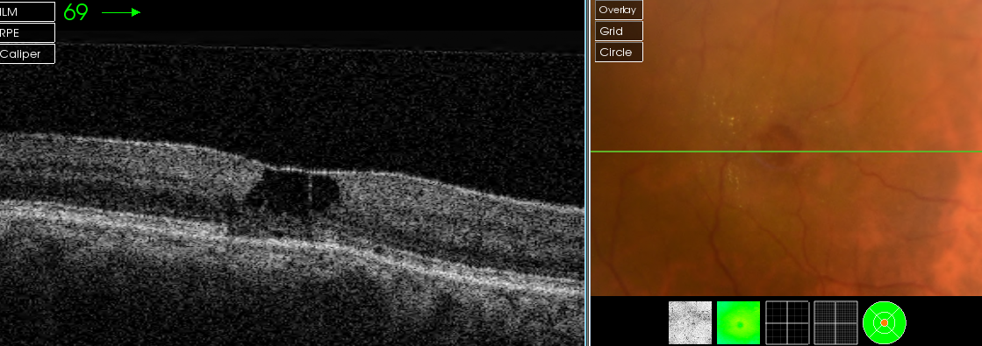
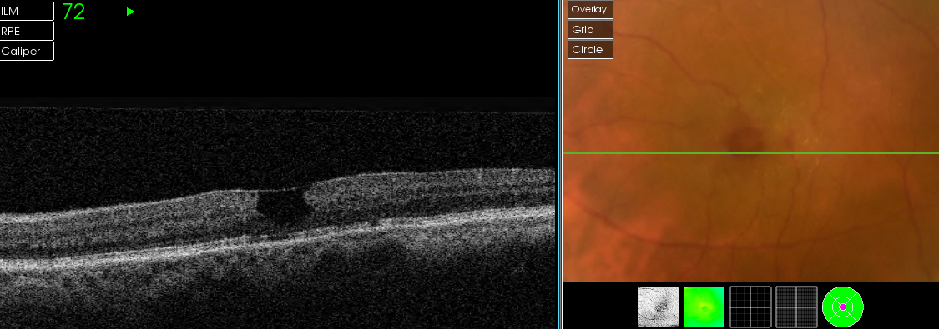

Slide 22
mactel

Slide 23
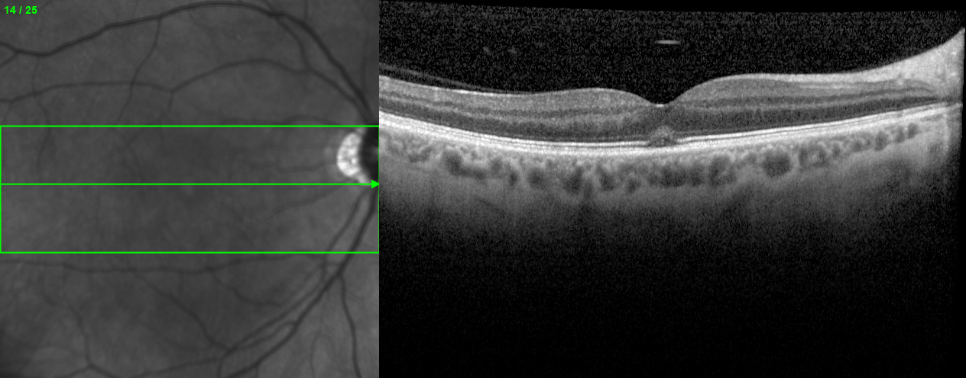
Poppers

Slide 24
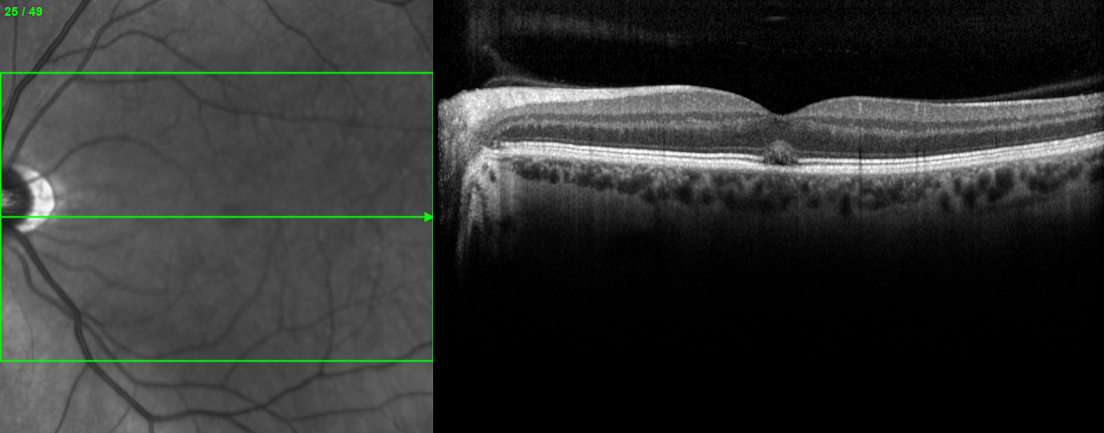
Poppers

Slide 25
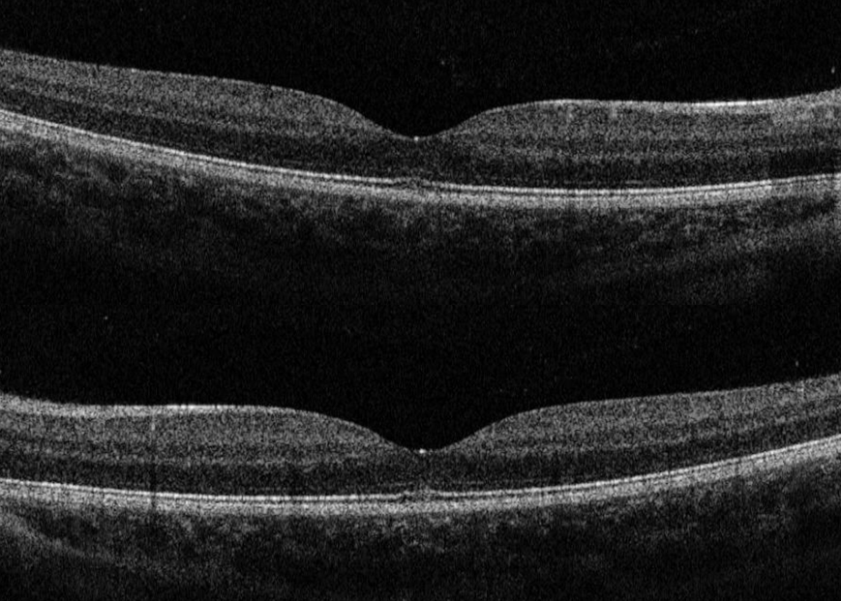

Slide 26
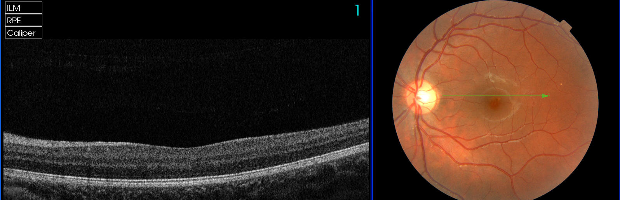
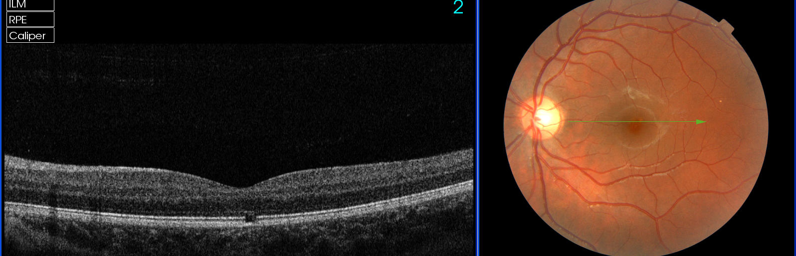


Slide 27
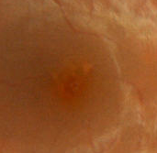
Have you been staring at the sun?
Yes, around once a month.
I stare at it until my eyes hurt.

Slide 28
Outline
A case
Overview of drugs which can affect the retina
Hydroxychloroquine: Why is it used and how can it affect the retina?
How can we detect toxicity? Key investigations
  Visual fields**
  OCT and autofluorescence imaging**
  Electrophysiology**
What is the prevalence of toxicity? Risk factors?
Guidelines for screening: RCOphth Feb 2018
Take home messages

Slide 29
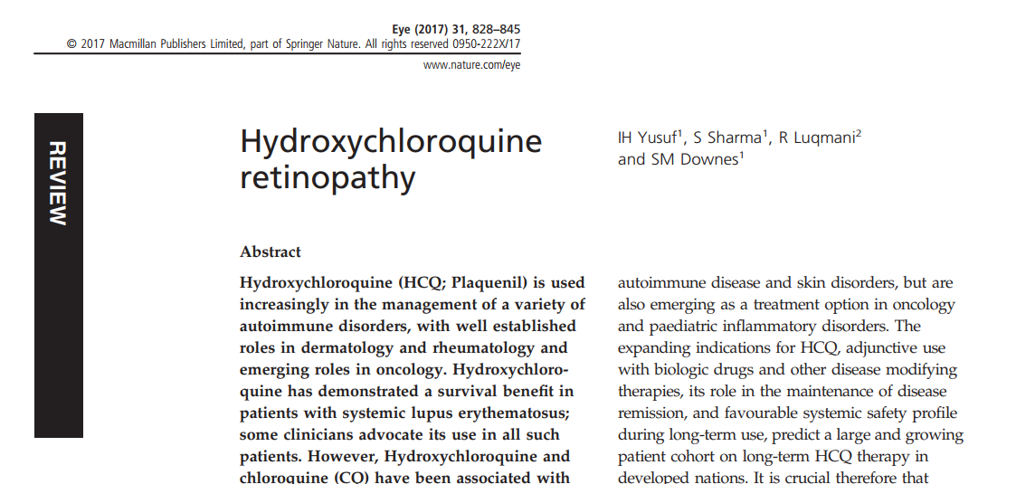

Slide 30
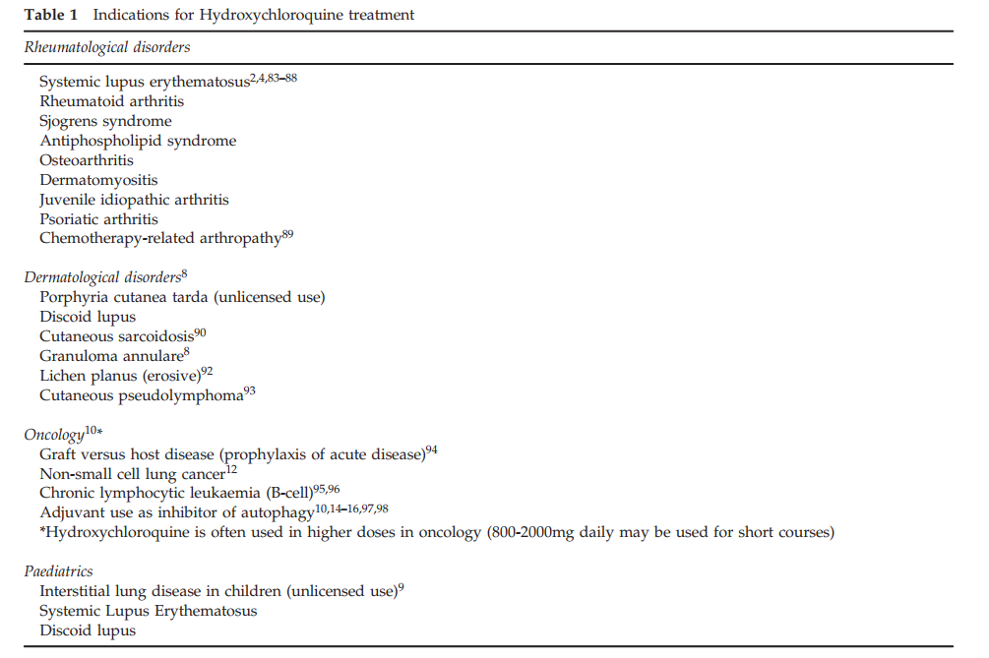
Survival benefit in SLE (LUMINA study)

Slide 31
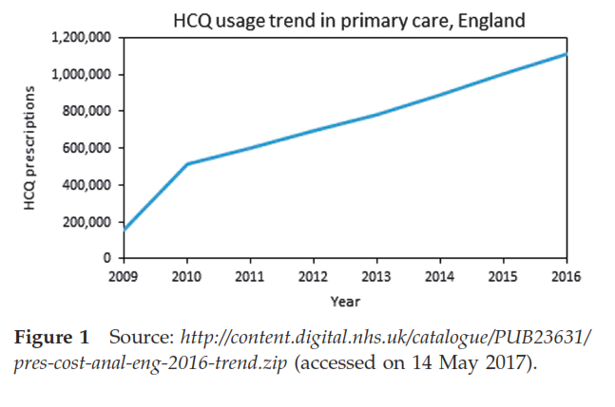
Yates et al. Hydroxychloroquine use: the potential impact of new ocular screening guidelines. Eye 2018

Slide 32
Retinal toxicity
Affects outer retina
  Photoreceptors and RPE
  Perifoveal or parafoveal
  Patients from Far East can have toxicity outside the macula (50%)
  Irreversible
  Can progress even after stopping (due to storage in RPE?)

Slide 33
Outline
A case
Overview of drugs which can affect the retina
Hydroxychloroquine: Why is it used and how can it affect the retina?
How can we detect toxicity? Key investigations
  Visual fields**
  OCT and autofluorescence imaging**
  Electrophysiology**
What is the prevalence of toxicity? Risk factors?
Guidelines for screening: RCOphth Feb 2018
Take home messages

Slide 34
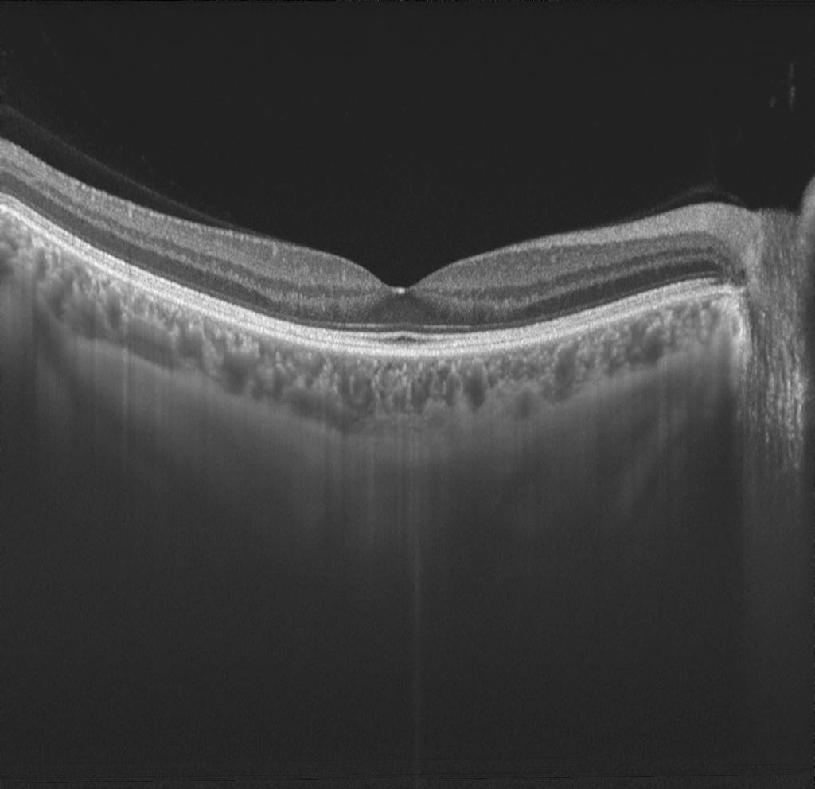

Slide 35
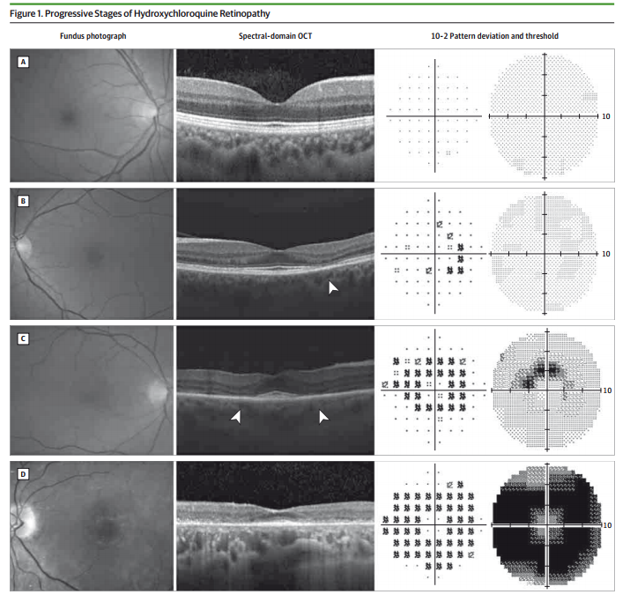

Slide 36
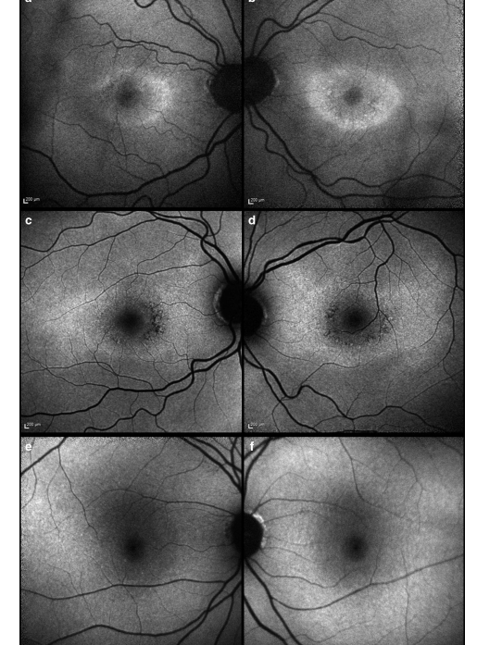
Short wavelength autofluorescence imaging
(sensitive for abnormalities in outer retina and RPE)

Slide 37
Electrons elevated to higher energy state
Some energy dissipated
Photons emitted
(Lower energy, longer wavelength)
Photons
Electrons within fluorophore in ground state

Slide 38
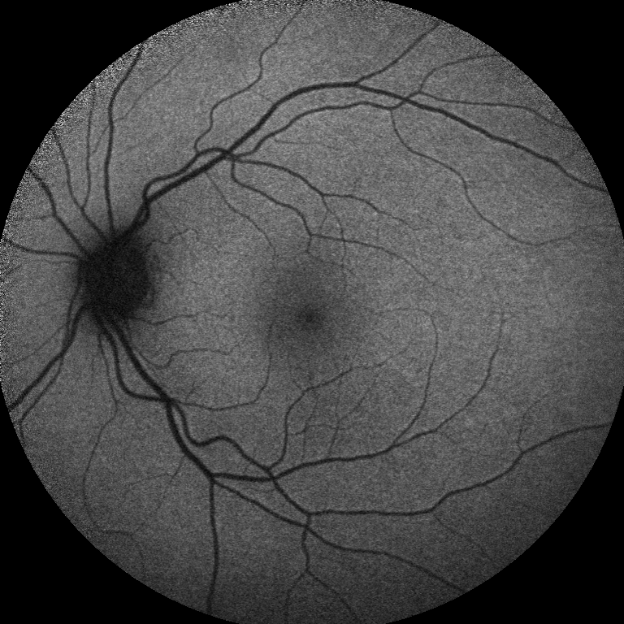
Spectralis

Slide 39
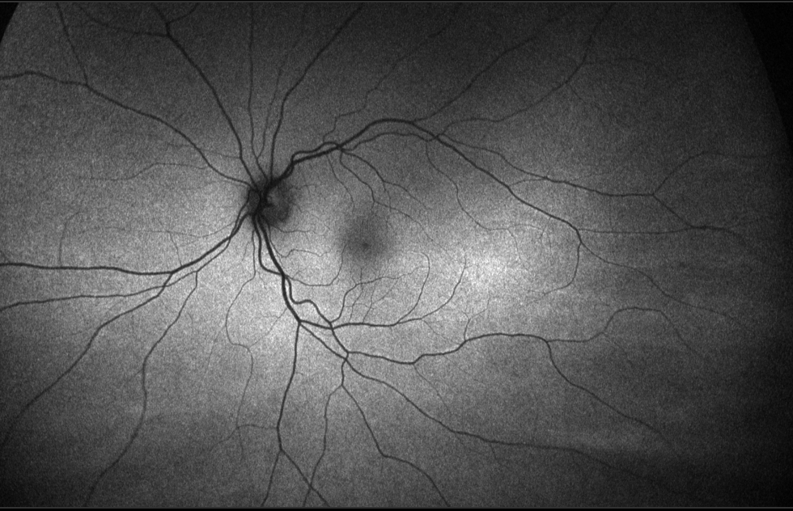
Optos

Slide 40
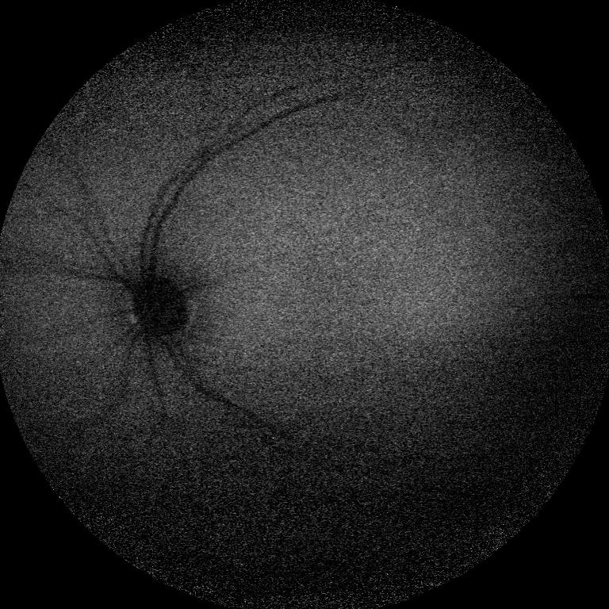
Albinism

Slide 41
HCQ retinopathy
Yusuf et al. Eye 2017

Slide 42
Electroretinogram (ERG)
The electrical responses of the cells of the retina to light stimuli
Could identify dysfunction prior to cell death
Full-field ERGs
  Responses of the whole retina (only abnormal in late retinopathy, not so useful in HCQ)
Multifocal ERGs
  Localised assessment of function
  Useful in HCQ

Slide 43
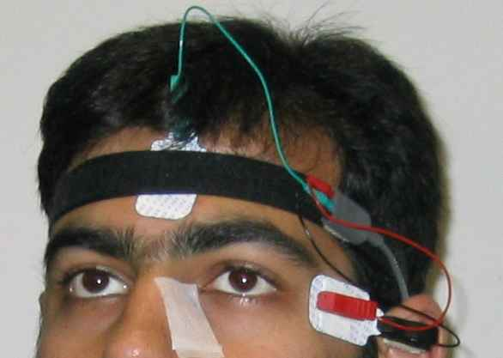
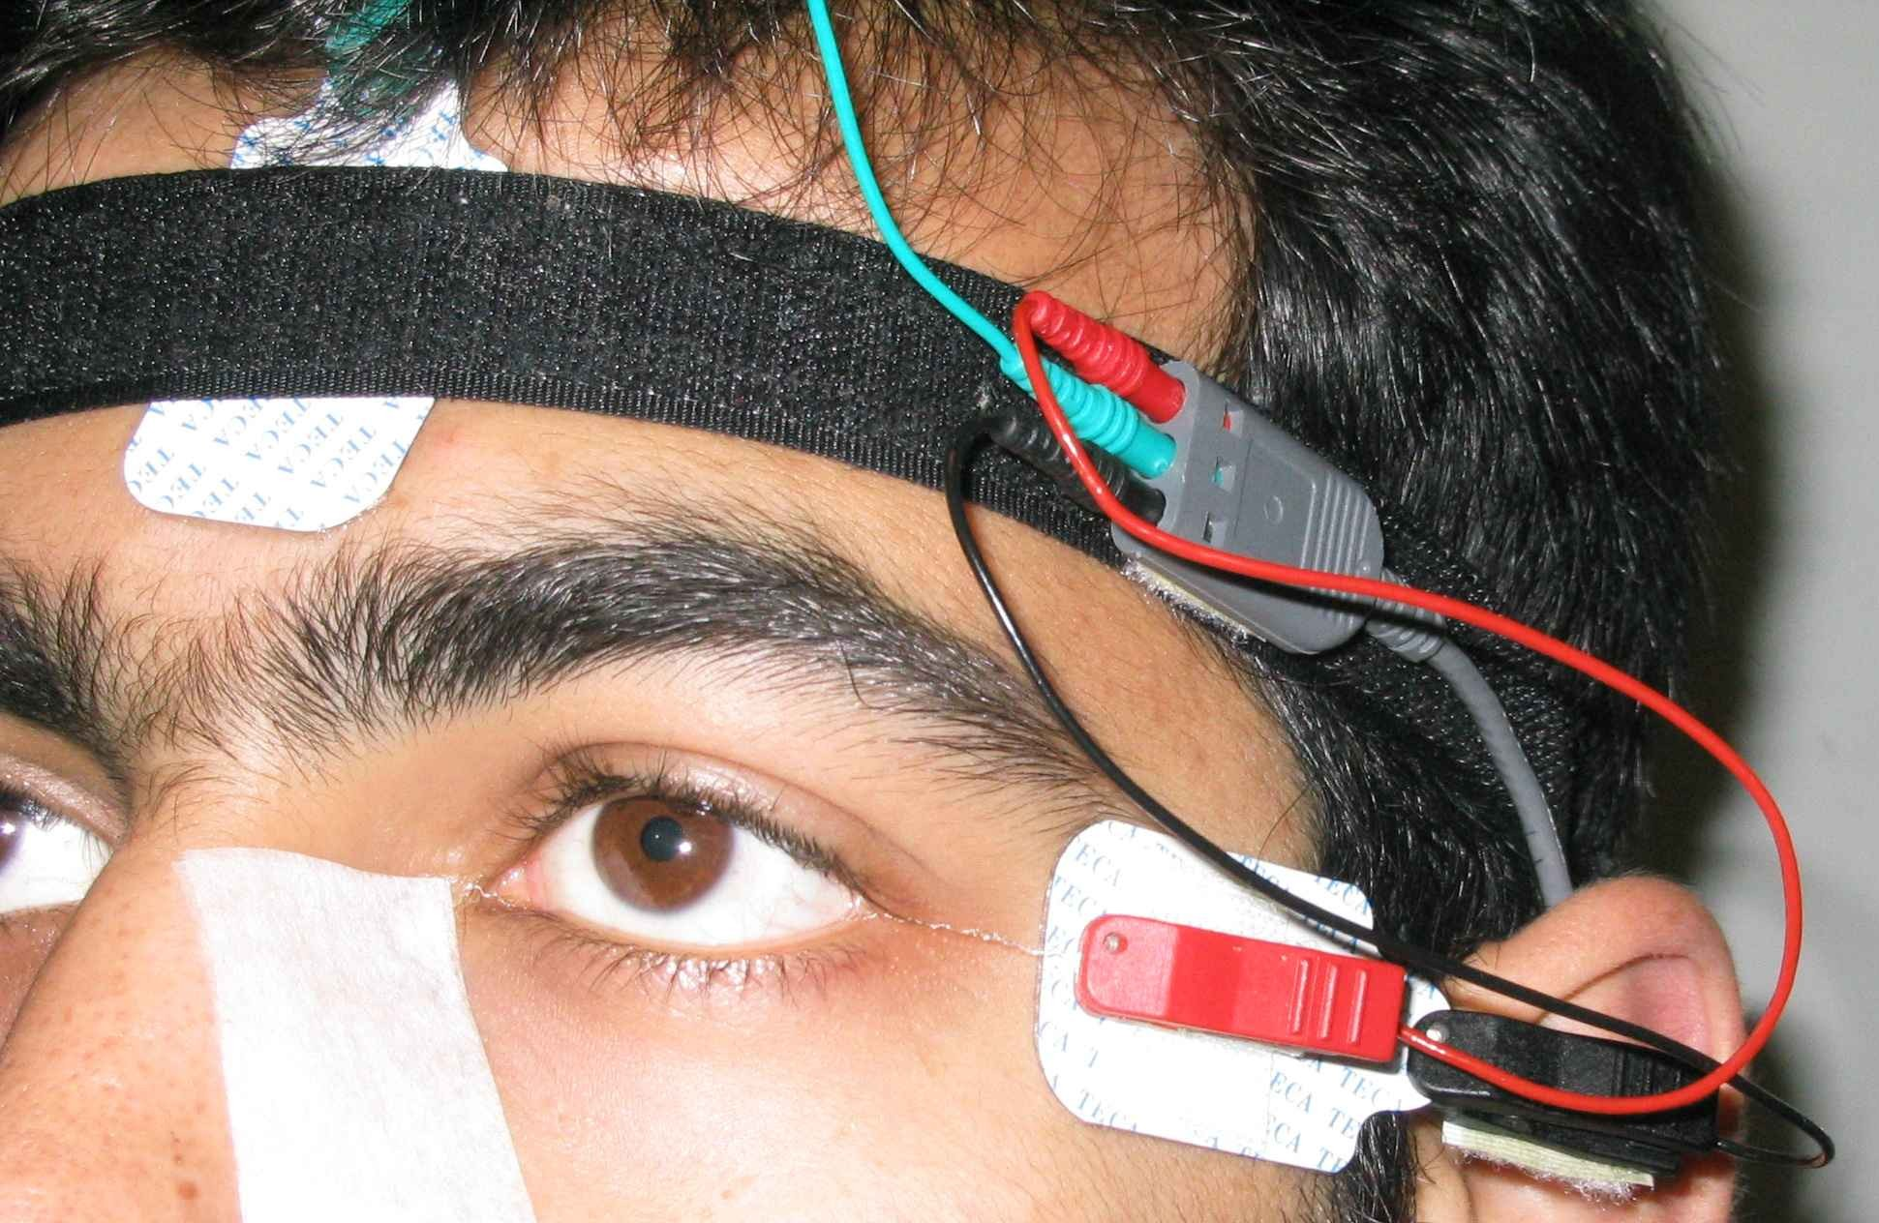
Headband
Skin surface electrode (ground)
DTL electrode
RECORDING
THE ERG
Skin surface electrode (reference)

Slide 44
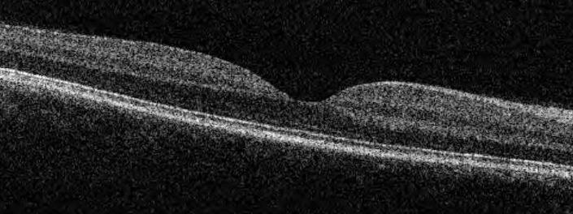
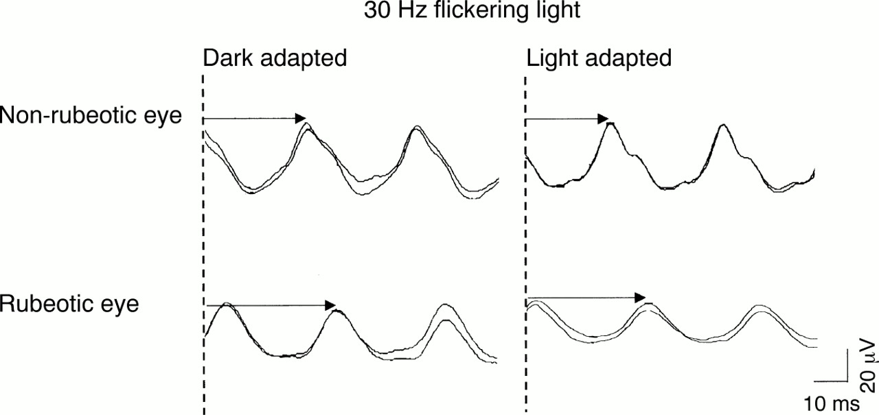
Origins of the ERG
30 Hz flicker: cone-driven, but arises in inner retina
Inner
Outer
Ganglion cells
Bipolar cells
“ON” and “OFF”
Photoreceptors
“OFF”
Flash ERG
B-wave: on-
bipolar cells
A-wave: Photoreceptors
and off-bipolar cells

Slide 45
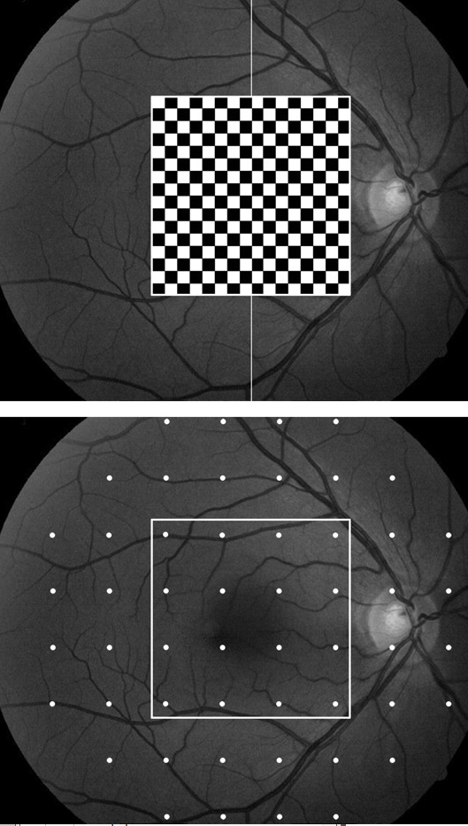
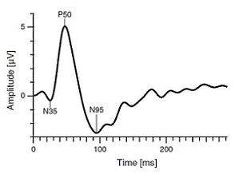

Slide 46
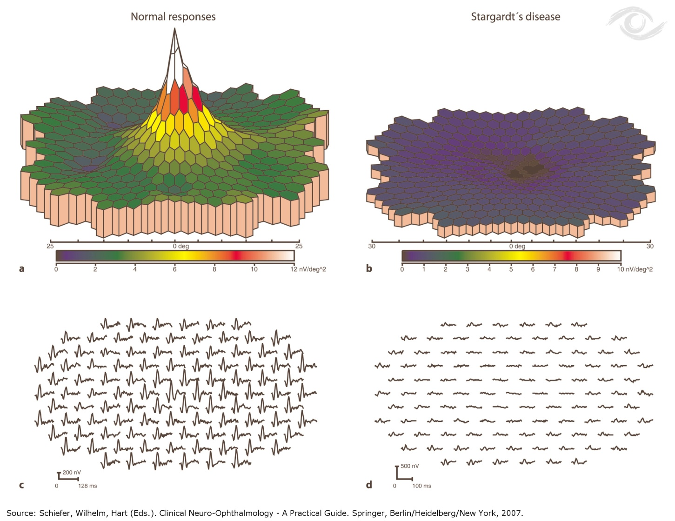
Multifocal ERG

Slide 47
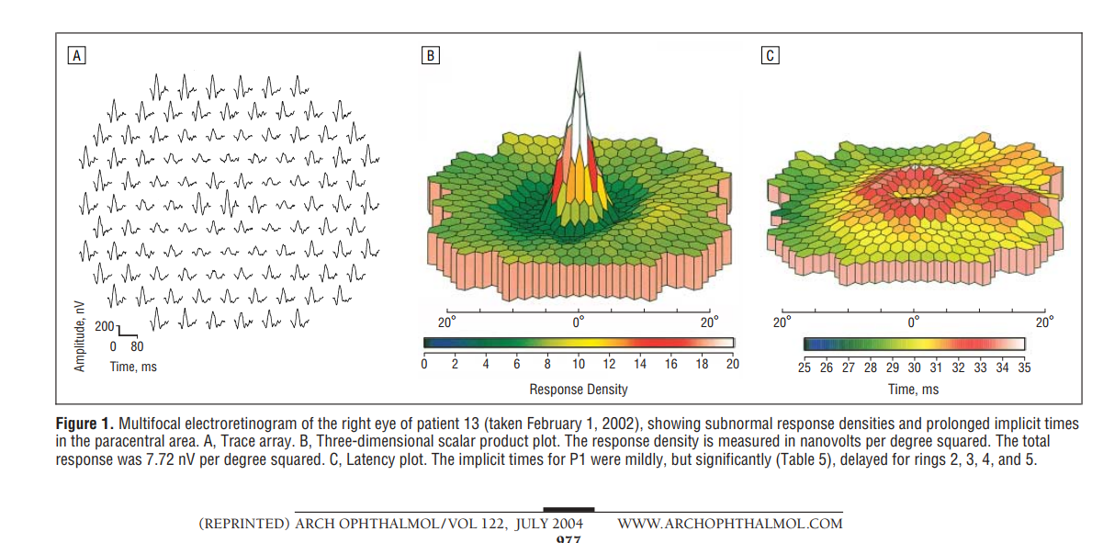

Slide 48
Outline
A case
Overview of drugs which can affect the retina
Hydroxychloroquine: Why is it used and how can it affect the retina?
How can we detect toxicity? Key investigations
  Visual fields**
  OCT and autofluorescence imaging**
  Electrophysiology**
What is the prevalence of toxicity? Risk factors?
Guidelines for screening: RCOphth Feb 2018
Take home messages

Slide 49



Slide 50
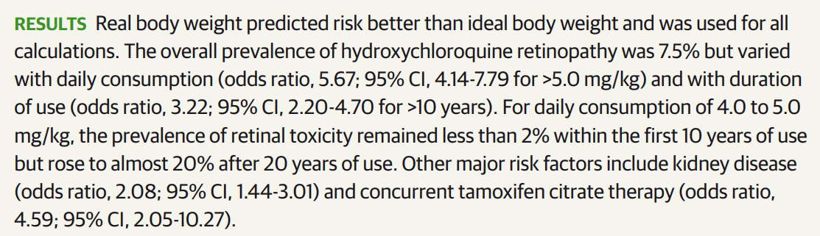

Slide 51
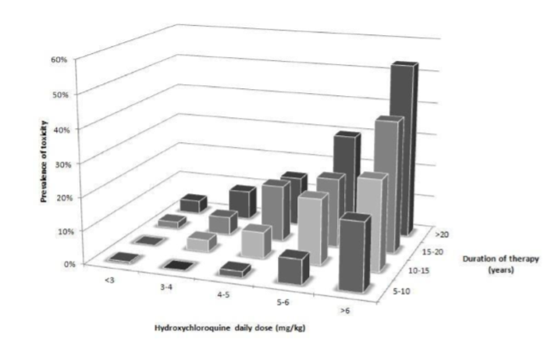
From RCOphth guidelines, from Ronald Melles MD

Slide 52
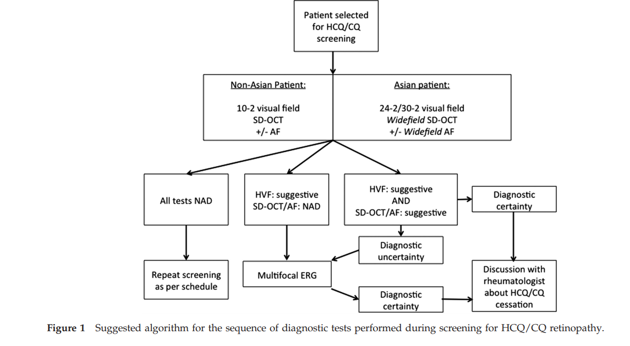
Yusuf et al., Eye 2017

Slide 53
Outline
A case
Overview of drugs which can affect the retina
Hydroxychloroquine: Why is it used and how can it affect the retina?
How can we detect toxicity? Key investigations
  Visual fields**
  OCT and autofluorescence imaging**
  Electrophysiology**
What is the prevalence of toxicity? Risk factors?
Guidelines for screening: RCOphth Feb 2018
Take home messages

Slide 54
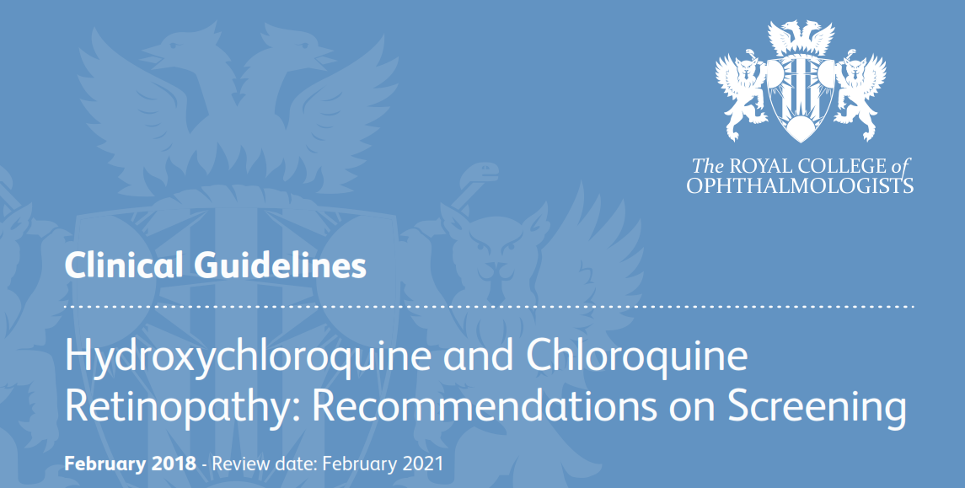

Slide 55
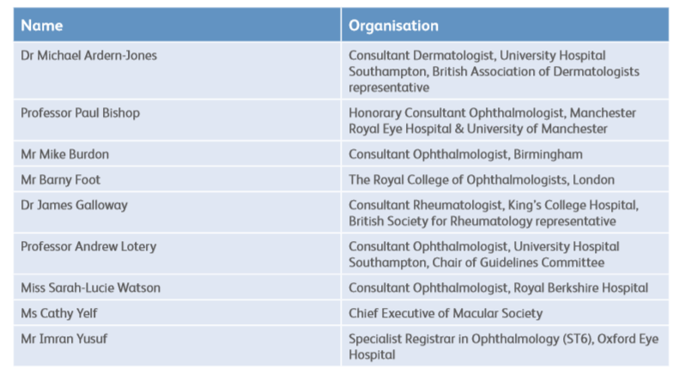

Slide 56
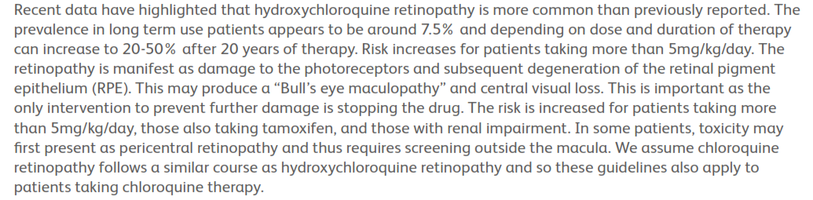

Slide 57
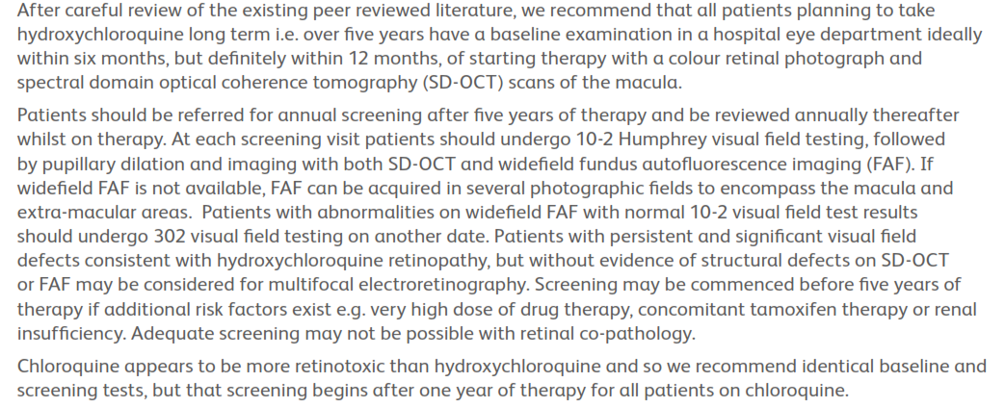

Slide 58
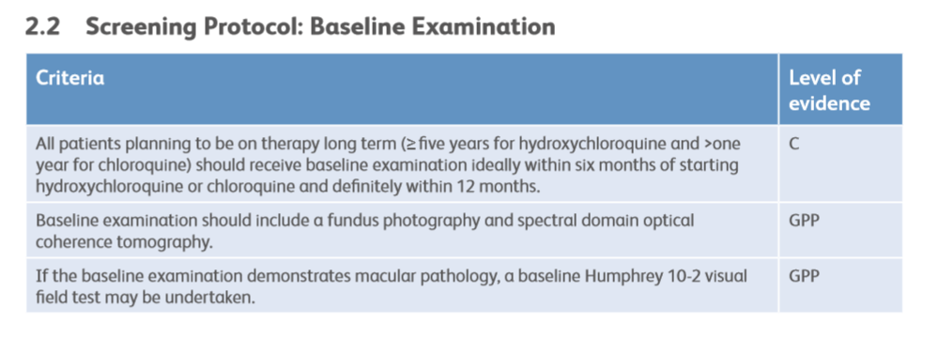

Slide 59
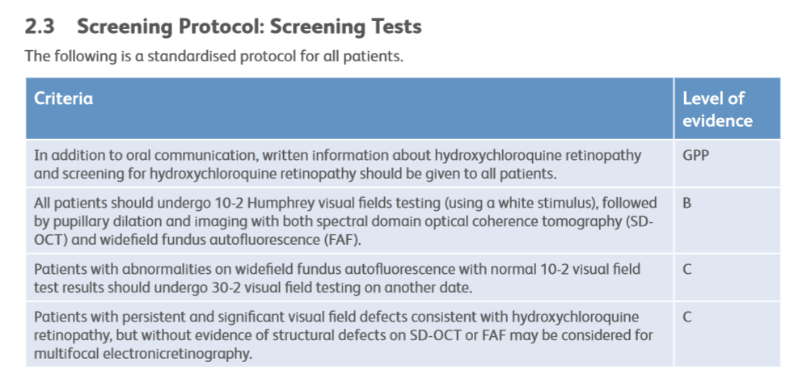

Slide 60
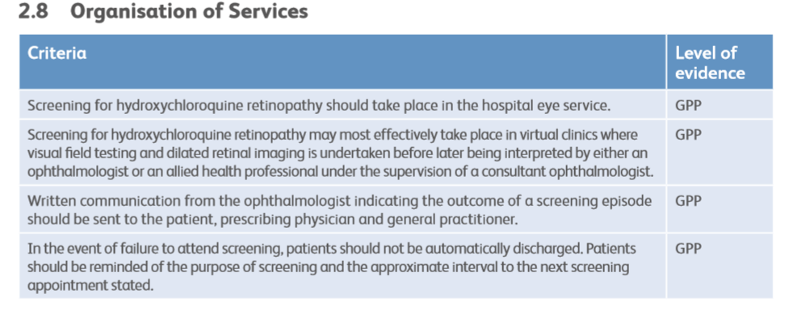

Slide 61
BASELINE ASSESSMENT
Patient begins HCQ/CQ drug treatment:
Referred for baseline screening
If abnormal fundus photo or SD-OCT
Colour fundus photograph
SD-OCT
(ideally within 6 months)
Baseline 10-2 HVF
NORMAL RETINAL IMAGING
If 10-2 HVF abnormal:
Discuss with prescribing physician re: suitability for HCQ/CQ therapy
Additional risk factors:
Concomitant tamoxifen use;
Impaired renal function;
HCQ dose > 5 mg/kg/day;
CQ use
No additional risk factors
Screening begins at 1 yr
Screening begins at 5 yrs

Slide 62
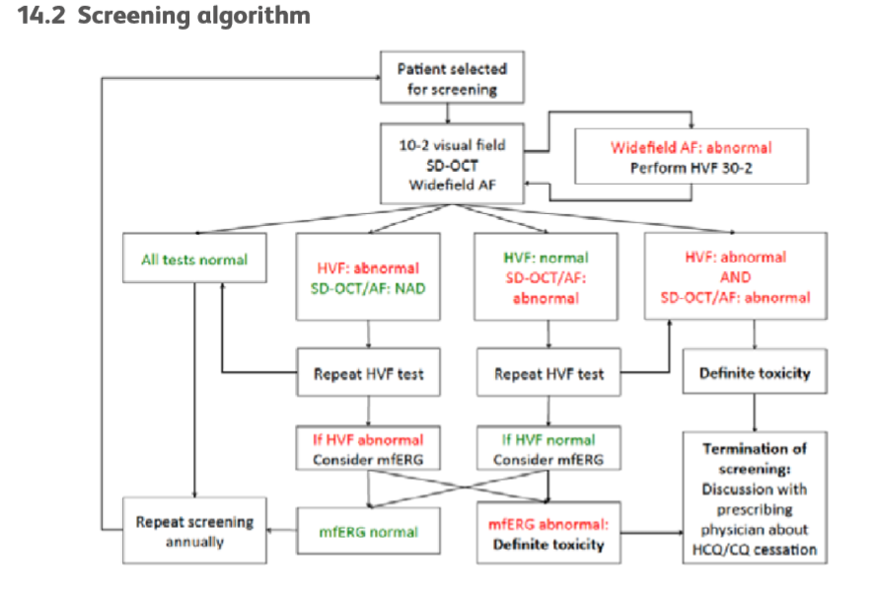

Slide 63
Outline
A case
Overview of drugs which can affect the retina
Hydroxychloroquine: Why is it used and how can it affect the retina?
How can we detect toxicity? Key investigations
  Visual fields**
  OCT and autofluorescence imaging**
  Electrophysiology**
What is the prevalence of toxicity? Risk factors?
Guidelines for screening: RCOphth Feb 2018
Take home messages

Slide 64
Take home messages
Check medication history
Be aware of latest evidence
Importance of screening – when does it make a difference?
Perform appropriate testing (additional role of electrophysiology)
Importance of communication
  With patient – e.g. diagnostic and prognostic uncertainty
  With other specialists

Slide 65
Thank you
omar.mahroo@moorfields.nhs.uk

